Slide 1
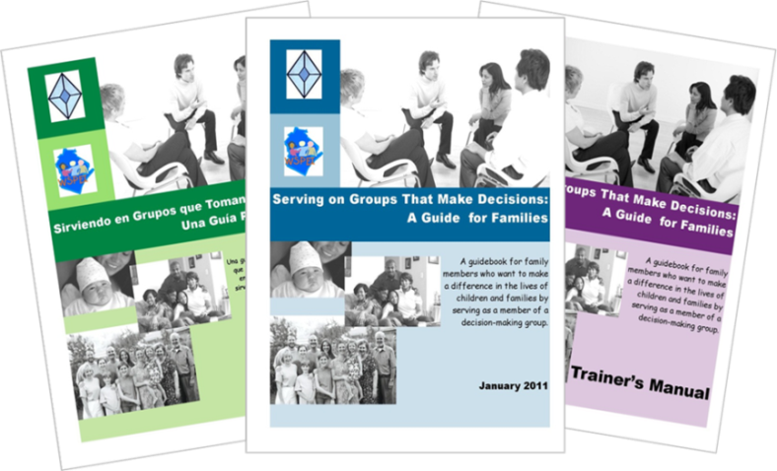

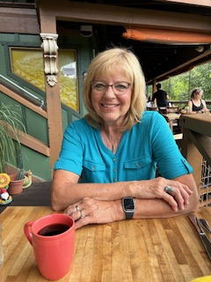
Serving on Groups That Make Decisions:
3. Processes Groups Use www.servingongroups.org
877-374-0511
MPACT - June 9, 2025
Presented by:
Jan Serak for WI FACETS
Notes:
Slide #1: Welcome and Introduction
Procedural Directions:
Review PPt, HOs, Speaker notes at least 2 week prior to webinar. Make sure all information is current and that all links are live. Slide 1 and HO1 must be revised.
One week before webinar, send the PPt, HOs, Speaker notes to webinar moderator. Important for moderator to have PPt slides in case she/he has to show the slides if technical problem arise.
Presenter Notes:
Hello and welcome to today’s webinar This is the 2nd in our 5-part Serving on Groups that Make Decisions fall webinar series – Section 3. Processes Groups Use.
My name is Jan Serak.
I am the founder & former (now retired) ED & CEO of WF.
I am currently the Director of Serak Consulting Services where I work with nonprofit agencies to provide training for Boards of Directors & others, grant writing, and other services.
I am the parent of two adult sons, one of whom has autism.
We covered Sections 1 & 2 in the 1st webinar in this series. That recording is available if you are interested. Just contact WI FACETS at the number listed on the screen.
The HOs for this webinar include a copy of all the slides that you will be seeing on your screen today.

Slide 2

Agenda for Today
Overview of SOG
Principles that guide group practices
Important processes groups use
Resources
Notes:
Slide #2: Section 3 Introduction
Presenter Notes:
Here’s the agenda for today’s webinar:
We’ll do a quick overview of the Serving on Groups Guidebook resource.
Today we will cover Section 3: Processes Groups Use.
We will look at a Guiding Principles framework that effective groups use in their process of shared decision-making .
Then, we will cover 6 common processes that effective groups use in their work..
Finally, we will end today with some additional resources.
I would like to do a quick POLL (#1) to see what your experiences are with serving on decision-making groups. In the Q&A box at the bottom of your screen (on Zoom), write:
A. If you have never served on a decision-making group
B. If you served on a decision-making group before
C. If you are thinking about joining a dec-making group
D. If you are currently serving on a decision-making group/s now (& write name of the group also in the Q&A box)
Results of Poll……

Slide 3
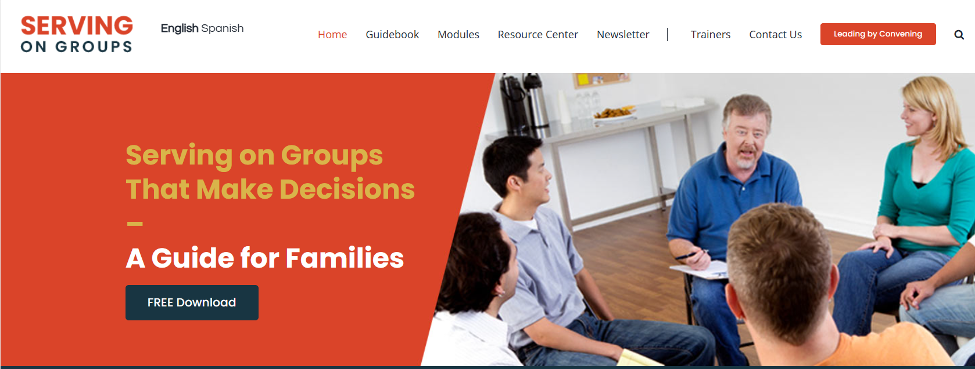
Overview of Serving on Groups
Developed due to an identified need
Collaborative effort by stakeholders
Audience – parents, educators, students, others
www.servingongroups.org
Notes:
Slide #3: Overview of Guidebook, its development and intended audience
Procedural Directions:
Review the Guidebook background by sharing info from Presenter notes.
Link to SOG website is “live” – show if time.
Presenter Notes:
First, for those of you who weren’t with us for Sections 1&2, I would like to briefly tell you about WI FACETS’ SOG publication.
Serving on Grps was developed in response to an identified NEED.
WI FACETS found that it is not enough to just invite parents to join decision-making groups, but that they may need empowerment, information, & support to be more effective participants.
The review of this SOG publication was the result of WI FACETS working with a large group of stakeholders from across WI that included parents, educators, state agencies, and others.
While SOG was developed initially to support families in serving on decision-making groups, the information & structure of this resource is intended really to support anyone serving on those groups.
The information not only applies to dec-making groups that are education-related, like IEP teams, School Boards, & school PTOs; but to ALL decision-making groups, such as-nonprofit agency boards, church boards, county boards, and more.
Also, the info is not specific just to WI, but can be applied nationally.
WI FACETS developed the Guidebook with funding from the WI Dept of Public Instruction & US Dept of Ed/Office of SpEd Programs..
You’ll hear me refer to the resource as “the Guidebook” for short.
There is something for everyone in the Guidebook. It is a great introduction for some, a welcome refresher for others, and a good resource for all, so everyone can come to the table ready to serve.
All the SOG Guidebook and many resources can be downloaded free from the SOG website. The link is on your screen. (Show if time) Also on the site is an Online Learning platform, that people can access 24/7 to go through the modules on their own. People can also order the hardcopy from the site.

Slide 4
Guiding Principles of the Process of Shared Decision-Making
Shared Decision Making
1. Shared Vision
3. Equal Partners
4. Collaboration
2. Representation
5. Shared Responsibility
6. Information Sharing
7. Producing Results
Notes:
Slide #4: Guiding Principles
Procedural Directions:
1. [CLICK] for animation to appear.
Presenter Notes:
Before we get into 6 common processes groups use, I want to share with you the Guiding Principles that are thought to contribute to the process of shared decision making.
[CLICK] These Guiding Principles are:
[CLICK] Shared Vision— means groups need to find common ground otherwise each member may be working towards different goals
[CLICK] Representation—which means there must be consideration for the needs & perspectives of all people who are affected - otherwise the group is making decisions for others without hearing their concerns, questions & opinions. You might get some backlash & lack of buy-in or your goals might not be reached because you didn’t have everyone involved when making a decision. (In the disability world we often use the phrase, “Nothing About Us Without Us.”)
Next is the principle of Equal Partners—means each member must be treated equally – allowed to share their opinions, have access to all the same information, have their needs met in order to participate. Otherwise, if some group members don’t feel like true participants, they may choose not to participate,& you will lose that very impt.voice.
[CLICK] The next principle is Collaboration—means there are opportunities to work together within the group otherwise everyone is working alone in their own bubble and, again, you won’t have that group unity and buy-in with all the objectives
[CLICK] Shared Responsibility—which means everyone agrees to do their part. For EX: if 1 person or a small group does it all, there is less feeling of ownership by the other members. What happens when that 1 person or small group leaves the group? Then, all the work they were responsible for is kind of left behind, or others don’t know how to do it and there is no one to lead that charge in that particular area.
[CLICK] Information Sharing- means staying up-to-date on all of the data, information, and news regarding an issue, otherwise a gap will arise within the group and not all members will be able to make well-informed decisions. That staying up-to-date yourself on issues you are working on in your group, and also sharing that information with others so their decision is just as informed as yours would be.
[CLICK] Finally, the last principle is Producing Results—groups need to check their progress and adjust what they are doing if they are not making progress. Otherwise, nothing is accomplished, so what is the point of convening your group if you are not meeting your goals?
Remember if even one of these principles is missing, the group outcomes are going to be impacted negatively and the shared decision-making is compromised. You won’t have true shared decision-making.

Slide 5
Guiding Principles
Example
IFSP/IEP meeting
1. Shared Vision
All want the child to be healthy, happy, and successful.
3. Equal Partners
All ideas, concerns, and questions are heard and are valued.
4. Collaboration
Everyone works together to come up with a plan.
2. Representation
Anyone working with the child or representing the child’s best interest is present.
5. Shared Responsibility
Everyone does their part to support the child’s learning at school, home, and in the community.
6. Information Sharing
The same information is given to all so all are able to make a well-informed decision.
7. Producing Results
Child makes progress.
Notes:
Slide #5: Guiding Principles Example
Procedural Directions:
*[CLICK] for animation.
Presenter Notes:
The idea of Guiding Principles can easily be applied to different types of dec.mkg groups. Let’s apply the Principles to an IEP Team mtg.
[CLICK] The 1st principle is Shared Vision—In this case, everyone on the IEP Team would want the child to be healthy, happy, &successful.
[CLICK] 2nd principle is Representation—the TEAM would include anyone working w/the child or representing the child’s best interests. They should all be present at the mtg or have found some way to get their info & concerns shared at the meeting.
[CLICK] 3rd principle is Equal Partners—Everyone on IEP Team should have an oppty to express their ideas, concerns, Qs; & have their info listened to & valued by other Tm mbrs
[CLICK] 4th is Collaboration—meaning that the entire IEP Team works together to come up with a Plan for the child.
[CLICK] 5th is Shared Responsibility—Everyone on the Team does their part to support the child’s learning at schl, home, & in the cmty. So, the group is not just creating the IEP together, but also implementing & taking responsibility for parts of the Plan together
[CLICK] 6th is Info Sharing—The same info is given to all Team members so all can make a well-informed decision. Any evaluation, academic or behavior data, medical info, reports of how things are going at home-all is impt info to share w/whole grp
[CLICK] The 7th Principle is Producing Results-feally, the child makes progress. That would be Team’s evidence the Plan is wkg & producing the desired results.
Remember, if one of these principles is missing, then it is not shared decision making and the child’s progress may suffer as a result.
Activity - In your HOs, there is a form, Guiding Principles Example for the Process of Shared Decision-Making. You can use it to think about how the Guiding Principles might apply to a dec-mkg grp you are a part of. You can fill it out yourself or together with your group.
POLL #2
Here is another quick poll. If you have been involved in a shared dec-mkg (as, an IEP Team mtg), were any of these 7 Guiding Principles missing? In the Q&A box on your screen, write the numbers any of the Principles that were missing for you in a group you served on. You can look at the chart on your screen for the number of each Principle (as, #1 for Shared Vision, etc.). Or, you can write #8 if all 7 Guiding Principles were present.
Share results (1. Shared Vision; 2-Representation; 3-Equal Partners; 4- Collaboration; 5-Shared Responsibility; 6-Information Sharing; 7-Producing Results, OR 8-All Principles present
Share the results of the POLL….

Slide 6



Helpful Reminders:
Start with the end in mind
  Focus on Outcomes
Work towards positive results
  = Celebrate and publicize the success
  = Go back and make adjustments
Notes:
Slide #6: Helpful Reminders
Presenter Notes:
Some helpful reminders for working on a group that uses the Guiding Principles for Shared-Decision making is to start with the end in mind.
In other words, you want to focus on the Outcomes and then work toward positive results.
If the results are not positive or not what the group hoped to have accomplished, the group will need to go back to the processes they are using and make adjustments until they have a plan that is producing positive results.
If your group is achieving what it set out to achieve, then you want to celebrate and publicize that success. You want to make sure that everyone on the team who has been a part of the work is acknowledged.

Slide 7

Processes Groups Use
1. Information Gathering
2. Goal Setting
3. Planning
4.Collaboration
5. Evaluation
6. Reaching Agreement
Notes:
Slide #7: Processes Groups Use
Procedural Directions:
* [CLICK] for animation to appear.
Presenter Notes:
Next, let us talk about some of the processes that are used by groups that are effective at making good decisions.
The six common processes groups use are:
[CLICK] Information Gathering
[CLICK] Goal Setting
[CLICK] Planning
[CLICK] Collaboration
[CLICK] Evaluation
[CLICK] Reaching Agreement
Now let’s take a look at each process in detail.

Slide 8
1. Information Gathering
Data
Numbers
Facts
Brain-
storming
Ideas
Focus Group Perspectives Stories
Prioritize Issues
Notes:
Slide #8: Information Gathering
Procedural Directions:
* [CLICK] for animation.
Presenter Notes:
1st process an effective-decision making group uses is Information Gathering.
It is impt for grps to gather & use accurate information.
[CLICK] The information (sometimes called data) can come in many forms - like numbers, facts, perspectives, ideas, or stories. It can be collected in many ways. SO, the first step is to find out what information is needed and to go out and collect it. (We will talk much more about Data in our Section 6 webinar on October 24th.)
[CLICK] Another way of information gathering is Brainstorming. This is a strategy used when groups want to generate & collect lots of ideas. Everyone should just throw out all of their ideas. Everyone should listen carefully to all the ideas and opinions without comment or judgement. And, then sort out from the list, which ones the group thinks are best and which ones to use for going forward.
[CLICK] Another way to gather information is to use a focus group. This is a group of participants who are asked questions and options and then share their perspectives or stories.
EX: Gathering families from a school or members of a community together.
[CLICK] During this Info. Gathering step, Issues may be identified that will need to be addressed as part of the group’s work.
Priority may be given to issues that are the most important or that may take the most time to accomplish.
The bottom line, no matter how you gather your information, is that it is critical to have accurate, up-to-date info., and that you have all the info. that you need before the group makes a decision.
Activity
You can give some thought to- How do you personally gather information before making decisions? And also, How do you and your group determine what issues or tasks are most important? Top down or bottom up? Time sensitive?

Slide 9

2. Goal Setting
What does the group want to see happen?
Helpful Tools to Set Direction
  Vision Statement
  Mission Statement
  S.M.A.R.T. Goals
      Specific
      Measurable
      Attainable
      Realistic
      Timely
Notes:
Slide #9: Goal Setting
Procedural Directions:
*[CLICK] on hyperlinks for videos.
Presenter Notes:
The 2nd Process is to Set Goals.
A goal is what a group wants to see happen and it needs to be stated up front so the group knows what they are working towards.
Goals, both short term and long term, are set after a group determines their priorities. (Hopefully, this done in the info gathering stage – the 1st process that we just talked about.)
Reviewing the group’s vision and mission statements are helpful guides during the goal setting process.
Ineffective groups often lack clear goals or they fail to communicate the groups’ goals to all members.
Sometimes people confuse a vision and a mission statement
A vision statement describes the changes the group wants to see happen in the future as a result of their actions – that is, what the group is working towards; or, the desired end state of your efforts. ([CLICK] video-5:33 in). Ex: A community where people of all ages are treated with respect and dignity and are valued for their contributions.
A mission statement provides the direction & sets the goals, actions, & dec.-making processes of the group. ([CLICK] video 4:04min). Ex: Linking older adults with a caring community.
If no time to show videos, say: In the Resources Slides at the end of this webinar, we have included the links for 2 short videos about Writing Vision and Mission Statements.
The other impt part of Goal Setting is to use S.M.A.R.T. goals. These are goals written to help the grp accomplish what they set out to do. One of the Resources at the end is a short video about SMART goals.
SMART, as you can see on your screen, is an acronym. SMART Goals are described as:
Specific – means What exactly are you going to do?
We are going to get better would not be specific enough.
Measurable – How are you going to do it? How will you show that you have done it?
We are going to increase our sales by 50%. We are going to reach 100 more consumers. We are going to improve our evaluation scores by 10%.
Attainable – Can you commit to doing it?
If you are currently serving 100 people a year, might want to start serving 300 before you aim at serving 10,000.
Realistic – Is it doable?
Are you going to increase your outreach by 1,000 times in one year – probably not. But set a goal that you can actually reach.
Timely – What is your timeframe?
If you say, we will accomplish something in the next 20 years, doesn’t really give a lot of focus and is hard to action plan. Setting a goal that is maybe 6 months or 1 year with benchmarks, or little shorter goals along the way, really helps make a time-bound, focused goal
EX: If you are part of an IEP Team for example, your group might try using SMART goals for goal setting when writing the IEP for a student with disabilities. [CLICK-video on SMART: 2:57 min)]
You have a HO– Creating Mission & Vision Statements - You can use this information to work on developing a Mission and a Vision Statement with a group you serve on.
---SPEAKER NOTE: Below info was moved to next slide (9A)so can easily do POLLS on Zoom….
POLL #3 – Vision or Mission Statement? An Asia and Pacific region free of poverty. Select one – Mission; Vision
Vision statement is correct – top of mountain is the “region free of poverty” ..the end game the grp envisions for the future.
POLL #4 – Vision or Mission Statement? Promoting child health and development through a comprehensive family and community initiative. Select 1 – Mission; Vision.
Mission statement is correct – has the “ing” verb, promoting, this is what we are going to do to get us from where we are now to the mountain top goal in our vision statement
I hope that this helps you think about your group’s own mission and vision statements, or if you are not in a group that has these guiding statements, maybe you can think about suggesting the grp work together to develop them

Slide 10
Vision or Mission Statement?
    An Asia and Pacific region free of poverty.
    Promoting child health and development through a comprehensive family and community initiative.
Notes:
Slide #9A: Vision or Mission Statement?
Procedural Directions:
Show slide
Presenter Notes:
Here is another quick POLL for you. In the Q&A box, please write:
if you think #1 is a Vision or Mission Statement? An Asia and Pacific region free of poverty.
And, if you think #2 is a Vision or Mission Statement? Promoting child health and development through a comprehensive family and community initiative.
Answer:
#1 is a Vision Statement– top of mountain is the “region free of poverty” ..the desired goal or end state that the grp envisions for the future.
#2 is a Mission statement – has the “ing” verb, promoting, this is what we are going to do to get us from where we are now to the mountain top goal that is in our vision statement
I hope that this helps you think about your group’s own mission and vision statements, or if you are not in a group that has these guiding statements, maybe you can think about suggesting the grp work together to develop them

Slide 11

3. Planning
Who will do what, by when, and in what order?
Helpful Tools to Reach Goals
  Action Plan
  Logic Models
  Schedules
  Strategy Charts
Notes:
Slide #10: Planning
Presenter Notes:
The 3rd process is Planning.
A Plan begins to form when the group agrees on the first steps, agrees on the goals, and agrees on when they are going to do it, in what order they are going to do it, who is going to do what, in what order will they do it, and what resources they need to use for their work.
Sometimes this Plan is called an ‘Action Plan’
A tool that can be effective in helping when you are trying to create your Plan is a Logic Model. You can also use Schedules and Strategy Charts as well.
Logic models are diagrams that illustrate how a group’s activities connect to its goals and outcomes. More info about these on next few slides.
Schedules, also referred to as timelines, provide the group with assignments to accomplish within agreed upon deadlines.
ACTIVITY:
Think about the last time you had to come up with a plan personally or in a group. How did you do it? What were you planning? Did you use one of these tools to help you reach your goal?
As, planning for an IEP meeting; birthday party or aby shower strategy chart, church fundraiser/ask for assignments & feedback by a certain date, etc.

Slide 12
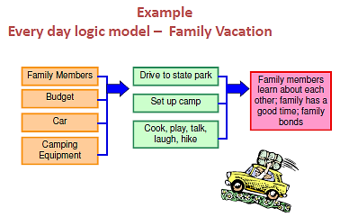
Logic Model Example
Notes:
Slide #11: Logic Model Example
Presenter Notes:
Go ahead and type in the Q&A box if a group that you are a part of uses a Logic Model as part of their regular communication of their action plan.
Here’s an EX of a logic model. It is for a family camping vacation.
The orange items are the inputs. These are the things that you are going to need to make this trip happen. SO, for a family vacation, you will need family members, a budget, a car, and camping equipment.
The green boxes are the outputs. These are the things that need to be done. You will need to drive to the state park, set up camp, and cook, play, talk, laugh, and hike.
The hot pink item, is the outcome of the family vacation that you are trying to reach. It will be that family members learn about each other, the family has a good time, and the family bonds.
This is a very basic model to give you the idea of how easy it is to develop a logic model – you just need to think through what the Inputs, Outputs, and Outcomes will be.

Slide 13
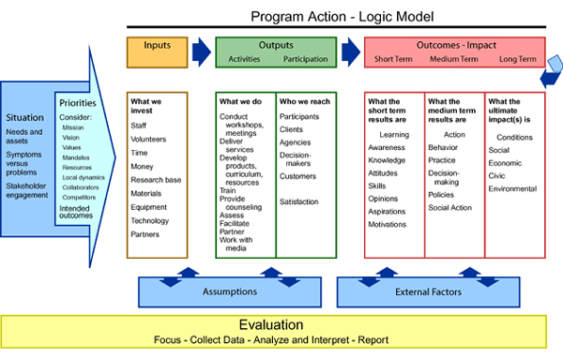
Logic Model Example
Notes:
Slide #12: Logic Model Example
Presenter Notes:
Here is another example of a logic model.
This one, looks more like what we would see in our professional settings of decision-making groups.
It has the same categories as the example on the last slide of inputs, outputs, and outcomes. There are other areas too.
You’ll see the outputs (green) are broken into Activities& Participation
The Outcomes (pink/orange) have subcategories of Short term, medium term, and long-term outcomes
The Model starts out w/the Situation (darker blue/far left)– what is the situation that the group is going into?
Also at the left (lighter blue) are the group’s Priorities.
In blue boxes near the bottom, are the Assumptions and External Factors that will impact decision-making.
Assumptions – are kind of a place to write what things are assumed about the work…such as, you will have the time to implement the change, you have the $
EX of an External Factor might be if the group was working on a school decision and the law changes halfway into the work, you will need to change the course of action.
And, at the bottom (in yellow), going across the whole plan is Evaluation. The group would be evaluating through the whole process – not just get to the end and then evaluate. The group will evaluate how the group is doing, make changes if needed, and decide next steps as we go along.’
You have a 1-page HO – Logic Model Template & Logic Model Example.
This is a great template you can use to develop a Logic Model with your group –
There is also an EX on your HO – Going to the Dr. with a Sick Child

Slide 14
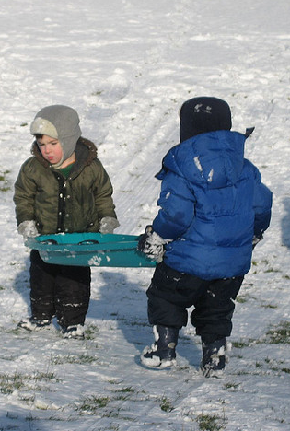
4. Collaboration
Members working together toward a common goal.
Helpful Tools:
    Agreed Upon Expectations
    On-going Communication and Networking
    Neutral Facilitator
    Meaningful Activities
    Focused Training and Technical Assistance
Notes:
Slide #13: Collaboration
Presenter Notes:
The 4th Process is Collaboration – this is when members of a group voluntarily bring their knowledge & experiences together to work toward a common goal.
There are several ways to help encourage collaboration among your group members if it is not already happening:
One way is to set expectations that everyone agrees upon. That helps increase cooperation and a positive working environment.
EX: If you are on a Board & people are not reading the materials ahead of time, then one of the expectations is that everyone reads the materials & comes prepared to the meeting. Then, if people show up unprepared, the group leader can refer them back to the list of expectations & cAn remind them that the group decided that this was necessary to make the group function well & encourage a positive work environment.
Another Collab tool is to encourage On-going commctn & netwkg.
EX: If you are part of a group that only meets a few times a year, find a way to stay in touch in between times, update each other with information via email maybe with smaller committee meetings, or a closed Facebook group (like Workplace), etc. to make sure that the work of the group is ongoing.
Another strategy for Collab is to have a neutral facilitator to help with group dynamics, especially if members of the group have not worked together before, or if there is already some barriers to the group working together effectively. This is just a person who is neutral, doesn’t have a strong opinion about the group’s work, can help make sure meetings run smoothly & stay focused on outcomes.
EX: When IDEA was reauthorized, WI had to change state law to conform with the federal IDEA law. I was part of a state leadership group whose job it was to make recommendations for changing the state law. This was a tough group that started
off with very diverse opinions. Our WI DPI brought in a mediator,
a neutral person, to facilitate the group’s work. This was very effective & made the work of the group much easier AND much more collaborative than it would have been without a facilitator.
Another strategy for Collaboration is making sure that there are Meaningful activities for all members.
EX: if someone is part of the group and they say they love planning events and then don’t get included in the Fundraising Planning committee, it is certainly not using their talents to the best of their abilities is a barrier to collaboration. Try to make sure you get to know people on the group, knowing where their skills and talents lie, what is important to people, and what will bring out their passion and their commitment to collaboration
Finally, another tool is to offer focused training & technical assistance to group members.
EX: If someone doesn’t understand budgets or financial reports, & you think the person is not making good decisions because they don’t really understand the information, rather than just ignoring them or excluding them from the group, offer them training about budgets &financial reports so they can improve their understanding & better collaborate with the group.

Slide 15

4. Collaboration
If you want to go fast, go alone;
if you want to go far, go together.
–African Proverb
Agreed Upon Expectations
On-going Communication and Networking
Neutral Facilitator
Meaningful Activities
Focused Training & Technical Assistance
Notes:
Slide #14: Collaboration
Presenter Notes:
A proverb that we like to share related to the importance of Collaboration is this wonderful African Proverb:
“If you want to go fast, go alone; if you want to go far, go together.”
Think about what experience you have had that illustrates the message in this proverb. Maybe being on a sports team, where it takes all members to play together, 1 player can’t do it alone.
EX: One of my experiences…. Passing a WI Seclusion/Restraint Law – we first tried to have just a grp of parents write & pass a state law related to S/R. No Luck. We then expanded our group to include all stakeholders – parents, school admins, teachers, school board, students, attorneys, special ed. admin. Once our group included everyone involved I the issue, and we were able to really collaborate, gather everyone’s ideas and give everyone a voice, we drafted a state law and proposed it together to the state legislature – it passed unanimously!
Looking back at tools we discussed for meaningful collaboration, it really depends on individual members of the group being raised up, increasing their skills & capacity, and their leadership, in order for the whole group to move forward together.
Some helpful Tools were:
Agreed Upon Expectations
On-going Communication and Networking
Using a Neutral Facilitator
Meaningful Activities for all members
Focused Training and Technical Assistance

Slide 16

4. Collaboration
Benefits
More Involvement
Better Relationships
Greater Commitment
Better Communication
Notes:
Slide #15Collaboration
Procedural Directions:
* [CLICK] for animation to appear.
Presenter Notes:
What are some of the benefits of collaboration?
[CLICK] When a collaborative process is used, there will be more involvement by its members. Members will feel more a part of the work and have ownership in the results.
Better relationships.
Greater commitment Members will be more committed because they helped design the process & helped choose the outcomes.
Better communication between members of the group because everyone is working together for this common goal.

Slide 17
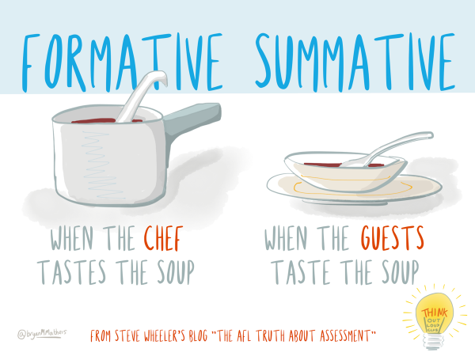
5. Evaluation
New information is compared to previously collected information
Helpful Types of Evaluation
Measure Final Results
Monitor Progress
Notes:
Slide #16: Evaluation
Presenter Notes:
The 5th impt process for an effective dec-mkg group is Evaluation.
After a grp has begun collaborating & Wkg together for a while, the members will need to revisit their plan to see if it is resulting in what they had hoped for. It may be nec. for the group to collect more info.. It might also be necessary to change course and do this differently.
Evaluation is when the new info is compared to the info you already know.
There are 2 types of evaluation to discuss in the dec-mkg process – these terms are formative evaltn & summative evaltn. It is impt to know diff.
A formative evaluation is when the information is reviewed, usually in-house or with a small test group, during the planning process, so that the plan can be tweaked if needed. It is also known as to monitor progress or “ Progress Monitoring”.
EX: the evals WI FACETS does after all of its wkshops, incl. the evaluation you’ll get after this webinar, is Progress Monitoring. During a grant yr, if a workshop isn’t getting good evals, WF can make changes, add or delete things, etc.
A summative evaltn is done at the end of the plan to look at what has been accomplished. Also known as “measure final results”.
A simple way of looking at it is:
"When the cook tastes the soup, that’s formative evaluation. You can still change it, you can add ingredients, make it warmer, etc.
when the guests taste the soup, that’s summative evaluation.” Everything is done at this point, and we are evaluating how we did, but you can’t go back & change what already has been done.
The impt thing with evaluation for a grp is to include in your planning to use Formative evaluations so the grp has time to make changes before it gets to the point where there’s not much oppty to make changes to what’s already done.

Slide 18

6. Process for Reaching Agreement
Voting
  Robert’s Rules of Order
    A structured process
    Making and Passing Motions
Consensus
  Discussion continues until all mutually agree
  Every member shares
  Key is compromise
Notes:
Slide #17: Process for Reaching Agreement
Presenter Notes:
Our 6th & final Process is to have an agreed upon process or way of how the group is going to “Reach an Agreement.”
Sometimes one of most difficult tasks for groups is reaching agreement on an issue.
One way groups choose to do this is by Voting - this is the most formal way to reach agreement
Robert’s Rules of Order is a specific tool that provides structure to the voting process. It requires a majority of group members to vote yes (in favor of) or no (in opposition of) to whatever the group is working on.
Someone has to make a “motion” to the group – the motion is asking them to make a decision on a certain thing.
Someone else has to “second” the motion.
Then, there is an opportunity to discuss the motion.
Then, the members all vote – either yes, no, or abstain (abstain means the person does not feel they can vote either yes or no).
The motion will pass if a majority of the members voted yes.
A majority is 51% of members (or 1/2 of the grp plus one).
If you have 16 members on the group, for EX, you need 9 of them to vote yes in order for the motion to pass.
Groups that use Robert’s Rules of order often keep very detailed meeting minutes documenting the decision-making process. As, what the motion was, who made the motion, who seconded the motion, and what the vote was, as 14 yes, 2 no, 0 abstentions.
Another impt. feature of Robert’s Rules is that there has to be a Quorum present. A Quorum means that an agreed upon number of members have to be present in order for a vote to take place.
This # is set by the group, it could be a majority (50% plus 1), or it could be a higher number. EX, if you have 16 people in your group and only 5 of them show up, you wouldn’t be able to proceed with your meeting and could not vote or make decisions.
P. 20 in your Section 3 HO has some impt rules from Roberts Rules of Order.
Another way groups create agreement is through consensus.
Consensus is when the whole group comes to a mutual agreement.
EX: if you had a required quorum of 16, passing a motion by majority vote would be having 11 yes’es/5 no’s.
With Consensus, you would have to have the Entire group (of all 16 in our EX) come together on one decision. In our
Consensus involves true compromise.
It can be a complicated, lengthy process. But it can also be very rewarding because everyone has put something impt to them into that compromise. &, hopefully, everyone will be happier w/the results.
Consensus does not nec. mean that everyone got exactly the outcome they wanted; instead, that an outcome was reached that is acceptable to everyone.
Consensus does have one advantage. It has the potential to strengthen group relationships. The key is compromise. Sometimes, by combining proposals, we can achieve a better overall position that has more support than what we would have accomplished individually.
Some grps use both types of ways of reaching agreement, or parts of both, so it is impt to you when you are joining a group to ask how the group will make decisions and how they are going to reach agreement – by majority vote OR by consensus OR both.
POLL #5 – What is true about reaching agreement by CONSENSUS?
Everyone in group has to agree;
Involves compromise; (Skip this poll for 10/5/23 webinar)
Potential to strengthen group relships;
Some grps combine consensus w/majority voting;
Requires a quorum of members to take a vote. (All but last one)
POLL #5a-What is a “motion” in Roberts Rules of Order?
Number of members required to hold a meeting
A proposal or a resolution to take a certain action or vote
To object to a proceeding in conflict with the rules
Answer – A proposal…

Slide 19

Tips to Help YOU Personally be Effective
  Organize your information
  Keep in mind the group’s goals
  List priorities
  Keep track of where others stand on decisions
  Ask the leader to explain member roles
  Take notes
  Write down the results of your activities
Notes:
Slide #18: Tips to Help be Effective
Presenter Notes:
Reaching agreement was the 6th process that groups use.
Even if the group does not have all 6 of these processes, your group can have its own individual processes to help the group with the decision-making process!
Pretty much, all of these processes are really just a plan for staying organized, taking action, and planning for the next steps.
Here are some things you can do Personally to be more effective in a group (& you can also encourage others in your group to do the same)
Start by organizing your information. Read all the materials, do research, talk to others, and organize all of the information in a way that you can find and easily refer to it when you need to.
Make sure that you Keep in mind the group’s goals so your decisions are headed toward reaching those outcomes
Make a List of priorities - so what is the most important thing you think the group needs to accomplish and what are some of the things that could take a back seat to get to when the group has time.
Keep track of where others stand on decisions. If you are in large group& you know there are some people in the group have a strong opinion on one side of the issue & there are others who feel the opposite, keep track of those feelings & opinions. When you share your proposal, frame it in a way to appeal to the feelings of both sides
You can Ask the group leader to explain member roles. If you don’t understand exactly what your role is, versus someone else, or you just want to get understand what roles are available to you.
Make sure to Take notes even if someone else in your group is taking Meeting minutes. Minutes often don’t include all the discussion and points of view that occurred – which might be useful for you later. If you take your own notes, they might be more helpful to you later.
And, finally, Write down the results of your activities . If you tried doing something in a different way, so that you can go back later and revisit what you did to reach that great outcome.

Slide 20
Section 3 - Resources
Conducting a Focus Group (video 5:36) https://www.youtube.com/watch?v=Auf9pkuCc8k
3 Brainstorming Techniques that Work (video 3:12) https://www.youtube.com/watch?v=jNFBoBAAYuw
How to Write a Vision Statement that Inspires (video 5:35) https://www.youtube.com/watch?v=ioY-YSOKBtY
Visioning: A Free Downloadable Guide to Create a Clear Vision https://onstrategyhq.com/resources/visioning-a-free-downloadable-guide-to-create-a-clear-vision-and-desired-future-state/
How to Write a Mission Statement (video 4:04) https://www.youtube.com/watch?v=XtyCt83JLNY
Mission Statements http://www.missionstatements.com/
Difference Between Mission & Vision Statement (video 5:14) https://www.youtube.com/watch?v=DzhJNiQ3vMM
Notes:
Slide #19: Section 3 Resources
Procedural Directions:
Here are some resources that might be helpful for your groups.
The yellow-highlighted ones are the VIDEO resources that I mentioned on earlier slides.
There are also resources for mission and vision statements & logic models

Slide 21
Section 3 - Resources
OSEP Logic Model & Conceptual Framework https://thisvsthat.io/conceptual-model-vs-logical-model
S.M.A.R.T. Goals (video 3:57) https://www.youtube.com/watch?v=1-SvuFIQjK8
WI Professional Development Model https://dpi.wi.gov/sites/default/files/imce/sped/pdf/wpdmtools.pdf
How to Make an Action Plan (video 3:12) https://www.youtube.com/watch?v=lwoVRVgKg-o
The Easy Guide to Developing an Action Plan https://creately.com/blog/diagrams/how-to-write-an-action-plan/
Leading by Convening http://servingongroups.org/leading-by-convening
Creating Agreement: Educators & Parents Working Together https://dpi.wi.gov/sped/topics/agreement
Proposal-based Decision Making (Video 3:43) https://www.youtube.com/watch?v=-SYTkMv1J-E&feature=youtu.be
Robert’s Rules of Order http://www.robertsrules.com/
Program Evaluation (video 17:03) https://www.youtube.com/watch?v=6ZEYgEv7EL4
Notes:
Slide #19: Section 3 Resources
Procedural Directions:
Here are more resources that might be helpful for your groups.
I love the Robert’s Rules of Order resources on their official website. The Robert’s Rules book is available from this site also.
Leading by Convening – this is actually a really awesome bunch of resources and 5 online learning modules – that are super helpful for convening and working with groups. The materials were developed by the IDEA Partnership, the National Center on Systemic Improvement (NCSI), both funded by the US Dept of Education/Office of Special Education Programs – of which WI FACETS was one of the stakeholders in the development.

Slide 22

Thank you!
  Register: https://wifacets.org/training/calendar/
  Serving on Groups webinar modules – start 9/11/25
Disclaimer. This publication was produced by WI FACETS with funding from the WI Dept. of Public Instruction & U.S. Dept.of Education, Office of Special Education Programs. The views expressed herein do not necessarily represent the positions or policies of these 3 agencies. No official endorsement by these agencies of any product, commodity, service, or enterprise mentioned in this resource is intended or should be inferred.
Notes:
Slide #30: Guidebook Sections for Personal or Group Skills
Procedural Directions:
*Slide contains animation. Click for animation to appear.
Share information from the presenter notes.
Presenter Notes:
So, where do you go from here?
If you are interested in learning about personal skills, knowledge & roles for serving on groups, you will find that in Sections 1 & 2 that we just covered; and you will want to join us for sections 6, 7, & 8 (Highlighted in YELLOW)
If you are interested in group skills, you will find that in Section 2 that we just finished, and also in Sections 3,4, 5 & 6 (highlighted in BLUE).
We are going to finish up with 3 quick polls.
Poll(#8): Do you think you will join a decision-making group in next 6 months? □ Yes □ No
Poll (#9): Do you think you might share SOG information with your group or others in next 6 months?
□ Yes □ No
Poll (#10): Do you think this workshop was of high quality? □ 4 Excellent □ 3 Very Good □ 2 Good □ 1 OK

