Slide 1
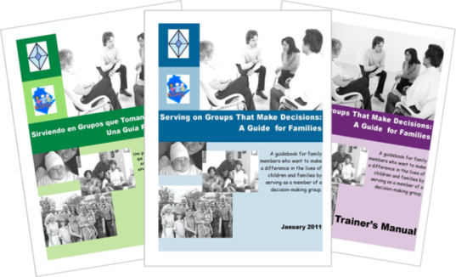

Serving on Groups
That Make Decisions:
A Guide for Families
Presented by:
Name
Organization/Agency
www.servingongroups.org
Notes:
Slide #1: Welcome and Introduction
Procedural Directions:
Have a copy of the Guidebook and the Training manual with you.
Make sure everyone has the materials needed for the presentation.
Ask if everyone can hear you and see the slides.
Introduce yourself and give a brief background of your experience (relevant to the group you are speaking to).
Address “housekeeping” such as restrooms, breaks, “parking lot”, group transitions, etc.
Presenter Notes:
Hello and welcome to this Serving on Groups that Make Decisions: A Guide for Families training.
My name is __insert name___ and I am the ___insert position__at _insert location__.
*Give a brief background of your experience (relevant to the group you are speaking to).
Activities

Slide 2
What brings you here today?
School
Family
Community
Leadership
Notes:
Slide #2: Reason for Attendance
Procedural Directions:
Show slide.
Have participants introduce themselves.
Ask suggested questions.
Ask follow-up questions for more information, specific details, etc.
Presenter Notes:
The purpose of this workshop is to increase confidence and participation of all members on decision-making groups.
Ask the question, “What brings you to today’s workshop?”
Please introduce yourself by sharing your name, where you live/work, and your role (family member/administrator/agency rep./community member/student/educator).
Also answer the question, “What do you hope to get out of today’s workshop?”
Activities
Participant introductions (name, location, role)
Question: What brings you to today’s workshop?
Question: What do you hope to get out of today’s workshop?
Activity: Experts Unite! (Share with a partner about one thing that you know about decision-making groups.)
Adjust participant introductions to the size of the group. (ie small group = share with whole group; large group = share with table or person(s) close by)
Activities

Slide 3

Agenda
Workshop Objectives
Guidebook Overview
  Family Engagement & Leadership
Guidebook Sections
    1. Opportunities to Get Involved
    2. Types of Groups
    3. Processes Groups Use
    4. Tools Groups Use
    5. Tips and Strategies for Groups
    6. Understanding Data as Information
    7. The Role of Families on Groups
    8. Skills for Serving on Groups
Additional Information & Resources
Notes:
Slide #3: Agenda: Workshop Outline
Procedural Directions:
Always include this slide in all workshops with all Guidebook sections listed. It is important for participants to see the whole Guidebook, as well as the separate sections.
Explain the agenda and the structure of the Guidebook and the topic of each section.
If only presenting on certain sections, you can highlight those featured sections by using PowerPoint animation.
Provide opportunity for participants to develop agreed upon ground rules for this training. *Referred to in Section 4 of the Guidebook.
Determine culturally responsive practices for group management during the workshop (ie raised hands, chimes, etc.)
Presenter Notes:
Today’s agenda for the presentation will start with the workshop objectives.
Next we will briefly introduce the Guidebook highlighting its intended audience and the features within it.
There are a total of eight sections in the Guidebook. Some sections are specific to individual skills for serving on a decision-making groups. Other sections are specific on how groups function and make decisions.
Then we will focus on the information within sections of the Guidebook.
Finally we will end with additional information and resources.
Activities
Slide 3: Workshop Ground Rules

Slide 4

Objectives
Familiarize yourself with the Guidebook resource and the contents within it
Build an understanding about decision-making groups
Learn about the principles that guide group practices and the processes groups use
Gain strategies to help you confidently and actively participate in a decision-making group
Notes:
Slide #4: Workshop Objectives
Procedural Directions:
Review each objective.
Connect objectives and audience needs.
Presenter Notes:
By the conclusion of the workshop, you will have:
Familiarized yourself with the Guidebook resource and the contents within it so it can support you and your group to be effective decision makers.
Built an understanding about decision making groups, learning how they function and what your role may be within them
Learned about the principles that guide group practices and the processes groups use
Gained strategies to help you confidently and actively participate in a decision making group of your choice
Activities

Slide 5
Beliefs in Leadership
Leaders are not born ~ they rise out of a person’s passion for how they want the world to be.
Leadership isn’t a gift ~ it’s accessible to anyone who wants it.
Leadership isn’t a calling ~ it’s a matter of listening to a question and trying to come up with an answer.
A leader is anyone who has a very BIG and COMPELLING story of how it could all turn out.
                Barbara Walsh, HP
                Family Leadership Project
Notes:
Slide #5: Beliefs in Leadership
Procedural Directions:
Share information from the presenter notes.
*Slide contains animation. Click for each section to appear.
Discuss each highlighted section.
Presenter Notes:
The idea of who can be a leader has been changing.
The traditional model would have only a select few with transcendent vision and charismatic presence can be leaders. They are elected or appointed to positions with high visibility and prestige. Leadership would be maintained through power over others.
The service leadership model, which is becoming increasing popular, states that anyone willing to serve can be a leader. It would be by ongoing service and care for others. Leadership would be maintain through power shared with others.
Activities
Choral read the bulleted points as a whole group or ask for volunteers.

Slide 6

Family Engagement & Leadership
To support and increase participation of families on decision-making groups
Research on family involvement in the decision-making process have found:
  Children have better outcomes when families are involved
  There needs to be support for families
Research of Dr. Joyce Epstein & others
Notes:
Slide #6: Research that supports the development of the Guidebook
Procedural Directions:
Discuss family engagement and leadership as the purpose of Guidebook.
Share information from the presenter notes.
Provide background Dr. Joyce Epstein’s research on family involvement.
Presenter Notes:
The purpose of this workshop is to help support and increase participation of families on decision-making groups.
Dr. Epstein and others have focused on the effects of family involvement and have come up with keys for successful school, family, and community partnerships. The research have found:
children have better outcomes when families are involved in the decision-making process and
there needs to be support for families in decision-making groups
Based on her research, Dr. Epstein identified 6 types of family involvement. They are:
Parenting
Communicating
Volunteering
Learning at Home
Decision Making &
Collaborating with the Community
All of the types are important. This workshop focuses specifically on Decision Making.
We are beginning to see a shift in thinking that emphasizes partnering with families… not just asking parents to do what is needed at school. Families are now regularly being invited into groups and committees that are working towards improved outcomes for kids. What we’ve found though is that it’s not enough just to invite families to the table; the families need to be empowered to be active members of these groups.
Activities
Handout: Epstein’s Six Types of Family Involvement

Slide 7
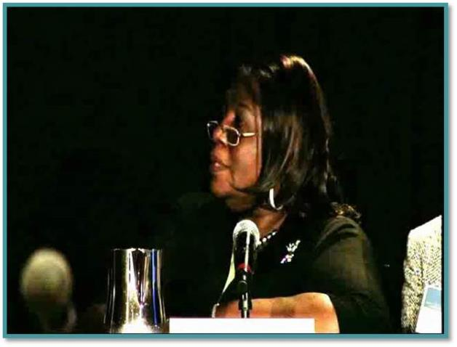
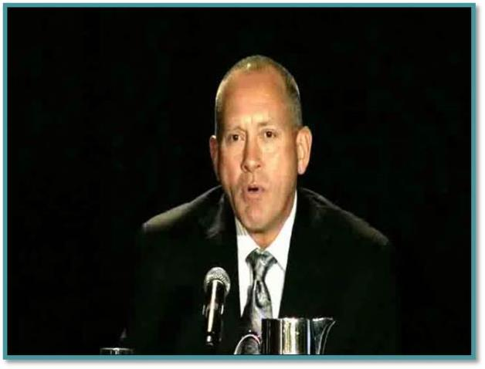
Family Engagement
Family Perspective
Professional Perspective
https://youtu.be/w2Ce7U8HeiI
https://youtu.be/ej4AbNV2fTg
Minnie Pearce-Tate
Parent Representative & Parent/Community Engagement Consultant
National Coalition of ESEA Title 1 Parents
Ron Mirr
President
RM Consulting
Notes:
Slide #7: Family & Professional video clips about family engagement
Procedural Directions:
Show video clips if time permits and your computer is connected to speakers or an audio system.
Presenter Notes:
Family engagement is an issue that is gaining momentum at the national level.
These clips are from the National Parental Information Resource Center policy forum on family, school, and community engagement held on November 9, 2010.
Activities
Video Clips:
The Family Perspective - Watch Pearce-Tate video clip (00:59:12). http://www.nationalpirc.org/engagement_forum/highlights-panel4.html
The Professional Perspective - Watch Mirr video clip (01:13:24). http://www.nationalpirc.org/engagement_forum/highlights-panel1.html

Slide 8
Benefits to (Shared) Decision Making
Results for Families
Awareness and input on policies
Feeling of ownership
Shared experiences and connections with professionals and other families
Results for Professionals
Awareness of family perspectives
Increased confidence and ability to partner with families
Acceptance of family representatives in leadership roles
Adapted from studies from J. Epstein & others
Notes:
Slide #8: Benefits for families and professionals to shared Decision Making
Procedural Directions:
Share information from the presenter notes.
Ask suggested questions.
Presenter Notes:
Involving families in decision making activities has benefits for families as well as professionals.
The benefits for families are an awareness and input on policies, a feeling of ownership, and shared experiences and connections with professionals and other families.
The benefits for professionals are an awareness of family perspectives, increased confidence and ability to partner with families, and an acceptance of family representatives in leadership roles.
Activities
Question: Do these benefits reflect your experience?
Question: What other benefits are there for families? Professional?

Slide 9

Overview of Serving on Groups
Developed due to an identified need
Collaborative effort by stakeholders
Audience
  Family Members
  Students
  Educators
  Groups
  Community Members
  Administrators
Notes:
Slide #9: Overview of Guidebook, its development and intended audience
Procedural Directions:
Review the background development of the Guidebook by sharing information from the presenter notes.
Presenter Notes:
The genesis of the guidebook came from an identified need to support families in serving on decision-making groups, but the information and structure of the book is intended to support anyone serving on those groups.
The Guidebook was developed from a grant that looks at education—the State Personnel Development Grant (or SPDG) from the WI Department of Public Instruction (or DPI). But, the Guidebook itself applies to all decision making groups, not just in education. Additionally, the information and skills included in the guidebook are NOT specific to Wisconsin.
There is something for everyone in the Guidebook. It is a great introduction for some, a welcome refresher for others, and a resource for all, including experts and mentors, so everyone can come to the table ready to serve.
Activities

Slide 10
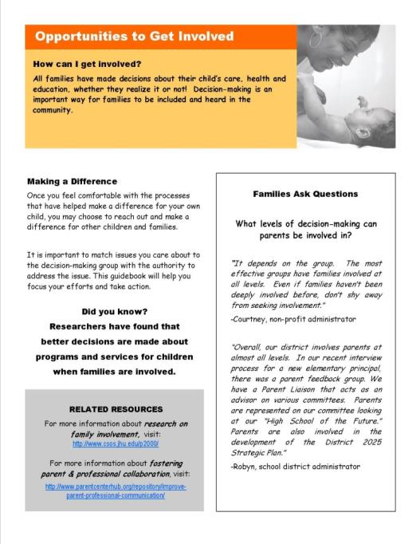
Sample Page
Real-Life Examples
Heading
with a
Focus Question
& Objective
Facts to Consider
Informative Reading
Additional Resources
Notes:
Slide #10: Sample Page of Guidebook
Procedural Directions:
*Slide contains animation. Click for each section to appear.
Discuss each highlighted section.
Presenter Notes:
Here is an example of a page from the guidebook. <Point out each highlighted section.> There are additional resources and activities embedded within some of the pages. All words bolded and italicized are found in the glossary in the appendix.
It’s important to use this book in a way that is going to be most meaningful for you and your group. If you need to use just one section, use just that section! If you want to take the book as a whole curriculum, that works too. The intention of the Guidebook is to meet the needs of the user. Use it however you’d like.
Activities
Have participants turn to a page or two in the Guidebook section(s) that the workshop is focused on.

Slide 11
Family Engagement & Leadership Resources
Family School Community Partnerships https://safesupportivelearning.ed.gov/training-technical-assistance/education-level/early-learning/family-school-community-partnerships
National Center for Family & Community Connections with Schools http://www.sedl.org/connections/
The Global Family Research Project https://globalfrp.org/
Project Appleseed National Campaign for Public School Improvement http://www.projectappleseed.org/chklst
National Association for Family, School, and Community Engagement (toolkits, other resources) https://nafsce.org/page/Resources
National PLACE Family Engagement Resources (Parent Leadership Advocacy & Community Empowerment) https://www.parentsatthetable.org/storage/app/media/resources/Main%20Resources/
National Standards for Family-School Partnerships https://www.pta.org/home/run-your-pta/National-Standards-for-Family-School-Partnerships
2021 Family Engagement Study: Insights for Building Effective School-Family Partnerships https://talkingpts.org/2021-family-engagement-study-insights-for-building-effective-school-family-partnerships/7173/
Notes:
Slide #11: Family Engagement & Leadership Resources
Procedural Directions:
Highlight 1 or 2 online resources listed on the slide.
Have one or two web links accessible and ready to show.
Presenter Notes:
National Center for Family and Community Connections with Schools
http://www.sedl.org/connections/
The Harvard Family Research Project
http://www.hfrp.org/
Project Appleseed: National Campaign for Public School Improvement
http://www.projectappleseed.org/chklist.html
National Coalition for Parent Involvement in Education (NCPIE)
http://www.ncpie.org
Family Leadership Project
http://familieslead.org/
SEDL Creating Collaborative Action Teams: Working Together for Student Success
http://www.sedl.org/pubs/fam18/
Activities
Handout: Guidebook Sectional Resource List

Slide 12
Family Engagement & Leadership Resources
Family Engagement Resources (U.S. DHHS/ACF/Children’s Bureau - ) https://www.childwelfare.gov/topics/famcentered/
National Family-School-Community Alliance https://fscalliance.org/category/resources/
Dual-Capacity Building Framework https://www.dualcapacity.org/
WI Interview with Dr. Karen Mapp on Family Engagement (Video 17:11) https://www.youtube.com/watch?v=eElzWQ6azMg
Building Parent-Teacher Relationships https://www.readingrockets.org/article/building-parent-teacher-relationships
Family & Community Engagement (WI RtI Center/3 videos) https://www.wisconsinrticenter.org/key-system-feature/family-community-engagement/
Family Engagement in a Virtual World https://www.pta.org/docs/default-source/default-document-library/family-engagement-in-the-virtual-world.pdf
Family Engagement Month Ideas https://www.ecac-parentcenter.org/family-engagement-month-2022/
Leading by Convening https://servingongroups.org/leading-by-convening
Serving on Groups http://www.servingongroups.org/
Notes:
Slide #11: Family Engagement & Leadership Resources
Procedural Directions:
Highlight 1 or 2 online resources listed on the slide.
Have one or two web links accessible and ready to show.
Presenter Notes:
National Center for Family and Community Connections with Schools
http://www.sedl.org/connections/
The Harvard Family Research Project
http://www.hfrp.org/
Project Appleseed: National Campaign for Public School Improvement
http://www.projectappleseed.org/chklist.html
National Coalition for Parent Involvement in Education (NCPIE)
http://www.ncpie.org
Family Leadership Project
http://familieslead.org/
SEDL Creating Collaborative Action Teams: Working Together for Student Success
http://www.sedl.org/pubs/fam18/
Activities
Handout: Guidebook Sectional Resource List

Slide 13
Serving on Groups
That Make Decisions:
A Guide for Families
Presented by:
Name
Organization/Agency
www.servingongroups.org
Notes:
Slide #12: Welcome and Introduction
Procedural Directions:
Have a copy of the Guidebook and the Training manual with you.
Make sure everyone has the materials needed for the presentation.
Ask if everyone can hear you and see the slides.
Introduce yourself and give a brief background of your experience (relevant to the group you are speaking to).
Address “housekeeping” such as restrooms, breaks, “parking lot”, group transitions, etc.
Presenter Notes:
Hello and welcome to this Serving on Groups that Make Decisions: A Guide for Families training.
My name is __insert name___ and I am the ___insert position__at _insert location__.
*Give a brief background of your experience (relevant to the group you are speaking to).
Activities

Slide 14

Section 1:
Opportunities to Get Involved
Questions
How can I get involved?
How can I share in decision making?
Who can serve on these groups?
Where do I begin?
Steps
Self-Reflection
Awareness of Possibilities
Options to Explore
Notes:
Slide #13: Section 1 Introduction
Procedural Directions:
Share information from the presenter notes.
If participants have a copy of the Guidebook, guide them to the appropriate section.
Presenter Notes:
By the end of Section 1, participants will:
Engage in a self-reflection of their experiences, knowledge, skills, and interests as individuals and as group/team members
Become aware of possibilities to use their experiences, knowledge, skills, and interests in future group/team roles
Learn of decision-making opportunities to explore that match their time/energy availability and current interests
Activities

Slide 15
How can I get involved?
MAP Activity
Who I Am
History
Dreams
Fears & Concerns
Needs
Notes:
Slide #14: MAP Activity
Procedural Directions:
Share information from the presenter notes.
Complete activity.
Ask suggested question.
Presenter Notes:
MAPS, or Making Action Plans, (formerly known as the McGill Action Planning System) is a planning process which may be used by teams who want to use a “person-centered” approach to help an individual plan for his or her future.
Plans that are developed through the MAPS process tend to be positive, forward-thinking, personalized and creative in their use of resources. The process fosters the development of self-advocacy skills among individuals and helps to establish trust and a sense of empowerment and shared responsibility among MAPS participants.
The MAPS process was originally developed by Marsha Forest, John O’Brien, Judith Snow and their colleagues (O’Brien, Forest, Snow and Hasbury, 1989).
There are 5 sections to the MAPS activity.
1. WHO AM I: a description of yourself, including the strengths, skills, likes, and values you bring to the leadership role.
2. HISTORY: a short description of the background and individual circumstances that led to your participation with the decision-making group.
3. DREAMS: a vision of things you would like to see happening as a result of your future participation with the decision-making group.
4. FEARS: a description of your worries or concerns about becoming a team member of the decision-making group.
5. NEEDS: a description of the things that need to happen to help make your vision for the future come true.
Activities
Activity: MAPS
Question: How will you use the information from your MAPS to expand your skills, knowledge, and roles as a group/team member?

Slide 16
Step 1: Who Am I?
WHO AM I?: How do you describe yourself?
Think about:
What words best describe you?
What skills, gifts, and talents will support your journey as a member?
What other skills and talents will you need?
What do you like/dislike about your current role(s) in working on a team?
What values and beliefs guide your life and work as a person?
Notes:
Slide #15: Step 1: Who Am I?
Procedural Directions:
Guide participants through activity and questions.
Provide time to reflect and share.
Presenter Notes:
WHO AM I?: A description of yourself, including strengths, skills, likes, that you will draw on to support your role as a leader and/or team member.
Note: By describing your strengths, skills, likes, dislikes, etc., you may be better able to develop your role as a leader or member.
Think about:
What words best describe you?
What skills, gifts, and talents will support your journey as a leader and/or team member?
What other skills and talents will you need?
What do you like/dislike about your current role(s) involving leadership and advocacy?
What values and beliefs guide your life and work as a person and a leader?

Slide 17
Step 2: History
HISTORY: Briefly describe the background and circumstances that led you here today.
Think about:
  What is significant about your personal history?
  What is significant about your family or child(ren)’s history?
  What were your first experiences in which you saw yourself as a leader or part of a decision-making team?
  What adult experiences and/or formal/informal training has helped you see yourself as a member of a group or team?
Notes:
Slide #16: Step 2: History
Procedural Directions:
Guide participants through activity and questions.
Provide time to reflect and share.
Presenter Notes:
HISTORY: Briefly describe the background and circumstances that led you here today.
Note: This history is not meant to be a detailed chronological account, more like highlights.
Think about:
What is significant about your personal history?
What is significant about your family or child(ren)’s history?
What were your first experiences in which you saw yourself as a leader or part of a decision-making team?
What adult experiences and/or formal/informal training has helped you see yourself as a member of a group or team?
Activities:

Slide 18
Step 3: Dreams
DREAMS: What dreams do you have in relation to your personal and professional development as a group or team member?
Think about:
What contributions and/or changes do you dream about that will involve your participation on a decision-making team?
What one thing do you most want to see happen?
What do you hope to accomplish in one year? 5 years? 10 years?
What other dreams are important to you as you begin this journey??
Notes:
Slide #17: Step 3: Dreams
Procedural Directions:
Guide participants through activity and questions.
Provide time to reflect and share.
Presenter Notes:
DREAMS: What dreams do you have in relation to your personal and professional development as a group or team member?
Note: Dream big! Dreams do not have to be “realistic”!
Think about:
What contributions and/or changes do you dream about that will involve your participation on a decision-making team?
What one thing do you most want to see happen?
What do you hope to accomplish in one year? 5 years? 10 years?
What other dreams are important to you as you begin this journey?
Activities:

Slide 19
Step 4: Fears & Concerns
FEARS & CONCERNS: Identify your worries or concerns about becoming part of a decision-making group or team.
Think about:
What concerns arise when you envision yourself as a leader or member of a team and about your role on the team?
What barrier might stand in the way of your realizing your leadership and participation dreams?
Notes:
Slide #18: Step 4: Fears & Concerns
Procedural Directions:
Guide participants through activity and questions.
Provide time to reflect and share.
Presenter Notes:
FEARS: Identify your worries or concerns about becoming part of a decision-making group or team.
Note: By identifying your fears, you may find ways to overcome some of your challenges.
What concerns arise when you envision yourself as a leader or member of a team and about your role on the team?
What barrier might stand in the way of your realizing your leadership and participation dreams?
Activities:

Slide 20
Step 5: Needs
NEEDS: What needs to happen to make your dreams about leadership and group membership become a reality?
Think about:
What skills would you like to develop further?
What else will you need to expand your role as a leader and team member?
What supports do you need from others?
Notes:
Slide #19: Step 5: Needs
Procedural Directions:
Guide participants through activity and questions.
Provide time to reflect and share.
Presenter Notes:
REFLECT: In preparation for the next step, please take a few moments to go back over the previous four steps and review your responses. Highlight or make a mental note of key ideas that emerged in each section. Keeping them in mind, you will be ready to complete the next step.
NEEDS: You are encouraged to use a brainstorming style approach to identify the things that need to happen to help make your dreams for the future come true.
What skills would you like to develop further?
What else will you need to expand your role as a leader and team member?
What supports do you need from others?
Activities:

Slide 21
Discussion
What common experiences have group members had in relation to each of the MAPS steps?
How will you use the information from your MAP to expand your leadership skills, knowledge and roles?
Notes:
Slide #20: Discussion
Procedural Directions:
Guide participants through questions.
Provide time to reflect and share.
Presenter Notes:
At the conclusion of the MAPS activity, back through each of the five MAPS steps and share some of your responses with one another.
The discussion questions on the power point slide can be used to generate a discussion about the common ideas and experiences that participants have had in relation to each of the MAPS steps.
In what ways can you use information from your MAPS to expand your knowledge, skills, and roles related to decision-making groups.
Activities:

Slide 22

Shared Decision Making
  “Decision-making means a process of partnering, of shared views and actions toward shared goals…not just a power struggle between conflicting ideas.”
  -Dr. Joyce Epstein
Notes:
Slide #21: Shared Decision-Making
Procedural Directions:
Highlight at least 2 or 3 key points.
Keep discussion brief.
Ask suggested activity questions.
Presenter Notes:
The Guidebook is built on the concept of shared decision making. So, what is shared decision making? Epstein is quoted as saying, “Decision-making means a process of partnering, of shared views and actions toward shared goals…not just a power struggle between conflicting ideas.”
Shared decision making is really just a way to explain the process that a group goes through to make decisions that involve multiple perspectives to be heard.
Shared decision-making is not about one person; it is about the entire group coming together for a common focus. When interested individuals share in the work of the group, better decisions are made and better outcomes can be expected. When members of a group have an increased sense of ownership in the work of the group, the result is greater commitment of time and energy to the work of the group.
Activities
Question: When making a decision, who do you consult or gain input from?
Question: How are decisions made that affect others in your family?

Slide 23

Who can serve on groups?
Interested Individuals
  Especially if the group’s decisions will affect them personally
BUT choose your opportunity wisely
  AND consider the TIME & ENERGY needed to serve
Notes:
Slide #22: Who can Serve?
Procedural Directions:
Share information on slide.
Expand upon or give an example for each key component on getting involved.
Presenter Notes:
It is important for families to be part of a group, especially if the group’s decisions will be affecting the family in one way or another.
There are many opportunities to serve on groups. Your time is valuable so you will want to find an opportunity that is meaningful to you.
To make sure your time is productive, carefully consider your options before agreeing to serve.
Also consider:
The amount of TIME you have available
The ENERGY it will take to fulfill the responsibilities of the role
Activities
Activity: Time & Energy Inventory

Slide 24

Where to begin?
Learn about available resources and services
Find an issue you care deeply about
Connect to a group with the authority to create or influence change
Prepare yourself to serve
Notes:
Slide #23: Where to Begin?
Procedural Directions:
Share information from the presenter notes.
Expand upon or give an example for each key component to getting involved.
Presenter Notes:
Where does one begin when they want to take part in a group that makes decisions? Here are some ideas to get you started:
Learn about the resources and services that are available. You can look on the web, at your local community center, school or library, with a state or national organization, or at a cooperative extension office.
Find an issue you care deeply about. It requires passion on your part to devote time from your daily schedule to an issue.
Connect to a group with the authority to create or influence change. That is the surest way of knowing you can make a difference to a greater number of people.
Prepare yourself to serve. This means making sure your time is productive by considering the amount of time you have available and the energy it will take to fulfill the responsibilities of the role on the group.
Activities

Slide 25
Section 1 Resources
Wisconsin Board for People with Developmentally Disabilities https://wi-bpdd.org/
National Network of Schools in Partnership http://schoolsinpartnership.org/Resources
National PTA Center for Family Engagement https://www.pta.org/center-for-family-engagement
National PTA Standards for Family-School Partnerships Implementation (See Implementation Guide) https://www.pta.org/home/run-your-pta/National-Standards-for-Family-School-Partnerships
ECTA Supporting Family Leaders (4 Videos:) Conversations with Family Leaders https://ectacenter.org/topics/familyeng/supportingfamilyleaders.asp
National PLACE Resources https://www.parentsatthetable.org/storage/app/media/resources/Main%20Resources/
Leading for Results: The Person-Role-System (Annie E. Casey Foundation Video 4:23) https://www.aecf.org/blog/new-leadership-video-get-results-by-understanding-person-role-system/
Notes:
Slide #24: Section 1 Resources
Procedural Directions:
Highlight 1 or 2 online resources listed on the slide.
Have one or two web links accessible and ready to show.
Presenter Notes:
Wisconsin Board for People with Developmentally Disabilities https://wi-bpdd.org/
National Network of Schools in Partnership http://schoolsinpartnership.org/Resources
National PTA Center for Family Engagement https://www.pta.org/center-for-family-engagement
National PTA Standards for Family-School Partnerships Implementation (See Implementation Guide) https://www.pta.org/home/run-your-pta/National-Standards-for-Family-School-Partnerships
ECTA Supporting Family Leaders (4 Videos:) Conversations with Family Leaders https://ectacenter.org/topics/familyeng/supportingfamilyleaders.asp
National PLACE Resources https://www.parentsatthetable.org/storage/app/media/resources/Main%20Resources/
Leading for Results: The Person-Role-System (Annie E. Casey Foundation Video 4:23) https://www.aecf.org/blog/new-leadership-video-get-results-by-understanding-person-role-system/
Activities
Handout: Guidebook Sectional Resource List

Slide 26
Section 1 Resources
Team Engagement for Quality Improvement https://www.dhs.wisconsin.gov/publications/p02349.pdf
U.S. Dept. of Education - Family & Community Engagement Team https://www.ed.gov/category/keyword/Family-Engagement
Rubric for Family & Community Engagement https://www.parentsatthetable.org/storage/app/media/resources/Education/Parent%20%26%20Community%20Engagement%20Rubrics.pdf
National Dropout Prevention Center Family Engagement Resources (tool kits, research, webinars) http://dropoutprevention.org/effective-strategies/family-engagement/resources/
National Center for Family & Community Connections with Schools https://sedl.org/connections/
Global Family Research Project (Family Eng. Playbook) https://medium.com/familyengagementplaybook/approaches/home
Making the Match: Getting Started in Board Service (Video 14:03 min.) https://boardsource.org/fundamental-topics-of-nonprofit-board-service/composition-recruitment/board-service/
Notes:
Slide #24: Section 1 Resources
Procedural Directions:
Highlight 1 or 2 online resources listed on the slide.
Have one or two web links accessible and ready to show.
Presenter Notes:
Team Engagement for Quality Improvement https://www.dhs.wisconsin.gov/publications/p02349.pdf
U.S. Dept. of Education - Family & Community Engagement Team https://www.ed.gov/category/keyword/Family-Engagement
Rubric for Family & Community Engagement https://www.parentsatthetable.org/storage/app/media/resources/Education/Parent%20%26%20Community%20Engagement%20Rubrics.pdf
National Dropout Prevention Center Family Engagement Resources (tool kits, research, webinars) http://dropoutprevention.org/effective-strategies/family-engagement/resources/
National Center for Family & Community Connections with Schools https://sedl.org/connections/
Global Family Research Project (Family Eng. Playbook) https://medium.com/familyengagementplaybook/approaches/home
Making the Match: Getting Started in Board Service (Video 14:03 min.) https://boardsource.org/fundamental-topics-of-nonprofit-board-service/composition-recruitment/board-service/
Activities
Handout: Guidebook Sectional Resource List

Slide 27
Serving on Groups
That Make Decisions:
A Guide for Families
Presented by:
Name
Organization/Agency
www.servingongroups.org
Notes:
Slide #25: Welcome and Introduction
Procedural Directions:
Have a copy of the Guidebook and the Training manual with you.
Make sure everyone has the materials needed for the presentation.
Ask if everyone can hear you and see the slides.
Introduce yourself and give a brief background of your experience (relevant to the group you are speaking to).
Address “housekeeping” such as restrooms, breaks, “parking lot”, group transitions, etc.
Presenter Notes:
Hello and welcome to this Serving on Groups that Make Decisions: A Guide for Families training.
My name is __insert name___ and I am the ___insert position__at _insert location__.
*Give a brief background of your experience (relevant to the group you are speaking to).
Activities

Slide 28


Section 2: Types of Groups
Questions
  What are the different functions of groups and member roles?
  What is a…
    Governing group?
    Advisory group?
    Leadership group?
    Planning group?
    Evaluation group?
    Practice group?
Notes:
Slide #26: Section 2 Introduction
Procedural Directions:
Share information from the presenter notes.
If participants have a copy of the Guidebook, guide them to the appropriate section.
Presenter Notes:
There are many different types of groups that have different functions and who have members that perform a variety of roles. Some of these groups may be new to you.
In this section, we will explain each group in detail and describe common functions and roles of each.
Activities

Slide 29

What Makes Decision-Making Groups Unique?
    Decision-making authority
    Issues
    Meeting structure
    Data used
    Input and feedback
    Processes
    Membership
    History
    Time since formation
    Diversity of perspectives
Notes:
Slide #27: What Makes Groups Unique?
Procedural Directions:
*Slide contains animation. Click for each section to appear.
Share information from presenter notes.
Presenter Notes:
Decision making groups can take on a lot of different forms
from a formal group, like a State Advisory committee providing input and feedback related to statewide issues;
to an informal group, an event committee for a local church.
Decision-making groups do important work, no matter their structure, issue, or size, and insuring that people are prepared to fulfill their role is important.
“Ad hoc” groups form for a specific purpose and are usually temporary
“Standing committees” are permanent and usually study issues and report or advise groups based on findings
Some groups meet for years and their membership changes over time. Others meet for an agreed-upon amount of time or until their work together is complete.
Each decision-making group is unique. Here are some variables that differentiate groups from one another.
Their decision-making authority
The issues they are working on
The meeting structure they choose
The data they use
The input and feedback they collect
The processes they use
Their membership
Their history
The length of time since formation
The diversity of perspectives represented
Activities

Slide 30
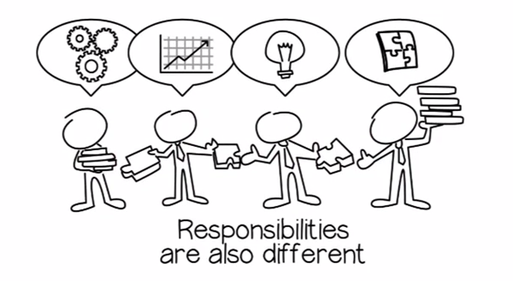
Member Roles
https://youtu.be/LmWiBnGkWww
Notes:
Slide #28: Member Roles
Procedural Directions:
Watch video clip. Make your computer is connected to speakers or an audio system.
Present information.
Ask suggested activity questions.
Presenter Notes:
Member roles vary from group to group depending upon the type and function of the group.
Insuring that people are prepared to fulfill their role is important.
Find out what types of roles there are for members of the group. Is there a leader? A facilitator? A chairperson?
Make sure you understand the role you are considering BEFORE you agree to commit to a role.
Activities
Question: Are there other member roles you might see in a group?

Slide 31
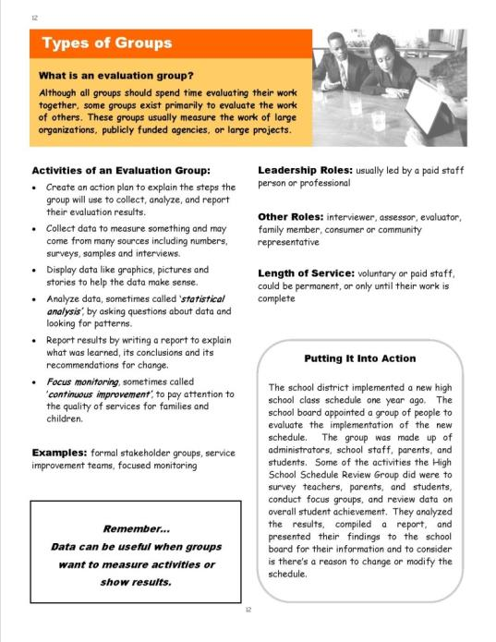
Sample Page
Leadership Roles
Definition
Other Roles
Activities
Length of Service
Examples
Putting It Into Action
Notes:
Slide #29: Section 2 Sample Page
Procedural Directions:
*Slide contains animation. Click for each section to appear.
Comment on each highlighted section.
Presenter Notes:
The Guidebook highlights 6 different types of decision making groups.
Here is a sample page from the Guidebook.
There is a Definition of the group at the top of each page.
Activities and Examples of the group are listed on the left side of the page.
On the right side of the page, it gives leadership roles in the group, other member roles in the group, the typical length of service, and a scenario called “Putting It Into Action”.
Activities

Slide 32
Functions of Groups
Governing
Advisory
Leadership
Planning
Evaluation
Practice
Notes:
Slide #30: Functions of Groups
Procedural Directions:
*Slide contains animation. Click once for sections to appear.
Share information from presenter notes.
Presenter Notes:
There are six unique functions of groups and some groups may serve more than one of these functions.
Governing
Advisory
Leadership
Planning
Evaluation
Practice
Remember groups can look very similar while having very different purposes. Let’s look a little more closely at each group.
Activities

Slide 33

Governing
Activities
  Establish by-laws
Govern an organization
Develop policies
Establish goals
Communicate with the public & funding sources
Employ & evaluate executives
Negotiate with employee groups
Allow for community participation
Examples
  School Board
  City Council
Notes:
Slide #31: Governing
Procedural Directions:
Share information from the presenter notes.
If participants have a copy of the Guidebook, guide them to the appropriate page.
Read the written scenario or share a personal example.
Presenter Notes:
The first type of group mentioned in the Guidebook is the Governing Group.
This is one of the more formal groups where members are usually appointed or elected to a position.
Their purpose is to govern an organization and set policy.
Scenario - Governing Groups: In school districts across the state, the best known example of a governing group is the school board. The school board is an elected body which develops and adopts policies that align to state and federal laws, employs and evaluates administrators, negotiates staff contracts, and provides oversight on the budget. Board members are elected by the taxpayers and are accountable to everyone.
Activities

Slide 34
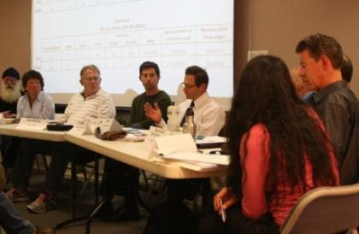
Advisory
Activities
Represent a broader group of people
  Seek out the views of those affected
Advise on needs
Bring awareness to issues
Help develop action plans
Make recommendations
Serve as a resource
Examples
  Committee
  Panel
  Focus group
Notes:
Slide #32: Advisory
Procedural Directions:
Share information from the presenter notes.
If participants have a copy of the Guidebook, guide them to the appropriate page.
Read the written scenario or share a personal example.
Presenter Notes:
The 2nd group is the Advisory Group.
This is a group usually concerned with a single issue and membership is composed of individuals who are representative of a broader group of people affected by an issue and who have expertise in the issue.
Unlike the governing board, the advisory group does not have fiscal or legal responsibility.
Advisory councils typically have their authority limited to giving advice or counsel to the board of the organization, the CEO or executive director, or members of the staff who are responsible for specific programs.
Examples of advisory group actions are:
making recommendations
providing background for board decisions
furnishing pros and cons
listing questions that are appropriate for a situation
The board will review and approve all recommendations from advisory groups, though it is not obligated to follow the advice.
Unlike committees, advisory groups are usually composed of individuals outside of the board (although they might include one or two board members as well).
Scenario - Advisory Groups: The district’s Special Education Advisory Group is comprised of parent and teacher representatives from each school in the district. The Special Education Director and a parent co-facilitate the group’s meetings. The focus of the group’s work is to discuss current initiatives and provide feedback on how those initiatives affect students with disabilities. The group provides input on the needs of families and may help assist with coordination of activities and events for families in the school or district.
Activities

Slide 35

Leadership
Activities
Initiate awareness of an emerging or systemic issue
Collectively work on targeted issues
Conduct listening sessions and public forums
Actively plan and implement strategies
Attract a collective voice
Monitoring entities (watchdog)
Examples
  Associations/Organizations/Coalitions
  School improvement teams
  Initiatives/Grants
Notes:
Slide #33: Leadership
Procedural Directions:
Share information from the presenter notes.
If participants have a copy of the Guidebook, guide them to the appropriate page.
Read the written scenario or share a personal example.
Presenter Notes:
The 3rd group is the Leadership Group.
This group can provide important direction for state lawmakers at a national level and for district administrators at a local level.
Membership can include any combination of family members, youth, community members, policymakers, and professionals.
Specific roles and responsibilities of a leadership team may vary widely from school to school or district to district.
A leadership team is typically a group of administrators, teachers, and other staff members who make important governance decisions in a school and/or who lead and coordinate school-improvement initiatives.
Participants may volunteer for a leadership team, or they may be recruited by administrators.
In recent decades, leadership teams have evolved into a form of shared leadership—the practice of expanding the number of people involved in making important decisions related to the organization, operation, and academics of a school.
Scenario - Leadership Groups: A school’s RtI & PBIS Leadership Team is an example of a leadership group. This group is comprised of various staff members and parents and / or community members. The leadership team looks at systemic issues such as student learning and outcomes. In this case, the school’s RtI and PBIS Leadership team would look at academic data as well as behavior data in the form of in-school suspensions and office referrals. The team looks at data and creates plans to implement strategies for addressing an identified need. They meet on a regular basis to monitor progress and suggest necessary changes if needed.
Activities

Slide 36

Planning
Activities
Research and study a specific issue
Assess needs and develop priorities
Make recommendations
Design information and conduct training
Develop or select a curriculum
A channel for communication and feedback
Plan and carry out an activity
Examples
  Committee
  Workgroup
  Action team
  IFSP/IEP team
Notes:
Slide #34: Planning
Procedural Directions:
Share information from the presenter notes.
If participants have a copy of the Guidebook, guide them to the appropriate page.
Read the written scenario or share a personal example.
Presenter Notes:
The 4th group is the Planning Group.
Planning groups deal with a specific issue and their job is to plan and carry out an activity, usually designated by a more formal group.
Tasks include:
Dealing with a specific issue
Plan and carry out an activity
Design information and conduct trainings about relevant topics
Develop or select a curriculum
Assess needs and develop priorities
IFSP = Individual Family Service Plan
IEP – Individualized Education Program
Scenario - Planning Groups: An IEP team is an example of a planning group. John’s daughter’s IEP team is comprised of John and his wife, the English teacher, her special education teacher, the speech therapist, occupational therapist, school guidance counselor, psychologist, and the principal. John’s daughter was invited to the IEP meeting too. The IEP team will review how well John’s daughter did this last year in working toward her IEP goals. The team will take into account her strengths, interests, and challenges, parent concerns, and baseline data on academic achievement and functional performance. Based on the data and information in the present level, annual goals are created, and services and supports will be determined. The team meets on an annual basis to review the plan and revise it for the next year as long as the student still qualifies.
Activities

Slide 37
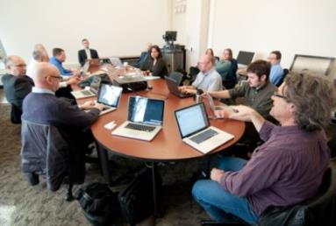
Evaluation
Activities
Create an action plan
Collect, display, and analyze data
Report results
Continuous monitoring for progress and improvement
Examples
  Formal stakeholder groups
  Service improvement teams
  Focused monitoring
Notes:
Slide #35: Evaluation
Procedural Directions:
Share information from the presenter notes.
If participants have a copy of the Guidebook, guide them to the appropriate page.
Read the written scenario or share a personal example.
Presenter Notes:
The 5th group is the Evaluation Group.
This group evaluates the work of others by measuring the work of large organizations, publicly funded agencies, or large projects.
Tasks include:
Evaluate the work of others
Measure the work of large organizations, publicly funded agencies, or large projects
Work with the stages of data use (plan, collect, organize, analyze, make recommendations, create a plan, share results, monitor for progress)
Scenario - Evaluation Group: The school district implemented a new high school class schedule one year ago. The school board appointed a group of people to evaluate the implementation of the new schedule. The group was made up of administrators, school staff, parents, and students. Some of the activities the High School Schedule Review Group did were to survey teachers, parents, and students, conduct focus groups, and review data on overall student achievement. They analyzed the results, compiled a report, and presented their findings to the school board for their information and to consider is there’s a reason to change or modify the schedule.
Activities

Slide 38
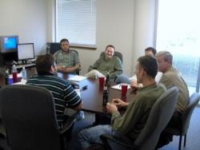
Practice
Activities
Provide a structure to communicate, learn, & act
Continually reach out to others
Create opportunities for networking & sharing
Enhance participation and connections
Discuss emerging or systemic issues
Promote interagency connections
Share information and solutions
Promote the spread of best practices
Examples
  A learning circle
  A community of practice
Notes:
Slide #36: Practice
Procedural Directions:
Share information from the presenter notes.
If participants have a copy of the Guidebook, guide them to the appropriate page.
Read the written scenario or share a personal example.
Lead suggested activity.
Presenter Notes:
The last group is the Practice Group.
A practice group provides a structure for communication, learning and action.
Members agree to meet regularly to promote interagency and stakeholder connections.
Tasks include:
Provide a structure to communicate, learn, and take action.
Promote interagency/stakeholder connections and ‘shared work’.
Seek and exchange information and solutions
Promote the spread of best practices
Continually reach out
Sense emerging or systemic issues
Scenario - Practice Group: John and Laura live in Wilson County. The Wilson County Community on Transition (C-CoT) meets each month during the school year. The C-CoT membership includes school district staff, adult service agency staff, parents, and students. The team learns together, shares information, and discusses issues and concerns around transitioning students with disabilities from high school to the adult world. They share experiences on best practices, work together on creating solutions, and schedule learning opportunities for students and their families.
Each year the C-CoT plans a student conference for high school students from all the high schools in the county. The focus of the conference is on preparing for college and living on your own. This is just one of the ways the C-CoT expands their learning community by engaging more people in a transition activity.
Activities
Activity: Types of Groups

Slide 39
Section 2 Resources
National Nonprofit Association Tools & Resources https://www.councilofnonprofits.org/resources/governance-and-leadership
Advocacy in Action: Parent Advisory Councils https://sepacguide.parentcenterhub.org/
Guidelines for Establishing Family Advisory Boards https://www.aucd.org/docs/Guidelines%20for%20Family%20Advisory%20Boards.pdf
Guidelines for Leadership Teams https://eleducation.org/resources/guidelines-for-leadership-teams
Build Leadership Team https://www.wisconsinrticenter.org/school-implementation/build-leadership-team/
IDEA Partnership – Practice Groups http://www.ideapartners.org/creating-community/23-cop-in-practice/school-behavioral-health/254-community-practice-groups.html?highlight=WyJwcmFjdGljZSIsInByYWN0aWNlJyIsInByYWN0aWNlJy4iLCIncHJhY3RpY2UiLCJncm91cHMiLCJncm91cHMnIiwicHJhY3RpY2UgZ3JvdXBzIl0=
Notes:
Slide #37: Section 2 Resources
Procedural Directions:
Highlight 1 or 2 online resources listed on the slide.
Have one or two web links accessible and ready to show.
Presenter Notes:
National Nonprofit Association Tools & Resources https://www.councilofnonprofits.org/resources/governance-and-leadership
Advocacy in Action: Parent Advisory Councils https://sepacguide.parentcenterhub.org/
Guidelines for Establishing Family Advisory Boards https://www.aucd.org/docs/Guidelines%20for%20Family%20Advisory%20Boards.pdf
Guidelines for Leadership Teams https://eleducation.org/resources/guidelines-for-leadership-teams
Build Leadership Team https://www.wisconsinrticenter.org/school-implementation/build-leadership-team/
IDEA Partnership – Practice Groups http://www.ideapartners.org/creating-community/23-cop-in-practice/school-behavioral-health/254-community-practice-groups.html?highlight=WyJwcmFjdGljZSIsInByYWN0aWNlJyIsInByYWN0aWNlJy4iLCIncHJhY3RpY2UiLCJncm91cHMiLCJncm91cHMnIiwicHJhY3RpY2UgZ3JvdXBzIl0=
Activities
Handout: Guidebook Sectional Resource List

Slide 40
Section 2 Resources
Strategic Planning Committee (video 4:11) https://www.youtube.com/watch?v=7F2-4zy_hj0
Board Effect - Strategic Planning Committee https://www.boardeffect.com/blog/what-is-a-strategic-planning-committee/
Planning https://www.minnesotanonprofits.org/resources-tools/principles-practices-for-nonprofit-excellence/planning
10 Keys to Successful Strategic Planning https://www.tccgrp.com/resource/ten-keys-to-successful-strategic-planning-for-nonprofit-and-foundation-leader/
Definition of Evaluation Committee https://www.lawinsider.com/dictionary/evaluation-committee
Shaping Outcomes - Evaluation https://shapingoutcomes.org/course/evaluate/d1.htm
School Board Program Evaluation Committee (video 8:18) https://www.youtube.com/watch?v=Rdp3bL7fwCE
Evaluation and Planning Resources https://www.minnesotanonprofits.org/resources-tools/resources-by-topic/evaluation-planning
Notes:
Slide #37: Section 2 Resources
Procedural Directions:
Highlight 1 or 2 online resources listed on the slide.
Have one or two web links accessible and ready to show.
Presenter Notes:
Strategic Planning Committee (video 4:11) https://www.youtube.com/watch?v=7F2-4zy_hj0
Board Effect - Strategic Planning Committee https://www.boardeffect.com/blog/what-is-a-strategic-planning-committee/
Planning https://www.minnesotanonprofits.org/resources-tools/principles-practices-for-nonprofit-excellence/planning
10 Keys to Successful Strategic Planning https://www.tccgrp.com/resource/ten-keys-to-successful-strategic-planning-for-nonprofit-and-foundation-leader/
Definition of Evaluation Committee https://www.lawinsider.com/dictionary/evaluation-committee
Shaping Outcomes - Evaluation https://shapingoutcomes.org/course/evaluate/d1.htm
School Board Program Evaluation Committee (video 8:18) https://www.youtube.com/watch?v=Rdp3bL7fwCE
Evaluation and Planning Resources https://www.minnesotanonprofits.org/resources-tools/resources-by-topic/evaluation-planning
Activities
Handout: Guidebook Sectional Resource List

Slide 41
Serving on Groups
That Make Decisions:
A Guide for Families
Presented by:
Name
Organization/Agency
www.servingongroups.org
Notes:
Slide #38: Welcome and Introduction
Procedural Directions:
Have a copy of the Guidebook and the Training manual with you.
Make sure everyone has the materials needed for the presentation.
Ask if everyone can hear you and see the slides.
Introduce yourself and give a brief background of your experience (relevant to the group you are speaking to).
Address “housekeeping” such as restrooms, breaks, “parking lot”, group transitions, etc.
Presenter Notes:
Hello and welcome to this Serving on Groups that Make Decisions: A Guide for Families training.
My name is __insert name___ and I am the ___insert position__at _insert location__.
*Give a brief background of your experience (relevant to the group you are speaking to).
Activities

Slide 42


Section 3:
Processes Groups Use
Questions
What are the principles that guide group practices?
What are important processes groups use?
Notes:
Slide #39: Section 3 Introduction
Procedural Directions:
Share information from the presenter notes.
If participants have a copy of the Guidebook, guide them to the appropriate section.
Presenter Notes:
The most effective groups use processes to guide their work. These processes may be new to you.
In this section, we will explain some common processes that groups might use.
Activities

Slide 43
Guiding Principles of
Shared Decision-Making
Shared Decision Making
Shared Vision
Equal Partners
Collaboration
Representation
Shared Responsibility
Information Sharing
Producing Results
Notes:
Slide #40: Guiding Principles
Procedural Directions:
*Slide contains animation. Click for animation to appear.
Explain the Guiding Principles framework by sharing information from the presenter notes.
Highlight each of the seven principles and explain what happens when a principle is missing.
Presenter Notes:
This graphic shows all of the principles that contribute to the process of shared decision making. Those principles are:
Shared Vision— which means groups need to find common ground otherwise each member is working towards different goals
Representation—which means there must be consideration for the needs and perspectives of all people who are affected otherwise the group is making decisions for others without hearing their concerns, questions, and opinions
Equal Partners—which means each member must be treated equally otherwise some members won’t feel like true participants
Collaboration—which means there are opportunities to work together otherwise everyone is working alone in their own bubble
Shared Responsibility—which means everyone agrees to do their part, for example, improving outcomes for children otherwise 1 person or a small group does it all and there is less feeling of ownership by the other members. What happens when that 1 person or small group leaves?
Information Sharing—which means staying up-to-date on information regarding an issue otherwise a gap will arise within the group and not all members will be able to make well-informed decisions
Producing Results—groups need to check their progress and adjust as needed otherwise nothing is accomplished so what is the point of the group?
Remember if one of these principles is missing, the outcomes are impacted and shared decision-making is compromised.
Activities

Slide 44
Guiding Principles
Example
IFSP/IEP meeting
Shared Vision
All want the child to be healthy, happy, and successful.
Equal Partners
All ideas, concerns, and questions are heard and are valued.
Collaboration
Everyone works together to come up with a plan.
Representation
Anyone working with the child or representing the child’s best interest is present.
Shared Responsibility
Everyone does their part to support the child’s learning at school, home, and in the community.
Information Sharing
The same information is given to all so all are able to make a well-informed decision.
Producing Results
Child makes progress.
Notes:
Slide #41: Guiding Principles Example
Procedural Directions:
*Slide contains animation. Click for animation to appear.
Discuss the relation between the guiding principles and an everyday example that relates to a decision-making body.
Lead suggested activity.
Presenter Notes:
The guiding principles can easily be applied to an individual group or a decision-making task.
An IFSP or IEP Team meeting is an everyday example of shared decision making. Let's take a look at each guiding principle through this lens.
Shared Vision—All want the child to be healthy, happy, and successful.
Representation—Anyone working with the child or representing the child’s best interest is present.
Equal Partners—All ideas, concerns, and questions are heard and are valued.
Collaboration—Everyone works together to come up with a plan.
Shared Responsibility—Everyone does their part to support the child’s learning at school, home, and in the community.
Information Sharing—The same information is given to all so all are able to make a well-informed decision.
Producing Results—Child makes progress.
Remember if one of these principles is missing, then it is not shared decision making and the vacation is not planned with everyone in mind.
IFSP = Individual Family Service Plan
IEP = Individualized Education Program
Activities
Activity/Handout: Example of Guiding Principles
Question: Have you been involved in shared decision-making? What made it successful? What was challenging?

Slide 45



Helpful Reminders:
Start with the end in mind
  Focus on Outcomes
Work towards positive results
  = Celebrate and publicize the success
  = Go back and make adjustments
Notes:
Slide #42: Helpful Reminders
Procedural Directions:
Share information from the presenter notes.
Presenter Notes:
The most effective groups use different processes to guide their work. In this section, we will go through some common processes that groups might use.
So how do groups make decisions, and hopefully GOOD decisions?
It is by starting with the end in mind, in other words, focusing on the outcomes and then working towards positive results.
If the results are not positive or what they hoped to have accomplished, the group will need to go back to the processes and make adjustments until they have a plan that is producing positive results.
Activities

Slide 46

Processes Groups Use
1. Information Gathering
2. Goal Setting
3. Planning
4.Collaboration
5. Evaluation
6. Reaching Agreement
Notes:
Slide #43: Processes Groups Use
Procedural Directions:
*Slide contains animation. Click for animation to appear.
Introduce processes group use by sharing information from presenter notes.
Presenter Notes:
The six common processes groups use are:
Information Gathering
Goal Setting
Planning
Collaboration
Evaluation
Processes for Reaching Agreement
Now let’s take a look at each process in detail.
Activities

Slide 47
1. Information Gathering
Data
Numbers
Facts
Brain-
storming
Ideas
Focus Group Perspectives Stories
Prioritize Issues
Notes:
Slide #44: Information Gathering
Procedural Directions:
*Slide contains animation. Click for animation to appear.
Share information from presenter notes.
Ask suggested activity question.
Presenter Notes:
It is important for groups to gather and use accurate information or sometimes called data. It can come in many forms like numbers, facts, perspectives, ideas or stories. It can be collected in many ways.
Brainstorming is a strategy used when groups want to generate and collect lots of ideas.
A focus group is a group of participants who are asked questions and then give their perspectives or stories.
Example: Gathering school families and community members together
Issues may be identified during the information gathering process that will need to be addressed.
Priority may be given to issues that are the most important or that may take the most time to accomplish.
The bottom line is that it is critical to have accurate, up-to-date information before the group makes a decision.
Activities
Questions: How do you personally gather information before making decisions? How do determine what issues or tasks are most important?

Slide 48

2. Goal Setting
What does the group wants to see happen?
Helpful Tools to Set Direction
  Vision Statement
  Mission Statement
  S.M.A.R.T. Goals
      Specific
      Measurable
      Attainable
      Realistic
      Timely
Notes:
Slide #45: Goal Setting
Procedural Directions:
*Slide contains hyperlinks to YouTube videos. Click on orange, underlined words for hyperlinked videos.
Share information from the presenter notes.
Define the differences between vision and mission statements.
Provide copies of handouts for all participants.
Presenter Notes:
A goal is what a group wants to see happen and it needs to be stated up front so the group knows what they are working towards.
Goals, both short term and long term, are set after a group determines their priorities.
Reviewing the group’s vision and mission statements are helpful guides during the goal setting process.
Ineffective groups often lack clear goals or have failed to communicate the groups’ goals to all members.
A vision statement describes the changes the group wants to see happen in the future as a result of their actions.
An example is: A community where people of all ages are treated with respect and dignity, and are valued for their contributions.
A mission statement provides the direction and sets the goals, actions, and decision-making processes of the group.
An example is: Linking older adults with a caring community.
S.M.A.R.T. goals are goals written to help the group accomplish what they set out to do and are described as:
Specific – What are you going to do?
Measurable – How are you going to do it?
Attainable – Can you commit to doing it?
Realistic – Is it doable?
And Timely – What is your timeframe?
Example: Making a peanut butter sandwich or cleaning a house on the weekend
Activities
Handout: Mission/Vision Statements
Handout: SMART Goals
Videos:
How to Write a Vision Statement that Inspires: https://www.youtube.com/watch?v=ioY-YSOKBtY
How to Write a Mission Statement: https://www.youtube.com/watch?v=XtyCt83JLNY
SMART Goals – Quick Overview https://www.youtube.com/watch?v=1-SvuFIQjK8

Slide 49

3. Planning
Who will do what, by when and in what order?
Helpful Tools to Reach Goals
  Action Plan
    Logic Models
    Schedules
    Strategy Charts
Notes:
Slide #46: Planning
Procedural Directions:
Share information from the presenter notes.
Ask suggested activity question.
Presenter Notes:
A plan begins to form when the team agrees on the first steps and how much to work on at a time.
Sometimes called an ‘action plan’, the plan should include who will do what, by when, and in what order.
Two tools that can be effective in helping to plan are logic models and schedules.
Logic models are diagrams that illustrate how a group’s activities connect to its goals and outcomes.
Schedules, also referred to as timelines, provide the group with assignments to accomplish within agreed upon deadlines.
Activities
Question: Think about the last time you have had to come up with a plan personally or in a group. How did you do it?

Slide 50
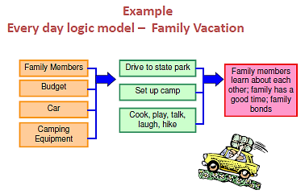
Logic Model Example
Notes:
Slide #47: Logic Model Example
Procedural Directions:
Explain the example of a logic model on the slide.
Presenter Notes:
Here is a simple example of a logic model. It is for a family camping vacation.
The orange items are the inputs. For a family vacation, you will need family members, a budget, a car, and camping equipment.
The green items are the outputs or what needs to be done. You will need to drive to the state park, set up camp, and cook, play, talk, laugh, and hike.
The hot pink item is the outcome of the family vacation. It will be that family members learn about each other, the family has a good time, and the family bonds.
Activities

Slide 51
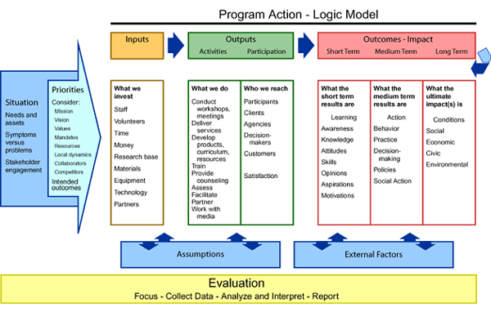
Logic Model Example
Notes:
Slide #48: Logic Model Example
Procedural Directions:
Briefly explain the example of the logic model on slide.
Presenter Notes:
Here is another example of a logic model.
It has the same categories as the last one of inputs, outputs, and outcomes.
There are other areas too. What are they? Why are they there?
Activities
Activity: Logic Model

Slide 52
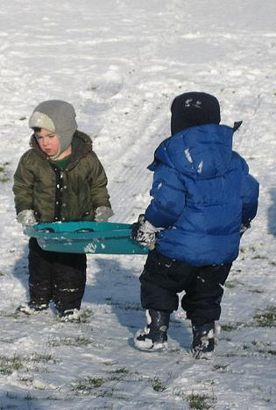
4. Collaboration
Members working together toward a common goal.
Helpful Tools:
    Agreed Upon Expectations
    On-going Communication and Networking
    Neutral Facilitator
    Meaningful Activities
    Focused Training and Technical Assistance
Notes:
Slide #49: Collaboration
Procedural Directions:
Share information from presenter notes.
Describe methods/tools of collaboration.
Presenter Notes:
Collaboration is when members of a group voluntarily bring their knowledge and experiences together to work toward a common goal. There are several ways to help encourage collaboration:
Agreed upon expectations which helps with cooperation and a positive working environment.
On-going communication and networking.
A neutral facilitator to help with group dynamics, especially if the members of the group have not worked together before.
Meaningful activities for all members
And focused training and technical assistance.
Activities

Slide 53
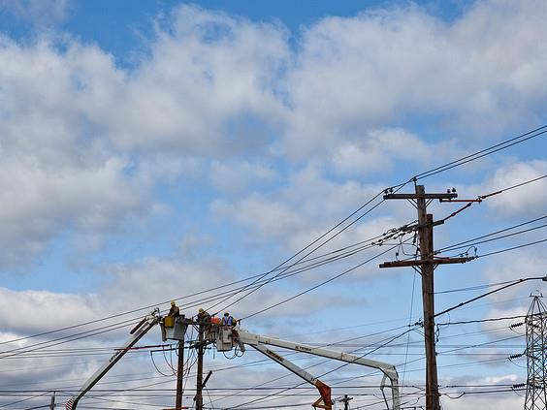
4. Collaboration
If you want to go fast,
go alone;
if you want to go far,
go together.
–African Proverb
Notes:
Slide #50: Collaboration
Procedural Directions:
Choral read proverb on slide.
Ask suggested question.
Provide personal example of experience that illustrates the message in the proverb.
Presenter Notes:
Read together: “If you want to go fast, go alone; if you want to go far, go together.” –African Proverb
Activities
Question: What is an experience you’ve had that illustrates the message in this proverb?

Slide 54

4. Collaboration
Benefits
More Involvement
Better Relationships
Greater Commitment
Better Communication
Notes:
Slide #51: Collaboration
Procedural Directions:
*Slide contains animation. Click for animation to appear.
Highlight benefits of collaboration.
Presenter Notes:
When a collaborative process is used, the benefits a group sees includes:
more involvement by its members
better communication
better relationships
greater commitment
Activities

Slide 55
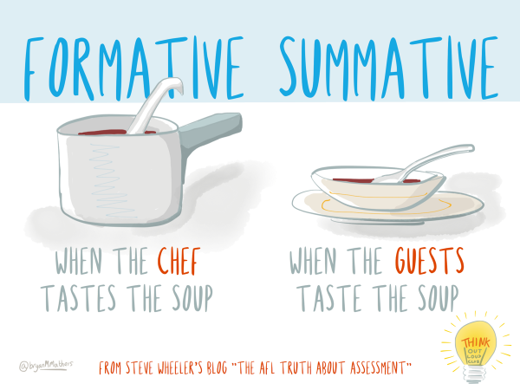
5. Evaluation
New information is compared to previously collected information
Helpful Types of Evaluation
Measure Final Results
Monitor Progress
Notes:
Slide #52: Evaluation
Procedural Directions:
Explain the difference between formative and summative evaluations.
Provide examples of each type of evaluation.
Presenter Notes:
After a group has begun collaborating and working together for a while, the members will need to revisit their plan to see if it is resulting in what they had hoped for. It may be necessary for the group to collect more information.
Evaluation is when the new information is compared to the information you already know.
There are two types of evaluation to discuss in the decision making process - formative and summative evaluations. What is the difference?
A formative evaluation is when the information is reviewed, usually in-house or with a small test group, during the plan so then the plan can be tweaked if needed. It is also known as to “monitor progress”.
A summative evaluation is done at the end of the plan to look at what has been accomplished. It is also known as “measure final results”.
Another way of looking at it is: "When the cook tastes the soup, that’s formative; when the guests taste the soup, that’s summative.” -quote by Robert Stakes.
Activities

Slide 56

6. Process for Reaching Agreement
Voting
  Robert’s Rules of Order
    A structured process
    Making and Passing Motions
Consensus
  Discussion continues until all mutually agree
  Every member shares
  Key is compromise
Notes:
Slide #53: Process for Reaching Agreement
Procedural Directions:
Share information from the presenter notes.
Define Robert’s Rules of Order and the processes used in reaching consensus.
Lead a review of terms and activity in activity/handout on Robert’s Rules of Order.
Presenter Notes:
Sometimes one of the most difficult tasks for groups is reaching agreement on an issue.
Parliamentary procedures may be used by groups to establish a process for managing discussions and reaching agreement.
Voting is one way and the most formal way to reach agreement.
Using Robert’s Rules of Order is a tool that provides structure to the voting process.
A majority of members must vote in favor for the motion to pass.
Meeting minutes typically document the decision-making process.
Another way groups create agreement is through consensus.
Consensus is when the whole group comes to a mutual agreement.
It is true compromise and can be a complicated, lengthy, yet rewarding process.
Consensus does not necessarily mean that everyone has gotten exactly the outcome they were desiring, but instead that an outcome was reached which is acceptable to everyone.
Consensus does have one advantage.
It has the potential to strengthen group relationships. In true consensus, the key is compromise. It involves combining proposals to achieve a better overall position that has more support.
Activities
Activity/Handout: Robert’s Rules of Order

Slide 57

Tips to Help YOU Personally be Effective
  Organize your information
  Keep in mind the group’s goals
  List priorities
  Keep track of where others stand on decisions
  Ask the leader to explain member roles
  Take notes
  Write down the results of your activities
Notes:
Slide #54: Tips to Help be Effective
Procedural Directions:
Share information from the presenter notes and slide.
Presenter Notes:
Even if the group has not found a process, you can!
All good processes are really just a plan for staying organized, taking action, and planning for the next steps.
Here are tips that may help you personally be effective. <read slide>
Activities

Slide 58
Section 3 Resources
Conducting a Focus Group (video 5:36) https://www.youtube.com/watch?v=Auf9pkuCc8k
3 Brainstorming Techniques that Work (video 3:12) https://www.youtube.com/watch?v=jNFBoBAAYuw
How to Write a Vision Statement (video 5:35) https://www.youtube.com/watch?v=ioY-YSOKBtY
Visioning: Free Guide to Create a Clear Vision https://onstrategyhq.com/resources/video-how-to-write-a-vision-statement/
How to Write a Mission Statement (video 4:04) https://www.youtube.com/watch?v=XtyCt83JLNY
Mission Statements http://www.missionstatements.com/
Difference Between Mission & Vision Statement (video 5:14) https://www.youtube.com/watch?v=DzhJNiQ3vMM
Logic Models: Tool for Effective Program Planning, Evaluation, & Monitoring https://www2.ed.gov/about/offices/list/oese/oss/technicalassistance/easnlogicmodelstoolmonitoring.pdf
Notes:
Slide #55: Section 3 Resources
Procedural Directions:
Highlight 1 or 2 online resources listed on the slide.
Have one or two web links accessible and ready to show.
Presenter Notes:
Conducting a Focus Group (video 5:36) https://www.youtube.com/watch?v=Auf9pkuCc8k
3 Brainstorming Techniques that Work (video 3:12) https://www.youtube.com/watch?v=jNFBoBAAYuw
How to Write a Vision Statement (video 5:35) https://www.youtube.com/watch?v=ioY-YSOKBtY
Visioning: Free Guide to Create a Clear Vision https://onstrategyhq.com/resources/video-how-to-write-a-vision-statement/
How to Write a Mission Statement (video 4:04) https://www.youtube.com/watch?v=XtyCt83JLNY
Mission Statements http://www.missionstatements.com/
Difference Between Mission & Vision Statement (video 5:14) https://www.youtube.com/watch?v=DzhJNiQ3vMM
Logic Models: Tool for Effective Program Planning, Evaluation, & Monitoring https://www2.ed.gov/about/offices/list/oese/oss/technicalassistance/easnlogicmodelstoolmonitoring.pdf
Activities
Handout: Guidebook Sectional Resource List

Slide 59
Section 3 Resources
OSEP Logic Model & Conceptual Framework https://osepideasthatwork.org/sites/default/files/documents/ConceptFrmwrkLModel+Defs2012.pdf
S.M.A.R.T. Goals (video 3:57) https://www.youtube.com/watch?v=1-SvuFIQjK8
WI Personnel Development Model https://dpi.wi.gov/sites/default/files/imce/sped/pdf/wpdmtools.pdf
How to Make an Action Plan (video 3:12) https://www.youtube.com/watch?v=lwoVRVgKg-o
The Easy Guide to Developing an Action Plan https://creately.com/blog/diagrams/how-to-write-an-action-plan/
Leading by Convening http://servingongroups.org/leading-by-convening
Creating Agreement: Educators & Parents Working Together https://dpi.wi.gov/sped/topics/agreement
Proposal-based Decision Making (Video 3:43) https://www.youtube.com/watch?v=-SYTkMv1J-E&feature=youtu.be
Robert’s Rules of Order http://www.robertsrules.com/
Program Evaluation (video 17:03) https://www.youtube.com/watch?v=6ZEYgEv7EL4
Notes:
Slide #55: Section 3 Resources
Procedural Directions:
Highlight 1 or 2 online resources listed on the slide.
Have one or two web links accessible and ready to show.
Presenter Notes:
OSEP Logic Model & Conceptual Framework https://osepideasthatwork.org/sites/default/files/documents/ConceptFrmwrkLModel+Defs2012.pdf
S.M.A.R.T. Goals (video 3:57) https://www.youtube.com/watch?v=1-SvuFIQjK8
WI Personnel Development Model https://dpi.wi.gov/sites/default/files/imce/sped/pdf/wpdmtools.pdf
How to Make an Action Plan (video 3:12) https://www.youtube.com/watch?v=lwoVRVgKg-o
The Easy Guide to Developing an Action Plan https://creately.com/blog/diagrams/how-to-write-an-action-plan/
Leading by Convening http://servingongroups.org/leading-by-convening
Creating Agreement: Educators & Parents Working Together https://dpi.wi.gov/sped/topics/agreement
Proposal-based Decision Making (Video 3:43) https://www.youtube.com/watch?v=-SYTkMv1J-E&feature=youtu.be
Robert’s Rules of Order http://www.robertsrules.com/
Program Evaluation (video 17:03) https://www.youtube.com/watch?v=6ZEYgEv7EL4
Activities
Handout: Guidebook Sectional Resource List

Slide 60
Serving on Groups
That Make Decisions:
A Guide for Families
Presented by:
Name
Organization/Agency
www.servingongroups.org
Notes:
Slide #56: Welcome and Introduction
Procedural Directions:
Have a copy of the Guidebook and the Training manual with you.
Make sure everyone has the materials needed for the presentation.
Ask if everyone can hear you and see the slides.
Introduce yourself and give a brief background of your experience (relevant to the group you are speaking to).
Address “housekeeping” such as restrooms, breaks, “parking lot”, group transitions, etc.
Presenter Notes:
Hello and welcome to this Serving on Groups that Make Decisions: A Guide for Families training.
My name is __insert name___ and I am the ___insert position__at _insert location__.
*Give a brief background of your experience (relevant to the group you are speaking to).
Activities

Slide 61

Section 4:
Tools Groups Use
What are helpful tools groups use?
Meeting Facilitator/Leader
Ground Rules
Agenda
Meeting Minutes
Written Guidance
Open & Closed Sessions
Notes:
Slide #57: Section 4 Introduction
Procedural Directions:
Share information from the presenter notes.
If participants have a copy of the Guidebook, guide them to the appropriate section.
Presenter Notes:
In this section about the tools groups use, we really get into the nuts and bolts of how groups operate.
Here is a list of tools groups use.
In the following slides, we will discuss these tools in further detail.
Activities

Slide 62

Meeting Facilitator/Leader
  Keeps discussions on track and on time
  Makes sure everyone is able to share
Ground Rules
  Creates an atmosphere where thoughts and perspectives can be openly shared
Notes:
Slide #58: Tools Groups Use
Procedural Directions:
Share information from the presenter notes.
Ask suggested activity question.
Presenter Notes:
A meeting facilitator/leader/chairperson keeps discussion going and makes sure everyone is able to share.
To facilitate a meeting, there are some common strategies good facilitators have. (Information also found in Section 8).
They make everyone feel comfortable and valued.
They encourage participation by all members.
They prevent or manage conflict.
They actively listen and observe the others in the group.
They ensure quality decisions are being made.
Finally, they make sure the meetings stay on track and the group is getting done what needs to be done.
Ground rules create an atmosphere where thoughts and perspectives can be openly shared.
Other terms for “ground rules” could include “working norms”, “group guidelines”, “group norms”, etc.
It is helpful if the groups agrees on the rules and reviews them and possibly posting them at the beginning of each meeting.
Members may need reminders about the ground rules throughout the meetings too.
Some examples of ground rules are:
speak openly and honestly
ask questions (sometimes families and others new to the group need that permission)
be additive, not repetitive
listen carefully and respectfully to each person (no sidebars)
keep comments brief and stay focused on task
turn cellphones to silent
start and end on time
explore differences respectfully and look for common ground
all shared information is confidential
Sometimes meetings are very formal and follow rules and procedures. Other meetings are very informal and may feel more like a conversation. It is important for groups to agree on how meetings will run.
Activities
Question: What ground rules are important to you?

Slide 63
Agenda
A roadmap for the meeting
Only include items to be discussed at the meeting
Created by leader or executive committee
The Opening
Welcome and introduce participants
Discussions & Decisions
Keep the group on task
The Conclusion
Identify next steps & future agenda items
Review and approve agenda
Review minutes from previous meeting
Assess the group’s interest level
Discuss old & new business
Provide feedback
Enforce ground rules
Evaluate the meeting
Set the tone and pace
Announcements
Make decisions
Notes:
Slide #59: Agenda
Procedural Directions:
Share information from the presenter notes.
Examples of a formal and informal agenda are found in the Guidebook on pages 27 and 28.
Presenter Notes:
An agenda is a roadmap for the meeting.
Agendas can be formal or informal and should only included items to be discussed at the meeting.
Agendas are created by the group’s leader or the executive (or steering) committee.
Many groups ask their members if they would like to add anything to the agenda before the meeting. This is a good way to put your topics or issues in front of the group.
Agendas are most useful if prepared in advance, preferably at least a few days before the meeting occurs.
They are also most useful if they are followed during the meeting!
The meeting facilitator follows the agenda and does the following activities:
During the opening, the facilitator will welcome participants and allow for introductions. They are responsible for setting the tone and pace of the meeting.
The middle part of the agenda is where discussion and decisions occur. The facilitator is responsible for keeping the group on task, assess the group's interest level, seek clarification of discussions and materials, provide feedback and enforce the ground rules. It is important to keep things moving along smoothly.
The conclusion of the meeting is usually a wrap up time where the group will identify next steps. This includes setting agenda items for the next meeting as well as a meeting date, time, and location.
Activities

Slide 64

Meeting Minutes
Summary of the meeting
Records decisions and actions
Typed and distributed
Previous meeting minutes may be approved at the next meeting
Reminder: Still take your own notes!
Notes:
Slide #60: Meeting Minutes
Procedural Directions:
*Slide contains animation. Click to emphasize reminder on slide.
Share information from the presenter notes.
An example of meeting minutes is found in the Guidebook on page 30.
Presenter Notes:
At each meeting someone should be responsible for taking the meeting minutes or informal notes.
They are the summary of what happened in the meeting and are the record of that meeting.
They record the decisions that were made and the actions to follow-up on.
One of your roles on a group will be to make sure that meeting minutes from the last meeting are accurate.
Between meetings the minutes are typed and distributed to the members of the group for their review.
At the beginning of each meeting, the previous meeting minutes will be reviewed.
Corrections or additions may be made and then the minutes are “approved”.
Groups that receive any type of government funding should make sure that their meeting minutes are made available to the public in some way.
Remember to still take your own notes of the meeting!
Activities

Slide 65

Meeting Time Management
If meetings continue to run over time, you may ask the group:
  Is the agenda too full?
  Do ground rules need to be established?
  Does there need to be a ‘time keeper’?
  Does more time need to be scheduled for meetings?
Notes:
Slide #61: Meeting Time Management
Procedural Directions:
Share information from the presenter notes and slide.
Presenter Notes:
If a meeting is running over the time limit, you could suggest that the topic be continued at the next meeting.
If meetings continue to run over time, you may ask the group:
Is the agenda too full?
Do ground rules need to be established?
Does there need to be a “time keeper”?
Does more time need to be scheduled for meetings?
Activities

Slide 66

Written Guidance
Helps individuals interact with the group
  May include:
      Bylaws
      Policies
      Procedures & Protocols
      Compacts
Notes:
Slide #62: Written Guidance
Procedural Directions:
Share information from the presenter slides.
Conduct suggested activity.
Presenter Notes:
Written guidance helps individuals know how to interact with the group.
All of the business your group does must conform with group's written guidance.
Written guidance may include the following.
Bylaws which are designed to help a group function in an orderly manner and can be considered the group's operating manual.
Policies differ from rules or laws. While laws can compel or prohibit a behavior, a policy typically guides actions toward those that are most likely to achieve a desired outcome.”. Robert's Rules of Oder for meetings is a policy.
Procedures and protocols are detailed, step-by-step instructions instructing how to complete a specific task. While policies describe the rules of an organization, a procedure describes in detail how a policy is translated into action. Both policies and procedures contribute to the overall efficiency and effectiveness of an organization by providing clearly written operational standards or guidelines. They are usually developed by those who oversee carrying out those decisions.
Compacts are like agreements. Groups can find it helpful to write a statement of common purpose, goals, and actions they will commit to. By writing the information down and having everyone sign the agreement, it becomes very clear how they will share the responsibility. Reviewing the compact will help keep the group focused and also helps them see what they have accomplished together.
Activities
Activity: Scavenger Hunt

Slide 67

Open vs. Closed
Open Meetings
  Open to ANYONE
  Public is invited to LISTEN to group’s discussion
  Public may share their views on the topics
    Refer to written guidance regarding public participation
Closed Sessions
  Used when not appropriate for non-members
  Topics that should be in closed sessions:
    Personnel Issues
    Confidential Information
Notes:
Slide #63: Open vs. Closed Meetings
Procedural Directions:
Share information from presenter notes and slides.
Presenter Notes:
Some groups are required to conduct their meetings openly. There are times, though, that a group may need to discuss issues privately.
Open meetings are open to anyone who wants to attend.
The public is invited to listen to the group’s discussion.
They MAY also be given an opportunity to share their views on topics during a scheduled public participation time (also known as public comment, citizen forum, or citizen input).
Open meetings build trust and credibility in your work as a group.
Closed sessions may be used by a group when it is not appropriate for the public or non-members to listen to discussion on an agenda item. There are certain topics that groups need to deal with in closed sessions. They are personnel issues and confidential information.
Meeting minutes should not detail closed session topics. Instead they may simply state that group went into closed session at, say, 3:30pm to discuss confidential information.
Activities

Slide 68

Common Reasons for Unproductive Meetings
  Participants aren’t prepared
  No agenda in advance
  Group doesn’t follow agenda
  Not everyone considers themselves “participants”
  Data is lacking or decisions made not based on data
  No action items are highlighted
  No timelines or deadlines
  No follow-ups
Notes:
Slide #64: Unproductive Meetings
Procedural Directions:
Share example from presenter notes of the MCI network study.
Allow time for participants to review the list of reasons for unproductive meetings.
Ask suggested activity question.
Presenter Notes:
Most professionals who meet on a regular basis admit to daydreaming (91%), missing meetings (96%) or missing parts of meetings (95%). A large percentage (73%) say they have brought other work to meetings and 39% say they have dozed during meetings. (A network MCI Conferencing White Paper, Meetings in America: A study of trends, costs and attitudes toward business travel, teleconferencing, and their impact on productivity (Greenwich, CT: INFOCOMM, 1998), 10.)
There are many reasons why meetings are unproductive.
Some common reasons are…
participants aren’t prepared the meeting,
an agenda isn’t given in advance,
the group doesn’t follow the agenda,
not everyone feels like their voices are being heard,
data is lacking or not used in making decisions,
no action items are given,
or if there are action items, no timelines, deadlines or follow-ups are set.
Activities
Question: Do any of these reasons for unproductive meetings resonate with you?

Slide 69
Section 4 Resources
How to Facilitate Your First Meeting (Video 6:07) https://www.youtube.com/watch?v=oPZJQ-Mhwq0
How to Run a Virtual Meeting (Video 5:07) https://www.youtube.com/watch?v=NPVTLroz2Ck
Ground Rules for Effective Meetings (Video 6:51) https://www.youtube.com/watch?v=Mm5YLxZrdgk
8 Ground Rules for Great Meetings https://hbr.org/2016/06/8-ground-rules-for-great-meetings
Mind Tools on problem solving, decision making, and practical creativity http://www.mindtools.com/pages/article/newTMC_00.htm
How To Write Minutes of Meeting Effectively https://www.lifehack.org/804185/meeting-minutes
How to Write a Good Board Report https://blog.joangarry.com/board-report-template/
Notes:
Slide #65: Section 4 Resources
Procedural Directions:
Highlight 1 or 2 online resources listed on the slide.
Have one or two web links accessible and ready to show.
Presenter Notes:
How to Facilitate Your First Meeting (Video 6:07) https://www.youtube.com/watch?v=oPZJQ-Mhwq0
How to Run a Virtual Meeting (Video 5:07) https://www.youtube.com/watch?v=NPVTLroz2Ck
Ground Rules for Effective Meetings (Video 6:51) https://www.youtube.com/watch?v=Mm5YLxZrdgk
8 Ground Rules for Great Meetings https://hbr.org/2016/06/8-ground-rules-for-great-meetings
Mind Tools on problem solving, decision making, and practical creativity http://www.mindtools.com/pages/article/newTMC_00.htm
How To Write Minutes of Meeting Effectively https://www.lifehack.org/804185/meeting-minutes
How to Write a Good Board Report https://blog.joangarry.com/board-report-template/
Activities
Handout: Guidebook Sectional Resource List

Slide 70
Section 4 Resources
Four Major Causes for Zoom Fatigue & Their Solutions https://www.forbes.com/sites/francesbridges/2021/03/30/stanford-researchers-identify-four-major-causes-for-zoom-fatigue-and-their-solutions/?sh=3b98d07157d7
Wisconsin’s Open Meetings Law https://www.doj.state.wi.us/sites/default/files/office-open-government/Resources/OML-GUIDE.pdf
Nonprofit Bylaws (Templates) https://form1023.org/how-to-draft-nonprofit-bylaws-with-examples
Why You Should Put Policies & Procedures in Writing https://www.mml.org/pdf/resources/publications/ebooks/GLV_Hamdbook_by_chapter/CH%2013%20Importance%20of%20Written%20Policies%20and%20Procedures%20x.pdf
Policies and Procedures http://www.mycommittee.com/BestPractice/Committees/Policiesandprocedures/tabid/248/Default.aspx
Policies & Procedures Handbook (Americorps Sample) https://www.americorps.gov/sites/default/files/document/Member%20Handbook-2021_10.28.21_1.pdf
Mind Tools http://www.mindtools.com/pages/article/newTMC_00.htm
Notes:
Slide #65: Section 4 Resources
Procedural Directions:
Highlight 1 or 2 online resources listed on the slide.
Have one or two web links accessible and ready to show.
Presenter Notes:
Four Major Causes for Zoom Fatigue & Their Solutions https://www.forbes.com/sites/francesbridges/2021/03/30/stanford-researchers-identify-four-major-causes-for-zoom-fatigue-and-their-solutions/?sh=3b98d07157d7
Wisconsin’s Open Meetings Law https://www.doj.state.wi.us/sites/default/files/office-open-government/Resources/OML-GUIDE.pdf
Nonprofit Bylaws (Templates) https://form1023.org/how-to-draft-nonprofit-bylaws-with-examples
Why You Should Put Policies & Procedures in Writing https://www.mml.org/pdf/resources/publications/ebooks/GLV_Hamdbook_by_chapter/CH%2013%20Importance%20of%20Written%20Policies%20and%20Procedures%20x.pdf
Policies and Procedures http://www.mycommittee.com/BestPractice/Committees/Policiesandprocedures/tabid/248/Default.aspx
Policies & Procedures Handbook (Americorps Sample) https://www.americorps.gov/sites/default/files/document/Member%20Handbook-2021_10.28.21_1.pdf
Mind Tools http://www.mindtools.com/pages/article/newTMC_00.htm
Activities
Handout: Guidebook Sectional Resource List

Slide 71
Serving on Groups
That Make Decisions:
A Guide for Families
Presented by:
Name
Organization/Agency
www.servingongroups.org
Notes:
Slide #66: Welcome and Introduction
Procedural Directions:
Have a copy of the Guidebook and the Training manual with you.
Make sure everyone has the materials needed for the presentation.
Ask if everyone can hear you and see the slides.
Introduce yourself and give a brief background of your experience (relevant to the group you are speaking to).
Address “housekeeping” such as restrooms, breaks, “parking lot”, group transitions, etc.
Presenter Notes:
Hello and welcome to this Serving on Groups that Make Decisions: A Guide for Families training.
My name is __insert name___ and I am the ___insert position__at _insert location__.
*Give a brief background of your experience (relevant to the group you are speaking to).
Activities

Slide 72
Section 5:
Tips & Strategies for Groups
What makes effective meetings?
What improves group dynamics?
What is two-way communication?
Notes:
Slide #67: Section 5 Introduction
Procedural Directions:
Share information from the presenter notes.
If participants have a copy of the Guidebook, guide them to the appropriate section.
Presenter Notes:
Effective groups use a variety of strategies to promote positive group dynamics and communication to help the group work better. Some of these strategies may be new to you. In this section, we will discuss a number of tips and strategies that groups might use.
Activities

Slide 73

Tips for Effective Meetings
Be prepared as a group
Start and end on time
Have the information needed to make decisions
Make sure you are not missing someone who is critical to the discussion
Follow a meeting agenda
Notes:
Slide #68: Effective Meeting Tips
Procedural Directions:
Highlight one or two tips from the slide and allow time for participants to review the list of tips.
Presenter Notes:
Here are some tips for effective meetings.
Be prepared as a group – have an agenda prepared ahead of time, send the agenda to all group members prior to the meeting, and ensure that everyone is present and ready
Start and end on time so as to be respectful of everyone’s time.
Have the information needed to make decisions. Share the information and data with the group in advance of the meeting as much as possible so that members have an opportunity to review in their own way.
Make sure you are not missing someone who is critical to the discussion. Are the people there that are needed to make the decisions a reality? Ask “Who is missing?”
Follow a meeting agenda. It keeps the meeting on track.
Activities

Slide 74

Improve
Group Dynamics
Internal group strategies can include:
  Have members get to know one another
    Share experiences & opportunities
    Use “ice breakers”
    Allow time for cultural connections
  An orientation for new members
  A refresher for all current members
  Provide training & mentorship
  Give group’s background information & history
Notes:
Slide #69: Internal Group Dynamics
Procedural Directions:
Explain the internal strategies and provide examples.
Presenter Notes:
Internally effective strategies focus on how to make the group itself function most effectively and improve group dynamics.
Strategies can include:
providing time for members to share their experiences,
playing universally accepted “ice breakers”,
allowing time for cultural connections,
providing an orientation for new members and a refresher for current members
providing on-going training & mentorship,
giving background information & history of the group,
Activities

Slide 75
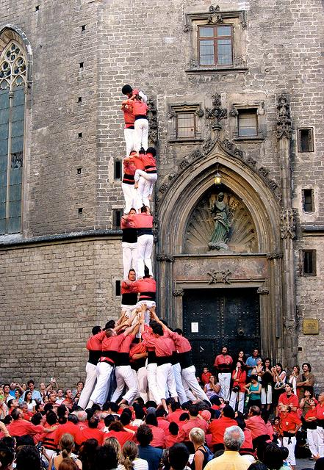
Alone we can do so little;
together we can do so much.
-Helen Keller
Notes:
Slide #70: Quote
Procedural Directions:
Share Helen Keller quote.
Presenter Notes:
Read quote “Alone we can do so little; together we can do so much.”
What is needed to be able to work with others?
Activities

Slide 76

Two-Way
Communication
External strategies can include:
Family surveys
Family centers in the community or school
Town meetings
Public listening sessions
‘Breakfast with the Principal or Policymaker’
Notes:
Slide #71: Two-Way Communication
Procedural Directions:
Explain the external strategies and provide examples.
Presenter Notes:
Externally effective strategies concentrate on how to build effective practices with the individuals who will be most affected by the decisions of the group. Strategies can include:
parent surveys,
family centers in the community or school,
town meetings,
public listening sessions,
‘Breakfast with the Principal or Policymaker’
When speaking to external groups, one needs to be careful not to appear to be “speaking on behalf” of a group.
Activities

Slide 77
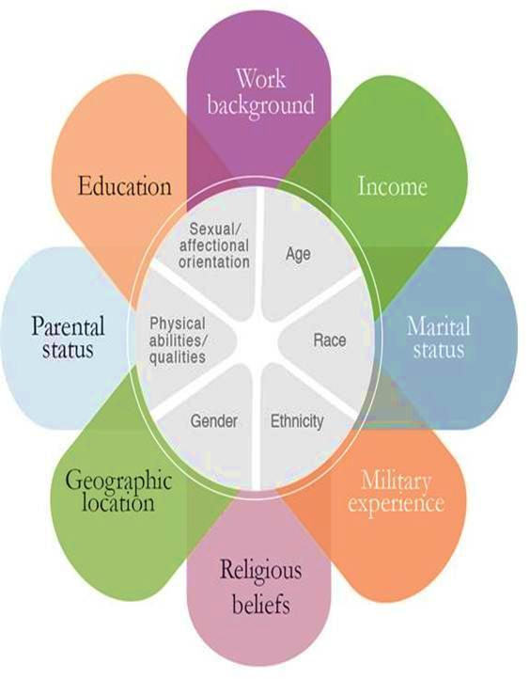
What is culture?
A way of life by a group of people
Equity Alliance at ASU
Notes:
Slide #72: Culture Diagram
Procedural Directions:
*Slide contains animation. Click to make culture definition appear.
Highlight components of the diagram (inner ring and outer petals).
Ask suggested activity question after explanation of diagram.
Presenter Notes:
What is Culture? Some definitions of culture are:
The characteristics of a particular group of people, defined by everything from language, religion, cuisine, social habits, music and arts
(http://www.livescience.com/21478-what-is-culture-definition-of- culture.html)
The customary beliefs, social forms, and material traits of a racial, religious, or social group
The characteristic features of everyday existence; a way of life shared by people in a place or time
(http://www.merriam-webster.com/dictionary/culture)
Each one of us brings our own culture to a situation or group.
The inner ring of the diagram illustrates the things that are typically more of a permanent or unchanging part of who you are. There are examples that can be given that can debate some of those, but overall you can’t change your age (though you may say you are a different age than what you are).
The outer petals on the diagram are more of the changing state of who you are. Think of how much has changed in your life in the last ten years.
All of this makes up who you are, who I am, and who each parent is. Along with encouraging family engagement activities, we need to be aware that every family is unique and comes with a different cultural background.
Activities
Suggested:
Question: What changes in your life have impacted who you are today from who you were 10 years ago?
Activity Handout: Cultural Competency & Cultural Humility

Slide 78

Culturally Responsive Family Engagement
Latino Learning Modules “What is Culture?”
https://www.youtube.com/watch?v=15jdTQIr7j4
Notes:
Slide #73: Culturally Responsive Family Engagement Video Clip
Procedural Directions:
Watch video clip. Play 1:39 to 3:26. Make your computer is connected to speakers or an audio system. https://www.youtube.com/watch?v=15jdTQIr7j4
Presenter Notes:
Culture is so much more than what is on the surface.
Reflect for a moment on your own culture. What is something understood but not on the surface?
Activities

Slide 79
Cultural Competency &
Cultural Humility
Cultural Competency can include:
mandates
laws
rules
policies
standards
practices
attitudes
Cultural Humility
is a process and a lifelong commitment to self-evaluation and critique to improve
relationships and
outcomes.
Notes:
Slide #74: Cultural Competency & Cultural Humility
Procedural Directions:
Share information from the presenter notes.
Ask suggested activity question.
Lead suggested activity.
Presenter Notes:
Cultural competency really started out by looking at how service providers worked with clients. Many of you might have been in other cultural competency courses, as many people started to go through classes that tried to help them master others’ cultures.
This doesn’t really work for two reasons—it’s impossible to master every other culture and this can also lead to stereotypes.
So standards of cultural competency have been helpful in many ways as mentioned on the slide, but it’s lacking in other areas. People were taking cultural competency classes that tried to help them master others’ cultures.
This doesn’t really work for two reasons—it’s impossible to master every other culture and this can also lead to stereotypes.
This is where “cultural humility” comes in.
Cultural humility is a lifelong commitment to self-evaluation and self-critique an developing beneficial and non-paternalistic relationships.
It includes:
addressing power relations
and working in partnerships
Activities
Question: How does cultural competency and/or cultural humility play a role in your personal and professional life?
Activity: Proverbs – We’re More Alike Than Different

Slide 80

Understand
Cultural Norms
Keep learning about the unique cultural values and beliefs of all members
Recognize and honor racial and ethnic variations
Provide trained interpreters
Limit the use of jargon
Encourage members to mentor one another
Utilize cultural liaisons
Notes:
Slide #75: Understand Cultural Norms
Procedural Directions:
Highlight strategies for cultural norms.
Complete suggested activity.
Presenter Notes:
So to understand cultural norms and increase the participation of families from all diverse backgrounds, here are some strategies.
Keep learning about the unique cultural values and beliefs of ALL members of the group and the communities the group is serving. Remember, there should be representation and/or considerations of all demographic groups within a community.
Take time to recognize and honor racial and ethnic variations
Provide trained interpreters
Limit the use of jargon
Encourage members to mentor each other to build skills and confidence
Utilize cultural liaisons to help inform the group as well as connect people in the community to the work of the group
Activities
Question: What are some additional ideas or strategies to increase participation from diverse communities?

Slide 81
Section 5 Resources
10 Tips for Conducting Effective Meetings https://getlighthouse.com/blog/tips-conducting-effective-meetings/
How to Run Effective Virtual Meetings https://www.mindtools.com/pages/article/running-effective-virtual-meetings.htm
10 Conversations Leaders Use to Move Results Forward (Annie E. Casey Foundation Video 6:00) https://www.youtube.com/watch?v=JfHfKok9rkY&feature=youtu.be
Leading for Results: High Action – High Alignment (Video 4:00) https://www.youtube.com/watch?v=tegofDl6Jg8&feature=youtu.be
Leading for Results: Creating the Container (Annie E. Casey Foundation Video 2:43) https://www.youtube.com/watch?v=78B-LUpNrPg&feature=youtu.be
Facilitating Groups to Drive Change https://www.imd.org/uupload/research/challenges/TC069_08_Facilitating_groups_to_drive_change.pdf
Effective Meeting Participation for Family Advisors http://www.wsha.org/wp-content/uploads/SeattleChildrens_EffectiveMeetingParticipationforFamilyAdvisors.pdf
Meetings: How Should I Participate? (Video 2:25) https://www.youtube.com/watch?v=H2IegZRo2sw
Notes:
Slide #76: Section 5 Resources
Procedural Directions:
Highlight 1 or 2 online resources listed on the slide.
Have one or two web links accessible and ready to show.
Presenter Notes:
10 Tips for Conducting Effective Meetings https://getlighthouse.com/blog/tips-conducting-effective-meetings/
How to Run Effective Virtual Meetings https://www.mindtools.com/pages/article/running-effective-virtual-meetings.htm
10 Conversations Leaders Use to Move Results Forward (Annie E. Casey Foundation Video 6:00) https://www.youtube.com/watch?v=JfHfKok9rkY&feature=youtu.be
Leading for Results: High Action – High Alignment (Video 4:00) https://www.youtube.com/watch?v=tegofDl6Jg8&feature=youtu.be
Leading for Results: Creating the Container (Annie E. Casey Foundation Video 2:43) https://www.youtube.com/watch?v=78B-LUpNrPg&feature=youtu.be
Facilitating Groups to Drive Change https://www.imd.org/uupload/research/challenges/TC069_08_Facilitating_groups_to_drive_change.pdf
Effective Meeting Participation for Family Advisors http://www.wsha.org/wp-content/uploads/SeattleChildrens_EffectiveMeetingParticipationforFamilyAdvisors.pdf
Meetings: How Should I Participate? (Video 2:25) https://www.youtube.com/watch?v=H2IegZRo2sw
Activities
Handout: Guidebook Sectional Resource List

Slide 82
Section 5 Resources
Attending Meetings: Making an Effective Meeting Contribution (Video 10:43) https://www.youtube.com/watch?v=VPhN3R4kOlY
10 Effective Meeting Icebreakers https://www.smartmeetings.com/tips-tools/96478/10-engaging-meeting-icebreakers
Interactive Group Activities for Special Ed. Advisory Committee Meetings https://www.pacer.org/parent/pdf/InteractivegroupactivitiesforSEACmeetings.pdf
Leading by Convening https://servingongroups.org/leading-by-convening
Template for a Great Board Orientation https://blog.joangarry.com/board-orientation-template/
National Center for Family & Community Connections with Schools https://sedl.org/connections/
What is Culture? From Latino Learning Modules: Latino Culture and Cultural Values (Video 1:39-3:26) https://www.youtube.com/watch?v=15jdTQIr7j4
A Fresh Look at Diversity and Boards https://blueavocado.org/board-of-directors/a-fresh-look-at-diversity-and-boards/?highlight=Diversity%20and%20the%20Nonprofit%20Ecosystem
Community Development: Strategies that Serve https://blueavocado.org/leadership-and-management/community-development-strategies-that-serve/
Notes:
Slide #76: Section 5 Resources
Procedural Directions:
Highlight 1 or 2 online resources listed on the slide.
Have one or two web links accessible and ready to show.
Presenter Notes:
Attending Meetings: Making an Effective Meeting Contribution (Video 10:43) https://www.youtube.com/watch?v=VPhN3R4kOlY
10 Effective Meeting Icebreakers https://www.smartmeetings.com/tips-tools/96478/10-engaging-meeting-icebreakers
Interactive Group Activities for Special Ed. Advisory Committee Meetings https://www.pacer.org/parent/pdf/InteractivegroupactivitiesforSEACmeetings.pdf
Leading by Convening https://servingongroups.org/leading-by-convening
Template for a Great Board Orientation https://blog.joangarry.com/board-orientation-template/
National Center for Family & Community Connections with Schools https://sedl.org/connections/
What is Culture? From Latino Learning Modules: Latino Culture and Cultural Values (Video 1:39-3:26) https://www.youtube.com/watch?v=15jdTQIr7j4
A Fresh Look at Diversity and Boards https://blueavocado.org/board-of-directors/a-fresh-look-at-diversity-and-boards/?highlight=Diversity%20and%20the%20Nonprofit%20Ecosystem
Community Development: Strategies that Serve https://blueavocado.org/leadership-and-management/community-development-strategies-that-serve/
Activities
Handout: Guidebook Sectional Resource List

Slide 83
Serving on Groups
That Make Decisions:
A Guide for Families
Presented by:
Name
Organization/Agency
www.servingongroups.org
Notes:
Slide #77: Welcome and Introduction
Procedural Directions:
Have a copy of the Guidebook and the Training manual with you.
Make sure everyone has the materials needed for the presentation.
Ask if everyone can hear you and see the slides.
Introduce yourself and give a brief background of your experience (relevant to the group you are speaking to).
Address “housekeeping” such as restrooms, breaks, “parking lot”, group transitions, etc.
Presenter Notes:
Hello and welcome to this Serving on Groups that Make Decisions: A Guide for Families training.
My name is __insert name___ and I am the ___insert position__at _insert location__.
*Give a brief background of your experience (relevant to the group you are speaking to).
Activities

Slide 84
Section 6:
Using Data as Information
What is data?
How can I learn more about data that groups use?
What are the stages of data use?
Notes:
Slide #78: Section 6 Introduction
Procedural Directions:
Share information from the presenter notes.
If participants have a copy of the Guidebook, guide them to the appropriate section.
Presenter Notes:
All groups use data. This section will be an introduction to understanding data as information within decision-making groups.
We will go through the eight stages of data use.
There are a lot of different terms used in talking about data. Some may be new to you. So let's get started.
Activities

Slide 85

What is Data?
Data…
Is factual information
Helps groups make decisions
Must be:
  Reliable
  Valid
  Accessible
Notes:
Slide #79: What is Data?
Procedural Directions:
Share information from the presenter notes.
Presenter Notes:
What is Data? Data is, most simply, factual information.
Now think about times when you’ve come across sources of data that are confusing and hard to understand? How did you deal with it? These are points to consider when we discuss understanding data in decision-making groups.
When decision-making groups use data to make decisions, they are basing their decisions on facts, not guesswork or feelings. This is called “Data Based Decision Making”.
Data doesn’t just apply to more formal decision-making groups. It is used by all kinds of groups and can come in many different forms.
Reliable means the data is accurate and true every time. Would it be the same if someone else collected the data?
Valid means the data reflects a truth and produces the desired result. In other words, does the data measure what it claims to measure?
Data also needs to be accessible. All concerns, needs, and abilities of the audience need to be considered when using data.
Reliability problems in education often arise when researchers overstate the importance of data drawn from too small or too restricted a sample.
For example, imagine if when I was a high school principal I claimed to the school board that I had evidence that the parents love our school's programs. When the board chair asked me how I could make such a claim, I responded by defensively asserting it was a conclusion based on “hard data”—specifically, a survey taken at the last winter band banquet. The board chair might respond that because that event was attended by only 5 percent of the school's parents and all the parents who attended had one thing in common—they had children in band—my conclusions were “unreliable.” He would be right. Claiming that such a small and select sample accurately represented the views of a total population (all the school's parents) stretches the credibility of my assertion well beyond reasonableness.
Activities

Slide 86

Confidentiality
A set of rules or a promise
Limit access or put restrictions on certain types of information
When working with data as a group, it is important to state if certain information should not be shared with others outside of the group.
Notes:
Slide #80: Confidentiality
Procedural Directions:
Share information from the presenter notes.
Presenter Notes:
Confidentiality is a set of rules or a promise that a person makes to limit access or put restrictions on certain types of information.
When working with data as a group, it is important to always state if certain information should stay in the group and not be shared with others.
Activities

Slide 87

Forms of Data
Quantitative Data
Typically numbers
Answers the questions:
  How much? How often? When? Where?
Qualitative Data
Typically descriptions
Answers the questions:
  What is it like? What do you observe about it?
Notes:
Slide #81: Quantitative vs. Qualitative Data
Procedural Directions:
Share information from the presenter notes.
Share examples of quantitative and qualitative data.
Presenter Notes:
Examine the differences between qualitative and quantitative data.
Quantitative Data deals with numbers.
It is data which can be measured.
Length, height, area, volume, weight, speed, time, temperature, humidity, sound levels, cost, members, ages, etc.
Quantitative → Quantity
Qualitative Data deals with descriptions.
Data can be observed but not measured.
Colors, textures, smells, tastes, appearance, beauty, etc.
Qualitative → Quality
For example, when we think of weather, quantitative data would be the exact temperature, barometric pressure, and wind speed.
The qualitative data can be a bit more subjective. Is it partly cloudy? Windy or calm? Cool or warm? It describes what is observed or felt.
Activities

Slide 88
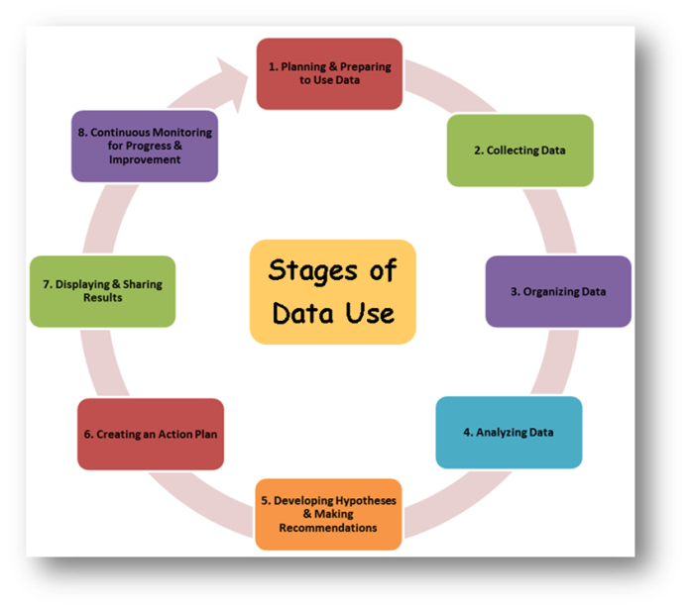
Stages of Data Use
Planning & Preparing to Use Data
Collecting Data
Organizing Data
Analyzing Data
Developing Hypotheses & Making Recommendations
Creating an Action Plan
Displaying & Sharing Results
Continuous Monitoring for Progress & Improvement
Notes:
Slide #82: Introduction to Stages of Data Use
Procedural Directions:
Briefly introduce the eight stages of data use.
Presenter Notes:
Using data in a decision-making group is a process with multiple steps or stages.
These eight stages help make sure a decision-making group is effectively using data to inform its decisions.
The following slides describe each of the eight stages decision-making groups are in when they use data to help make decisions and take action.
Activities

Slide 89
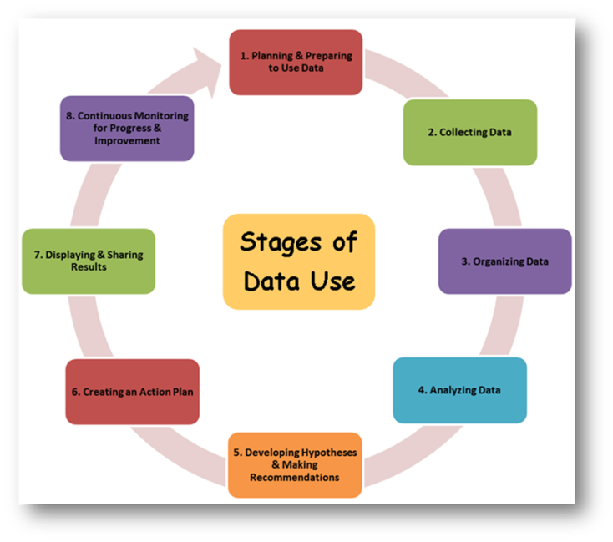

Stages of Data Use
Planning & Preparing to Use Data
Collecting Data
Organizing Data
Analyzing Data
Developing Hypotheses & Making Recommendations
Creating an Action Plan
Displaying & Sharing Results
Continuous Monitoring for Progress & Improvement
Notes:
Slide #83: Introduce Stage 1 of Data Use
Procedural Directions:
*Slide contains animation. Click for animation to appear.
Share information from the presenter notes.
Presenter Notes:
The first step in working with data is to plan and prepare by asking questions.
The group needs to reflect and plan before the data are collected.
Activities

Slide 90

Stage 1:
Planning & Preparing to Use Data
What do we want to know?
Tips
  Ask focusing questions
  Use a variety of methods & sources
  Find data already out there - baseline
  Try to find gaps
  Pinpoint possible roadblocks
  Ask others knowledgeable of the data
Notes:
Slide #84: Stage 1 of Data Use
Procedural Directions:
Share information from the presenter notes.
Presenter Notes:
All data planning should start with the question, "What do we want to know?" This helps to focus the data search and keeps the group on track.
Selecting or collecting data is not always about finding new data.
The group needs to look at what data they already have and what data they need. More often groups spend time trying to find the right data.
Ask focusing questions that help pinpoint the information that you need to be able to make an informed decision and take action.
Use a variety of methods & sources to select data. You will want to have multiple sources of data to inform your decisions.
Find out what data is already out there to use. What is the baseline?
Try to find gaps in information found in the current data.
Pinpoint possible roadblocks in finding information and figure out how to overcome them.
Ask school staff familiar with data to explain what the school or district knows. Have them also share areas where there is not enough data to make a hypothesis.
Activities

Slide 91
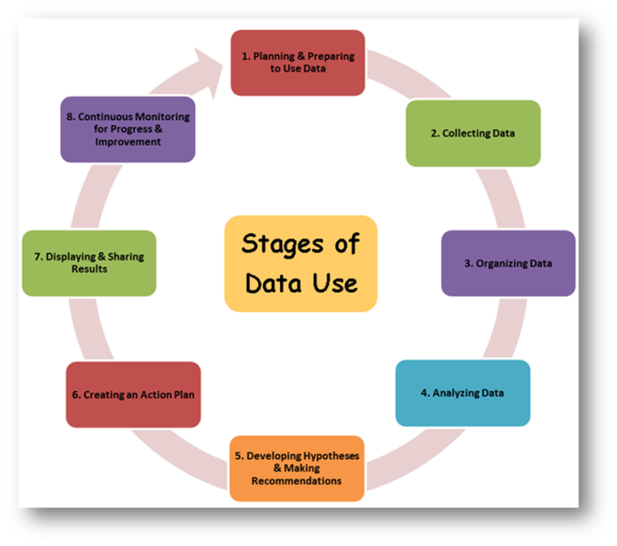
Stages of Data Use
Planning & Preparing to Use Data
Collecting Data
Organizing Data
Analyzing Data
Developing Hypotheses & Making Recommendations
Creating an Action Plan
Displaying & Sharing Results
Continuous Monitoring for Progress & Improvement
Notes:
Slide #85: Introduce Stage 2 of Data Use
Procedural Directions:
*Slide contains animation. Click for animation to appear.
Share information from the presenter notes.
Presenter Notes:
The next step in working with data is to collect it. Data should be collected for a specific reason or purpose relevant to the work of the group.
Groups can collect data themselves or use data that someone else has collected.
The question a group needs to answer when collecting data is “How do I find the data –both new and existing -that I need?”
Groups should only collect data they will use.
Too much information can be overwhelming. Too little information won't help the group find the answers they're looking for.
Activities

Slide 92
Stage 2: Collecting Data
Answer questions to make an informed decision and act.
Data from Schools
Student Learning Data
School Perception Data
Families as a Data Source
Surveys
Participants or Attendees
Focus Groups
Student Demographic Data
School Process Data
School Perception Data
Notes:
Slide #86: Stage 2 of Data Use
Procedural Directions:
Share information from the presenter notes and slide.
Presenter Notes:
Schools are full of data. For example there is:
Student learning data is about the school work and assessments of individual students.
Student demographic data are the personal factors about each student.
School perception data is information about the school based on views of school staff, parents, and the community.
School process data provide information about school management, administration, structure and general workings of the school.
Ways Schools Can Use Families as a Source of Data
Surveys
Focus groups
Participants/attendees
From School Perception Data
It is important for schools to communicate to families why they are collecting data provided by families and what schools will do with the data.
Activities

Slide 93

Stages of Data Use
Planning & Preparing to Use Data
Collecting Data
Organizing Data
Analyzing Data
Developing Hypotheses & Making Recommendations
Creating an Action Plan
Displaying & Sharing Results
Continuous Monitoring for Progress & Improvement
Notes:
Slide #87: Introduce Stage 3 of Data Use
Procedural Directions:
*Slide contains animation. Click for animation to appear.
Share information from the presenter notes.
Presenter Notes:
The third step in working with data is to organize it in a way that helps others to understand it.
Data is organized for different purposes. Finding the right way to organize data should depend on both your audience and the data you’re trying to present.
Activities

Slide 94
Stage 3: Organizing Data
Aggregated Data:
a whole set of data formed by combining several parts
Disaggregated Data:
a whole set of data separated into its categories or subgroups
Notes:
Slide #88: Aggregated & Disaggregated Data
Procedural Directions:
Share information from the presenter notes.
Presenter Notes:
Groups may look data that is aggregated and/or disaggregated.
Aggregated Data
Most data is first shown as aggregated data. When you aggregate data, you total all the data from the whole group which gives you the big picture. For example, teachers aggregate data to get an overall picture of their classes. This “big picture” view of data is especially useful in sharing information with audiences such as your governing body. Aggregated data is also appropriate for annual reports to the public.
Disaggregated Data
A group may want to disaggregate data. This means looking at results or scores from the whole or larger group and breaking it down by smaller groups to get more and more details.
When you disaggregate data, you can dig deeper and deeper. You can disaggregate district-wide data by school, school data by grade, grade-level data by classroom, and classroom data by child.
You can disaggregate five-year data by year, yearly data by month, and monthly data by week. Each time, you get a better look of one part of data.
Sometimes disaggregated data can surprise you. Disaggregated data can help you decide on and prioritize your action plans.
Activities

Slide 95
Stage 3: Organizing Data
Triangulated Data:
Use of multiple independent sources of data to establish the truth & accuracy of a claim.
College Admissions
Essay
Extracurricular Activities
High School Grades
Interview
ACT/SAT Scores
Application
References
Notes:
Slide #89: Triangulated Data
Procedural Directions:
Share information from the presenter notes.
Presenter Notes:
Groups may look data that is triangulated.
Triangulated data means that the group looks at, or compares, three or more different sources of data that applies to the same person, place, object, or subject. They do this to see if the information from one source is supported by other sources. Comparing data from different sources also can provide insights.
For example, a college admission process wants to see the whole picture of the student.
It answers the questions: Is this student ready to be successful in college? At our college? How do we know?
Data includes not just the grade point average from high school but also listing the volunteer and extracurricular activities, an essay, application form, references, interview, etc.
Activities

Slide 96
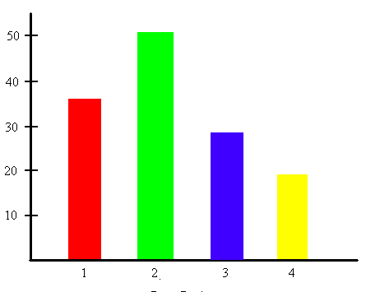
Stage 3: Organizing Data
Tips for Interpreting Graphs
Read all labels.
What is…
  in each COLUMN?
  in each ROW?
  the RANGE OF VALUES?
Where was…
  the MOST change or growth?
  the LEAST change or growth?
Notes:
Slide #90: Tips for Interpreting Graphs
Procedural Directions:
Share information from the presenter notes.
Presenter Notes:
There are still more ways of organizing data to make it easier to understand.
Formats like lists, tables, charts, spreadsheets, and written and verbal descriptions help you see a visual representation of data.
Tips for Interpreting All Graphs
Remember to read all of the labels on the presented graph or table.
Ask yourself:
What is in each column?
What is in each row?
What is the range of values?
Does the data have a direct or indirect relationship?
Do the lines have positive or negative slopes?
Where was there the most change or growth?
Where was there the least?
Activities

Slide 97
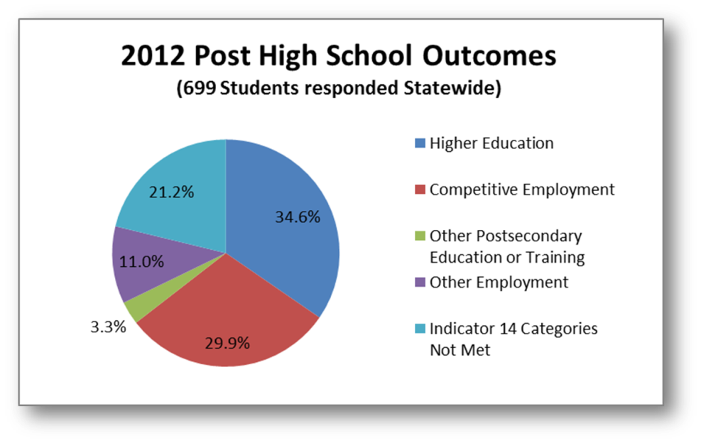
Stage 3: Organizing Data
A Snapshot in Time
Notes:
Slide #91: A Snapshot in Time
Procedural Directions:
Share information from the presenter notes.
Talk out loud as you observe and study the pie chart or have participants provide statements based on the pie chart.
Presenter Notes:
A Snapshot in Time
All data is a snapshot in time. For example, a pie chart shows a snapshot in time. A pie chart shows information by dividing a circle into several parts and showing how each part relates to the whole. There always needs to have a total of 100% when using pie charts.
Pie Chart Example
For example, a community member wants to find out what students with IEPs are doing after they graduate from high school. One way to locate this information is to go to Wisconsin Post School Outcomes website at www.posthighsurvey.org. A report will appear that contains all kinds of data.
The pie chart shows what students who had IEPs in high school are doing one year after graduation from high school.
Activities

Slide 98
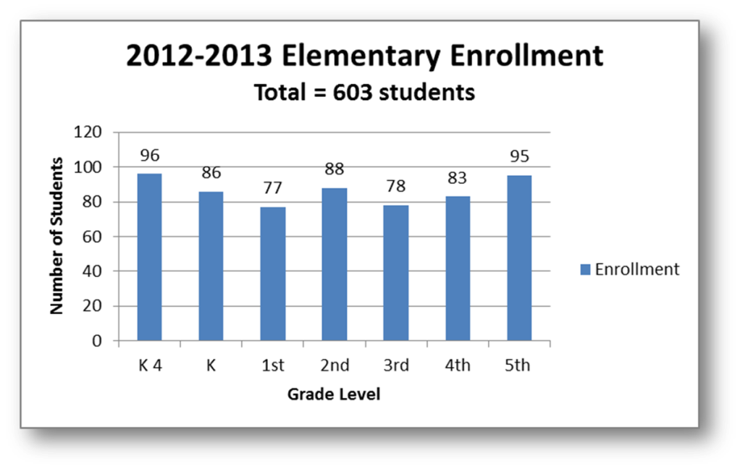
Stages 3: Organizing Data
Comparisons
Notes:
Slide #92: Comparisons
Procedural Directions:
Share information from the presenter notes.
Talk out loud or ask for volunteers to provide information based on the bar graph as you view it and take it in.
Ask the suggested activity questions.
Presenter Notes:
Comparisons
Using a bar graph or a line graph can help us compare the relationship between several variables.
Variables may be the grade level, gender, English Language Learner or other categories. Studying this data can help draw conclusions about student achievement.
Bar Graph Example
This bar graph displays the elementary school’s total student enrollment during the 2012-2013 school year. The graph tells us how the 603 students are distributed across the seven grade levels, from K4 through 5th grade. This information helps to guide decisions on the number of teachers and other staff needed in a particular grade level. For example: Class size policies are present in most school districts. If the class size policy states that 4K and K classes will have a range of 18 to 22 students per class, we would see 4 classrooms of 19 students and one classroom of 20 students in 4K this year. The Kindergarten would have had 2 classes of 22 students and 2 classes with 21 students.
Activities
Reflect– Use the bar graph on the slide to answer the questions.
How does the number of students in a grade affect the staffing needs of the school?
How do enrollment numbers affect instructional needs (textbooks, computers, office supplies)?

Slide 99
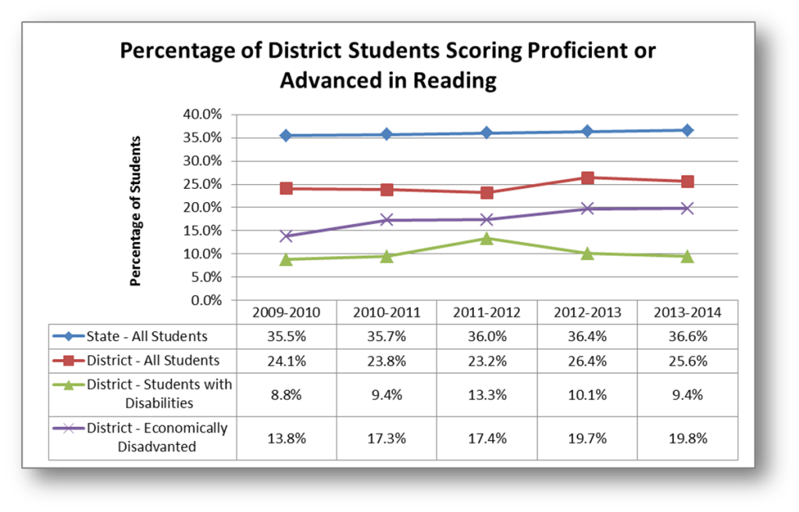
Stages 3: Organizing Data
Trends
Notes:
Slide #93: Trends
Procedural Directions:
Share information from the presenter notes.
Talk out loud or ask for volunteers to provide information based on the line graph as you view it and take it in.
Ask the suggested activity questions.
Presenter Notes:
Trends
Comparing data over time helps identify trends. This can help you make predictions about the future.
Using baseline data, you can track progress towards goals over time.
To see achievement trends in different groups of students over time, it is helpful to use a bar graph, line graph or spreadsheet.
When data from multiple periods of time (weeks, months, years, etc.) is also displayed, we begin to see trends form.
Line Graph Example
This line graph displays the Wisconsin Student Assessment System (WSAS) results in reading from the 2009-2010 school year to the 2013-2014 school year. The WSAS test includes students who took the Wisconsin Knowledge and Concepts Exam (WKCE) with and without accommodations as well as students who took the Wisconsin Alternative Assessment for Students with Disabilities (WAA-SwD). Students in Grades 3, 4, 5, 6, 7, 8, and 10 took this test.
Activities
Reflect– Use the line graph and spreadsheet on the slide to answer the questions.
Which group(s) of students are improving?
Which group(s) of students are staying the same?
What do you notice about the data over time?
What questions do you have based on the data?

Slide 100

Stage 3: Organizing Data
Tips to Validate the Findings
To make sure the data are sound:
Use trusted sources
Follow-up with questions
Use different ways of gathering data
Ensure everyone agrees and accepts the findings
Notes:
Slide #94: Validate Findings
Procedural Directions:
Share information from the presenter notes.
Presenter Notes:
To validate the findings means to accept the results as accurate.
We may use the following processes to make sure your data are sound:
Look for trusted sources
Follow-up with questions to make sure data are accurate and understood
Use many different ways of gathering data
Make sure the group agrees and accepts the findings
Activities

Slide 101

Stages of Data Use
Planning & Preparing to Use Data
Collecting Data
Organizing Data
Analyzing Data
Developing Hypotheses & Making Recommendations
Creating an Action Plan
Displaying & Sharing Results
Continuous Monitoring for Progress & Improvement
Notes:
Slide #95: Introduce Stage 4 of Data Use
Procedural Directions:
*Slide contains animation. Click for animation to appear.
Share information from the presenter notes.
Presenter Notes:
After collecting and organizing the data, the next step is to analyze it. This means thinking about what the data mean and finding patterns in it.
Analyzing data is not a simple process and the group may have to look at the data in several ways to make a decision.
Activities

Slide 102
Stage 4: Analyzing Data
Look for Relationships in the Data
  Each view provides unique insight
  Look from many viewpoints
  Understand the parts as well as the whole
  Strengths and challenges
  Don’t draw conclusions too soon
  Record information as it appears in the source
Notes:
Slide #96: Look for Relationships in the Data
Procedural Directions:
Share information from the presenter notes.
Presenter Notes:
When analyzing data, similarities, differences, trends, and other relationships may show information that the group otherwise could not see.
Each view of the data provides a unique insight, making it important to look at the data from many viewpoints. Only after studying the data do patterns become apparent, whether surprising, expected, or repeated.
Sometimes data is collected automatically and people ask questions about it later.
For example, a school’s registration form is filled out by every family in August. This information is stored in the school district’s database. Official school enrollment is counted on the third Friday of September and a report is shared in October. August’s registration could be compared to the enrollment data from September. The school board could sort and display the information if they want to know how many students are male, female, minorities, in a grade level, with IEPs, resident status, etc. Patterns may begin to be seen by looking at the data.
During this step it may be possible to begin describing findings from the data as strengths and challenges.
Strengths are results in the data that show a success.
Challenges are results showing areas where focus is needed.
Remember...Do not draw conclusions too soon.
When finding and recording data, you must always remind yourself to record information as it appears in the data source, and to avoid analyzing the information to early.
Activities

Slide 103

Stage 4: Analyzing Data
Terms when Working with Numbers
  MEAN – average of a group of numbers
  MEDIAN – middle value
  MODE – most frequent value
  RANGE – difference between lowest & highest values
  OUTLIER – very high or very low number
  STATISTICALLY SIGNIFICANT – results true & not because of chance
Notes:
Slide #97: Terms when Working with Numbers
Procedural Directions:
Share information from the presenter notes.
Presenter Notes:
There will be unfamiliar terms that may come up when you are analyzing data as a group. It is important to have a way of understanding those terms.
Analyzing numbers can be done a few different ways. Depending on how it is done, results can be very different. Calculating the mean, median, mode, and range for a series of numbers can help you in analyzing data, but first you have to know what the terms mean.
Mean is the average of a group of numbers. It is not always a good way of show the middle of a data sample.
Median is the middle value of numbers when they are ordered from smallest to largest. It is better at showing the middle of a data sample.
Mode is the most frequent value or the number that shows up the most in a data sample.
Range is the difference between the lowest and highest values.
An outlier is either a very high or very low number in a data sample that can distort the average. It also leads to more discussion and questions.
A term that may come up in discussions around data is the term statistically significant. Statistically significant means the data results are probably true and not because of chance.
Activities

Slide 104
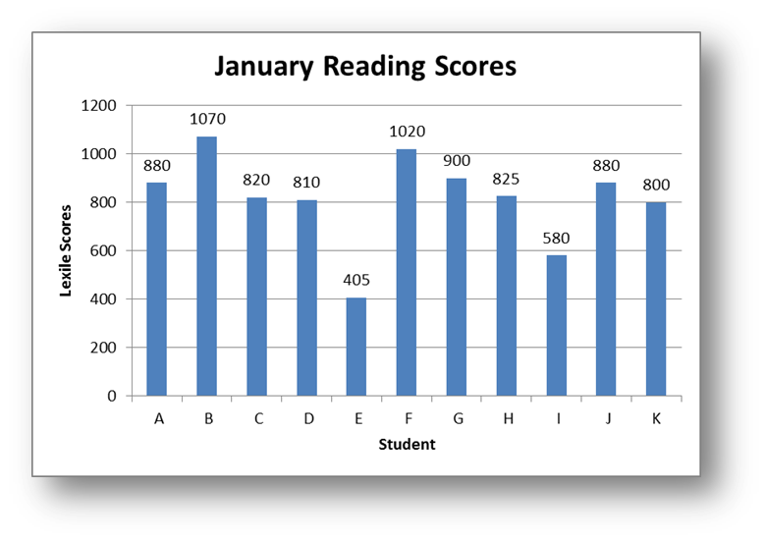
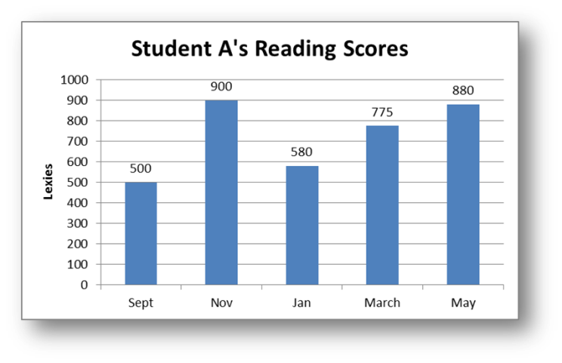

Stage 4: Analyzing Data
Examples of Working with Numbers
Mean = 817.3
Median = 825
Mode = 880
Range = 665
Outlier
Notes:
Slide #98: Examples of Working with Numbers
Procedural Directions:
Discuss graphs on slide by sharing information from the presenter notes.
Presenter Notes:
Graph of January Reading Scores
For example, Mrs. Smith checks her students’ reading scores five times a year. Here is a graph showing the reading scores of her students in January. Reading scores are based on a scale of zero to 1800.
Looking at the data in the one graph, the Mean is figured out as 817.3, the Median is 825, the Mode is 880, and the Range is 665.
The Mean is computed as follows:
880+1070+820+810+405+1020+900+825+580+880+800 = 8,990, 8,990 / 11 = 817.3.
The Median is the middle number. In this case, we place the numbers in order:
405, 580, 800, 810, 820, 825, 880, 880, 900, 1020, 1070. The middle number is the 6th number out of 11 numbers, or 825.
The Mode is the number which shows up the most in the data set. In this case, 880 is present twice and is therefore the Mode.
The Range is the difference between the highest number and the lowest number in the data set. The highest number is 1070 and the lowest is 405. The difference is 665.
Graph of Student A’s Reading Scores
For example, Student A’s reading scores during the school year are as follows. The student’s second checkpoint during the school year could be considered an outlier. Student A did unusually well, scoring 400 points higher in just two months. By the time January rolled around, Student A scored lower again and then showed steady progress through the rest of the year. Was the November reading material used to test Student A an area of high interest or something familiar that he did so well? Could the dip in January be due to the student not feeling well, uninteresting testing materials, or is it exactly where the student should be? Remember each score is just a snapshot of that student’s reading at that time. One just doesn’t know, however what we do know is that the student made great progress during the year in reading.
Activities

Slide 105

Stages of Data Use
Planning & Preparing to Use Data
Collecting Data
Organizing Data
Analyzing Data
Developing Hypotheses & Making Recommendations
Creating an Action Plan
Displaying & Sharing Results
Continuous Monitoring for Progress & Improvement
Notes:
Slide #99: Introduce Stage 5 of Data
Procedural Directions:
*Slide contains animation. Click for animation to appear.
Share information from the presenter notes.
Presenter Notes:
When developing a hypothesis, you'll explain what the data represents and why it looks the way it does.
Then you will decide what recommendations to make based on those hypotheses.
Activities

Slide 106
Stage 5: Developing Hypotheses & Making Recommendations
Hypotheses & Recommendations
  Understand why we think it is happening
  Look at other data
  Ask additional questions
  Agree upon the conclusions
  Figure out possible solutions
Notes:
Slide #100: Hypotheses & Recommendations
Procedural Directions:
Share information from the presenter notes.
Presenter Notes:
Now that you've analyzed the data, it's time to develop a hypothesis and use what you've learned.
Data may tell you what is happening but not why. The more you analyze and understand the data, the better your conclusions and solutions are likely to be. In this stage, you will try to figure out the "why."
First try to understand why something might be happening. Brainstorm possible ideas based on the data.
Look at other data. See if these data help support your ideas or not.
If still not sure, ask additional questions about the data. Your questions may help clear up why something might be happening.
The group must agree upon the conclusions drawn from analyzing the data before recommendations are made.
Once you know why something is happening, you can figure out possible solutions.
Activities

Slide 107
Stages of Data Use
Planning & Preparing to Use Data
Collecting Data
Organizing Data
Analyzing Data
Developing Hypotheses & Making Recommendations
Creating an Action Plan
Displaying & Sharing Results
Continuous Monitoring for Progress & Improvement
Notes:
Slide #101: Introduce Stage 6 of Data Use
Procedural Directions:
*Slide contains animation. Click for animation to appear.
Share information from the presenter notes.
Presenter Notes:
Making something happen requires creating an action plan.
Groups who want to make something happen after looking at a variety of data often create an action plan.
Action plans can help you improve and encounter less challenges.
An action plan usually includes goals, steps, assignments, and deadlines. Some action plans will occur over a short period of time and have quick evaluations. Other action plans will take longer and may require more time to put in place.
Activities

Slide 108

Stage 6: Creating an Action Plan
1. Bring key people together
2. Figure out:
· What
· Who
· When
Where
· Resources
· Communication
3. Review completed action plan
4. Follow through
5. Communicate
6. Keep track of progress
7. Celebrate!
Notes:
Slide #102: Action Planning
Procedural Directions:
Share information from the presenter notes.
Presenter Notes:
Steps to create an action plan.
1. Bring key people together to design the action plan.
2. Create an action plan made up of action steps that address all possible changes. Goals must be clearly stated. Figure out:
What action or change will occur
Who will carry it out
When it will take place, and for how long
Where will it happen
What resources (i.e., money, staff) are needed to carry out the change
Communication (who should know what)
3. Review your completed action plan carefully to check if it is complete.
4. Follow through on the work by using a timeline.
5. Let everyone in the group know what's going on.
6. Keep track of what is happening.
7. Celebrate when action plan goals are met!
Activities

Slide 109
Stages of Data Use
Planning & Preparing to Use Data
Collecting Data
Organizing Data
Analyzing Data
Developing Hypotheses & Making Recommendations
Creating an Action Plan
Displaying & Sharing Results
Continuous Monitoring for Progress & Improvement
Notes:
Slide #103: Introduce Stage 7 of Data Use
Procedural Directions:
*Slide contains animation. Click for animation to appear.
Share information from the presenter notes.
Presenter Notes:
When people of different perspectives look at the same data, they may make new conclusions and see ways to make changes.
This is how sharing data can be useful.
Activities

Slide 110

Stage 7: Displaying & Sharing Results
Displaying Results
Make Sure the Report is:
  Appealing
  Accessible
  Accurate
  Audience-specific
Be Fair and Objective
Notes:
Slide #104: Displaying Results
Procedural Directions:
Share information from the presenter notes.
Presenter Notes:
The group needs to present information found in the data in a way that is easy for an audience to understand.
Make sure the report is:
Appealing: Keep it simple, clear, and visually attractive.
Accessible: Use a reading level accessible to your audience. Avoid jargon or acronyms that the audience doesn't understand. Use bulleted lists and the language(s) spoken by the audience members.
Accurate: Data must be free of errors. The report must be about what the data actually say, not what you wish the data said.
Audience-specific: Focus on the issues that the audience cares about. Think about the level of detail needed by the audience and what the audience already knows.
Be Fair and Objective
Use data to drive decision making. It may be tempting to make a decision and then search only for those data that support it.
Such selective choosing of data is unethical and not useful.
Activities

Slide 111
Stage 7: Displaying & Sharing Results
Sharing Results
Know the Purpose of your Report
  Does it need to provide information?
  Is it to raise awareness?
  Will it be used to make decisions?
Know your Audience
  What do they already know about the topic?
  Do they need the big picture or lots of details?
Notes:
Slide #105: Sharing Results
Procedural Directions:
Share information from the presenter notes.
Presenter Notes:
A lot depends on the audience when figuring out what, how, and even when to share data. Different audiences need different views of the data. As a report of the results is written, think about the following questions:
What is the purpose of your report?
Does it need to provide information or to raise awareness?
Will it be used to make decisions?
What information is new and surprising?
What does the audience already know about the topic?
What level of information do they need: the big picture or lots of details?
Be sure to share the results of your group. Decide where this data will be shared.
Consider sharing data with families at:
school board meetings
district website and newsletter
community newspaper
parent group meetings
Activities

Slide 112

Stage 7: Displaying & Sharing Results
Make the Data Come Alive
Social Math
  Relating data numbers to what is familiar and concrete to your audience.
Data Stories
  Compelling narrative
  Audience-Specific
  Be objective
  Don’t censor
  Explain the data
Notes:
Slide #106: Make the Data Come Alive
Procedural Directions:
Share information from the presenter notes.
Presenter Notes:
Social math is about painting a picture with data. Sometimes numbers are just numbers when the context is missing or unfamiliar. Social math is all about relating data numbers to what is familiar and concrete to your audience. It brings numbers down to earth by blending them with compelling stories and by providing comparisons with familiar things. It works by analogy.
For example, if every person in the U.S. were to change their page margins from 1.25 to .75, we would save a forest around the size of Rhode Island each year.
Social math can backfire if the story and the visual comparisons are not linked to the message you want to convey. Numbers can be presented in a memorable way but may sometimes cause the opposite reaction in your audience.
Data stories are being used more and more to explain and visualize information that is collected and analyzed. Behind every data example is a story just waiting to be told.
Here are strategies on telling a good story that apply to data visualizations.
Find the compelling narrative.
Think about your audience and what they know about the topic.
Be objective and offer balance.
Don’t censor the data in the visualization.
Edit and try to really explain the data.
Activities

Slide 113
Stages of Data Use
Planning & Preparing to Use Data
Collecting Data
Organizing Data
Analyzing Data
Developing Hypotheses & Making Recommendations
Creating an Action Plan
Displaying & Sharing Results
Continuous Monitoring for Progress & Improvement
Notes:
Slide #107: Introduce Stage 8 of Data Use
Procedural Directions:
*Slide contains animation. Click for animation to appear.
Share information from the presenter notes.
Presenter Notes:
Dealing with data doesn’t end with creating an action plan. It is only the beginning!
Good data practice involves continuously collecting and evaluating data to make sure progress is made.
Activities

Slide 114

Stage 8: Continuous Monitoring for Progress & Improvement
Check Your Work
  Regularly revisit the plan
  Identify challenges
  Make changes as needed
Evaluate the Action Plan
  Collect the same TYPE of data
  from the same data SOURCE
Notes:
Slide #108: Continuous Monitoring for Progress & Improvement
Procedural Directions:
Share information from the presenter notes.
Presenter Notes:
Groups should regularly revisit the action plan which was developed as a result of data received.
Group members should regularly check in with one another, identifying challenges, making changes as needed, and celebrating successes.
When checking to find out if the action plan is working, the group should collect the same type of data from the same data source used to start the data cycle.
When data are used from different sources, differences in how the data were collected could lead to different results.
For example, if a group received and used survey data from community members to make their action plan, they should again survey community members to discover if their plan is working. They should not survey students or school staff to see if their decisions are making a difference. The group can more easily compare results if the same group is surveyed twice.
Activities

Slide 115
Stage 8: Continuous Monitoring for Progress & Improvement
Process Begins Again
Ask yourself:
  To what extent has the initial question been answered?
  What new concerns or questions have come up?
  Which factors are clearly understood and which ones need more data?
  Has the situation improved?
Notes:
Slide #109: Process Begins Again
Procedural Directions:
Share information from the presenter notes.
Presenter Notes:
Sometimes looking at how well the action plan is working leads to new questions or the needs for new data. Effective, continuous progress monitoring often addresses questions such as:
To what extent has the initial question been answered?
What new concerns or questions have come up?
Which factors are clearly understood and which ones need more data?
Has the situation improved?
The Drive to Continue
Monitoring for progress and improvement gives group members a chance to see the results of their hard work. When groups see good things happening in education based on their decisions, their drive to keep working at it is renewed. If things are not working as planned, the group can revisit their questions and data to adjust their plan.
Activities

Slide 116



Review
Notes:
Slide #110: Review of the Stages of Data Use
Procedural Directions:
*Slide contains animation. Click for each animation to appear.
Review the eight stages of data use by sharing information from the presenter notes.
Presenter Notes:
Using data in a decision-making group is a process with multiple steps or stages.
These eight stages help make sure a decision-making group is effectively using data to inform its decisions.
Stage 1: Planning and Preparing to Use Data
Pinpoint the information you need.
Stage 2: Collecting Data
Gather new and/or already collected data.
Stage 3: Organizing Data
Help to make the data understandable.
Stage 4: Analyzing Data
Find out what the data means.
Stage 5: Developing Hypotheses and Making Recommendations
Look at the data to try to figure out why and possible next steps.
Stage 6: Creating an Action Plan
Make a plan to get something done.
Stage 7: Displaying and Sharing Results
Show others the data and future plans.
Stage 8: Continuous Monitoring for Progress and Improvement
Check the work to make sure things are getting better.
Activities

Slide 117
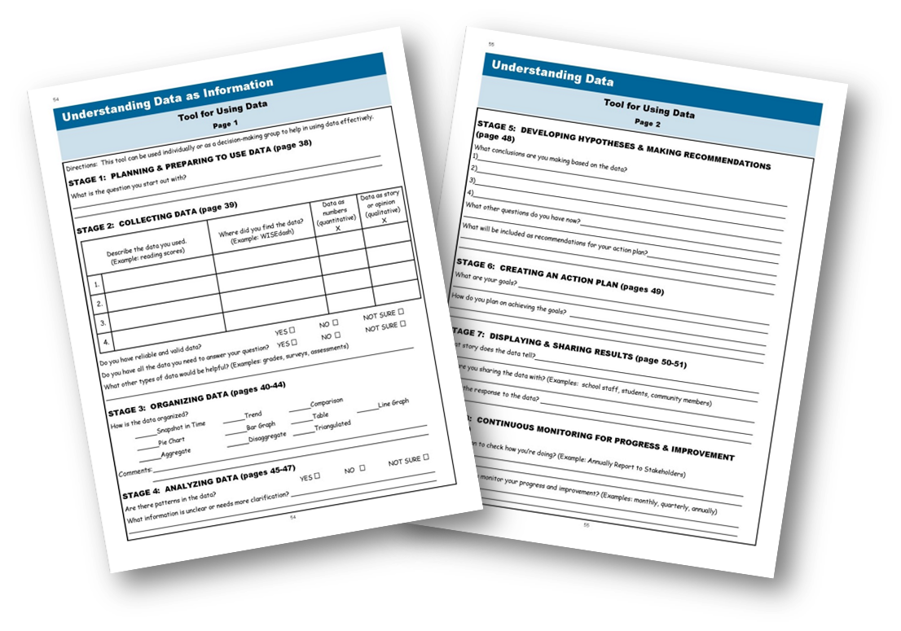
Tool for Using Data
Notes:
Slide #111: Tool for Using Data
Procedural Directions:
Provide copies of the handout or refer to the Guidebook pages 54 & 55 and highlight its important features.
Presenter Notes:
On pages 54-55, there is a tool people may use to help work through the stages of data use.
This tool can be used individually or as a decision-making group to help in using data effectively to make informed decisions.
Activities
Handout: Tool for Using Data

Slide 118
Section 6 Resources
Data-driven Decision Making (video 3:28) https://www.youtube.com/watch?v=9Lew4yWlv5Q
What is Data-Driven Decision Making? (video 4:17) https://www.youtube.com/watch?v=5efZCmUaTyw
WISEdash (WI Information System for Education Data Dashboard) http://wisedash.dpi.wi.gov/
Intro to WISE (video 3:30) https://www.youtube.com/watch?v=lMzTy3hJvzw
National Center for Education Statistics Kids’ Zone https://nces.ed.gov/nceskids/
Profile of Your State/County https://data.census.gov/cedsci/profile?g=0100000US
Data about Children in Your State http://datacenter.kidscount.org/
State Education Data Profiles https://www.nationsreportcard.gov/profiles/stateprofile?chort=1&sub=MAT&sj=&sfj=NP&st=MN&year=2019R3
WI School Performance Report https://dpi.wi.gov/spr
U.S. Dept. of Education Public Data Listing https://www2.ed.gov/about/data/list.html
Data.gov (U.S. Open Data) https://www.data.gov/
WI Post High School Survey (Indicator 14) https://www.indicator14wi.org/reports.statewide.php
Census Bureau Quick Facts Data https://www.census.gov/quickfacts/fact/table/US/PST045217
Notes:
Slide #112: Section 6 Resources
Procedural Directions:
Highlight 1 or 2 online resources listed on the slide.
Have one or two web links accessible and ready to show.
Presenter Notes:
Data-driven Decision Making (video 3:28) https://www.youtube.com/watch?v=9Lew4yWlv5Q
What is Data-Driven Decision Making? (video 4:17) https://www.youtube.com/watch?v=5efZCmUaTyw
WISEdash (WI Information System for Education Data Dashboard) http://wisedash.dpi.wi.gov/
Intro to WISE (video 3:30) https://www.youtube.com/watch?v=lMzTy3hJvzw
National Center for Education Statistics Kids’ Zone https://nces.ed.gov/nceskids/
Profile of Your State/County https://data.census.gov/cedsci/profile?g=0100000US
Data about Children in Your State http://datacenter.kidscount.org/
State Education Data Profiles https://www.nationsreportcard.gov/profiles/stateprofile?chort=1&sub=MAT&sj=&sfj=NP&st=MN&year=2019R3
WI School Performance Report https://dpi.wi.gov/spr
U.S. Dept. of Education Public Data Listing https://www2.ed.gov/about/data/list.html
Data.gov (U.S. Open Data) https://www.data.gov/
WI Post High School Survey (Indicator 14) https://www.indicator14wi.org/reports.statewide.php
Census Bureau Quick Facts Data https://www.census.gov/quickfacts/fact/table/US/PST045217
Activities
Handout: Guidebook Sectional Resource List

Slide 119
Section 6 Resources
Data Driven: Making Student and School Data Accessible and Meaningful To Families, U.S. Dept. of Ed. (video 1:20:00) https://www.youtube.com/watch?v=BF-UPuEMyS8
A Nonprofit Dashboard and Signal Light for Boards https://blueavocado.org/board-of-directors/a-nonprofit-dashboard-and-signal-light-for-boards/
Data Visualization: User-Centered Design https://blueavocado.org/leadership-and-management/data-visualization-user-centered-design/
What is Data? (video 2:45) https://www.youtube.com/watch?v=EhcWQmg9EeE
Data Use (Institute of Education Sciences) https://ies.ed.gov/ncee/edlabs/projects/data_use.asp
Sample Confidentiality Policy https://resources.workable.com/confidentiality-company-policy
Constructing a Hypothesis (video 2:21) https://www.youtube.com/watch?v=iMVuPJc1waY
Continuous Improvement -A Tool Kit https://ies.ed.gov/ncee/edlabs/regions/northeast/pdf/REL_2021014.pdf
National SEPAC Guide https://www.parentcenterhub.org/wp-content/uploads/repo_items/National_SEPAC_Guide_120218.pdf
3 Tips for Sharing Data with Others https://d31hzlhk6di2h5.cloudfront.net/20230323/92/53/40/92/825b0444fe6f534512eadfbb/3-Terrific-Tips-for-Sharing-Data.pdf
Notes:
Slide #112: Section 6 Resources
Procedural Directions:
Highlight 1 or 2 online resources listed on the slide.
Have one or two web links accessible and ready to show.
Presenter Notes:
Data Driven: Making Student and School Data Accessible and Meaningful To Families, U.S. Dept. of Ed. (video 1:20:00) https://www.youtube.com/watch?v=BF-UPuEMyS8
A Nonprofit Dashboard and Signal Light for Boards https://blueavocado.org/board-of-directors/a-nonprofit-dashboard-and-signal-light-for-boards/
Data Visualization: User-Centered Design https://blueavocado.org/leadership-and-management/data-visualization-user-centered-design/
What is Data? (video 2:45) https://www.youtube.com/watch?v=EhcWQmg9EeE
Data Use (Institute of Education Sciences) https://ies.ed.gov/ncee/edlabs/projects/data_use.asp
Sample Confidentiality Policy https://resources.workable.com/confidentiality-company-policy
Constructing a Hypothesis (video 2:21) https://www.youtube.com/watch?v=iMVuPJc1waY
Continuous Improvement -A Tool Kit https://ies.ed.gov/ncee/edlabs/regions/northeast/pdf/REL_2021014.pdf
National SEPAC Guide https://www.parentcenterhub.org/wp-content/uploads/repo_items/National_SEPAC_Guide_120218.pdf
3 Tips for Sharing Data with Others https://d31hzlhk6di2h5.cloudfront.net/20230323/92/53/40/92/825b0444fe6f534512eadfbb/3-Terrific-Tips-for-Sharing-Data.pdf
Activities
Handout: Guidebook Sectional Resource List

Slide 120
Serving on Groups
That Make Decisions:
A Guide for Families
Presented by:
Name
Organization/Agency
www.servingongroups.org
Notes:
Slide #113: Welcome and Introduction
Procedural Directions:
Have a copy of the Guidebook and the Training manual with you.
Make sure everyone has the materials needed for the presentation.
Ask if everyone can hear you and see the slides.
Introduce yourself and give a brief background of your experience (relevant to the group you are speaking to).
Address “housekeeping” such as restrooms, breaks, “parking lot”, group transitions, etc.
Presenter Notes:
Hello and welcome to this Serving on Groups that Make Decisions: A Guide for Families training.
My name is __insert name___ and I am the ___insert position__at _insert location__.
*Give a brief background of your experience (relevant to the group you are speaking to).
Activities

Slide 121


Section 7:
The Role of Families on Groups
Where do I start?
What do I need to know about my role?
What do I need to know about the group?
What ways might I represent the perspective of other families?
What ways might I share my family story?
Notes:
Slide #114: Section 7 Introduction
Procedural Directions:
Share information from the presenter notes.
If participants have a copy of the Guidebook, guide them to the appropriate section.
Presenter Notes:
In this section, we will review the role of families on decision-making groups.
A particular emphasis will be on the family representative role and ways to make sure all voices are heard and represented.
Activities

Slide 122

The Group
Learn about:
  Mission, Purpose, & History
  Style of leadership
  Priorities and goals
  Structure
  Decision-making process
Reminder…
  Review past meeting minutes
  Attend a meeting before joining
Notes:
Slide #115: The Group
Procedural Directions:
Share information from the presenter notes.
Discuss the different aspects of groups.
Share a personal example of a decision-making group.
Presenter Notes:
Each group is unique in their mission, style, priorities, structure, and decision-making process.
Your time is valuable so choose your opportunity wisely. You will want to find an opportunity that is meaningful to you. To make sure your time is productive, consider a few points before agreeing to serve.
Review the group’s mission statement, purpose and history to see if the group is working on issues that are important to you. Find out the reason the group was created in the first place.
Is the group formal or informal? Is there a president, vice-president, secretary, and treasurer? If there is no designated leader, find out who organizes the meetings.
Find out the group’s expectation and description of member roles. Are there attendance requirements? Do you have the time and necessary commitment level? Are you required to serve on additional committees?
Ask if meeting notes from the past few meetings are available. This will help you understand what the group has been doing most recently. These meeting minutes record what the group has talked about and also identifies any decisions that were made.
Visit one of the group’s meetings before you officially commit to joining. This will help you see the group dynamics.
Activities

Slide 123
The Group
Important to understand….
How the group’s work fits
into the work of the larger organization
The process and timeline for getting things done
Remember: Be patient and don’t give up!
Notes:
Slide #116: Big Picture
Procedural Directions:
*Slide contains animation. Click to make animation appear.
Share information from the presenter notes.
Consider a personal example to share to illustrate the information.
Presenter Notes:
It is important to understand the big picture of how the group’s work fits into the larger organization.
Understand the process and timeline for considering and implementing the recommendations given by the group.
Things often don’t happen right away! Be patient and don’t give up.
Activities

Slide 124
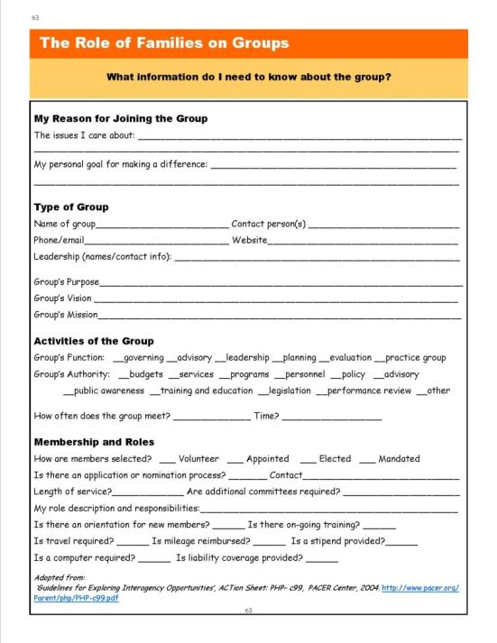
Resource
*Page 63:
What Information Do I Need to Know About the Group?
Uses:
Learning Tool
Reflection
Assessment
Mentorship
Notes:
Slide #117: Resource: What Information do I need to know about the Group?
Procedural Directions:
Provide copies of the handout (in-person or online) or refer to the Guidebook page 63 and highlight its important features.
Have participants complete the first section and then as much as possible.
Presenter Notes:
This resource helps organize information about the group.
As someone new to a group, it can be used to build an understanding about your purpose on the group, the structure of the group, and the processes the group uses.
As someone experienced on a group, it can be used to assess your own understanding of the group, as a resource for mentors and new members, or as an instrument to determine missing information about the group.
Question: Where could you go to find information to complete the resource?
Possible answers: Ask the group leader or your mentor, visit the group’s website, review the group’s bylaws and other written guidance
Activities
Guidebook pg. 63: What Information Do I Need to Know About the Group?

Slide 125

Your Role on the Group
  Connect with past representative
  Ask for a mentor
  Come prepared
  Ask for group’s written guidance
  Inquire about attendance support
  Plan introduction carefully
Notes:
Slide #118: Your Role on the Group
Procedural Directions:
Share information from the presenter notes.
Discuss the different aspects of the family representative on decision-making groups.
Share a personal example of being a representative on a decision-making group.
Presenter Notes:
As a family representative, you will be required to bring the family perspective to the decision-making process.
When the families can’t physically be in the meeting, they rely on family representatives to bring their interests and concerns to the discussion.
The energy you will spend learning new skills, preparing for and attending meetings will be worth it, especially when you begin to see the results of your efforts.
There are a few things to do as you begin your new role.
Connect with the parent who served before you to get an honest picture of your role.
Ask for a mentor in the group who can serve as your guide as you begin.
Always try to come to the meeting prepared. If the group will be reviewing a draft document at the meeting, it may be helpful to you to read a copy ahead of time.
Find out if the group has by-laws or procedures that guide the way they operate. If so, ask for a copy of the most recent version and review them.
Ask what the process is for requesting reimbursement or a stipend. Especially if childcare is needed in order for you to participate, you have out-of-pocket expenses, or if travel is required.
Finally, make sure you plan your introduction carefully. You may only have a few minutes or less to introduce yourself so you want to make sure you state a little about yourself, why you are here, and what YOU will bring to the group.
Activities

Slide 126
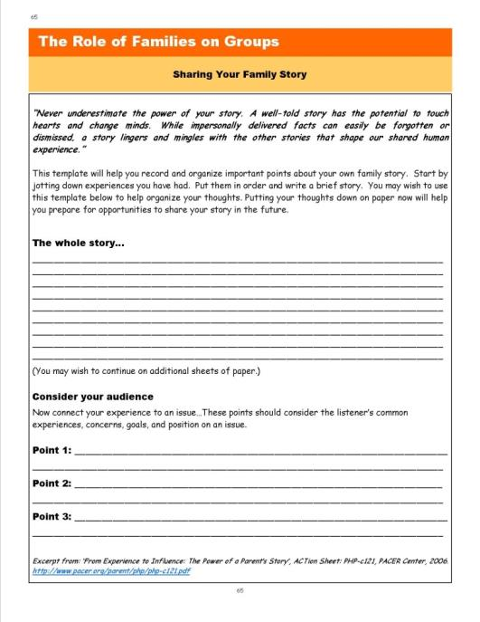
Resource
*Page 65:
Sharing Your Family Story
Answer the questions:
Who are you?
What brings you to the group?
What will YOU bring to the group?
Notes:
Slide #119: Resource: Sharing Your Family Story
Procedural Directions:
Provide copies of the handout (in-person or online) or refer to the Guidebook page 65 and highlight its important features.
Have participants complete it.
Presenter Notes:
As mentioned in the previous slide, it is important to plan your introduction carefully.
Keep it concise and relevant to the group.
Answer the 3 questions:
Who are you (relevant to the group)?
What brings you to the group?
What will YOU bring to the group?
Activities
Guidebook pg. 65: Sharing My Family Story

Slide 127

Best Ways to Represent Others
Welcome Input
  Create a brief survey
  Go where the families are
Be Accessible
  Attend meetings in the community
  Provide contact information
  Seek out and support involvement
Communicate
  Write and post summary reports
  Be the link between families and the group
Notes:
Slide #120: Representing Others
Procedural Directions:
Share information from the presenter notes.
Offer examples of groups working with diverse communities.
Complete suggested activity.
Presenter Notes:
A family representative’s role is to represent the voice of families in their community.
Family representatives on groups serve as liaisons to families by providing them with information they need to know. This information will help families participate an contribute in meaningful ways.
Family representatives also help connect input and questions from families to the people who need this information.
As a family representative, remember it is your job to represent the voice of MANY families, not just your own.
It is your role to seek out and support the involvement of families who are interested in and potentially affected by the group’s decisions.
Be accessible to families and reach more people by attending parent group meetings and other community or school meetings and events. Have your contact information available so families can call or email you.
Also always welcome ongoing input from families.
Provide feedback to families so they can see the impact they made by providing summary reports about the group’s decisions and posting them in places like libraries, grocery stores, and community centers.
If you’re feeling like there are families that you haven’t been receiving any input from and want to represent better, you might need to reach out to them. Some ideas are to:
Create a brief survey. Be mindful of confidentiality.
Plan a focus group meeting for anyone interested in a specific topic, but remember to provide information in advance so people can prepare their thoughts.
Offer to visit with families in their home or neighborhood location.
Activities
Activity: Representing Families

Slide 128
Section 7 Resources
Leading by Convening www.servingongroups.org/leading-by-convening
EPIC– Every Person Influences Children (video-20:26) http://www.youtube.com/watch?v=BI4rqX_F69c
Board of Management in Your Primary School: A Guide for Parents https://www.educatetogether.ie/wordpress/wp-content/uploads/2010/02/the_board_of_management_in_your_primary_school__a_guide_for_parents.pdf
Advocacy in Action: A Guide to State Education Parent Advisory Councils https://www.parentcenterhub.org/wp-content/uploads/repo_items/National_SEPAC_Guide_120218.pdf
Home and Community Positive Behavior Support Network (HCPBS) https://hcpbs.org/
Tips for Recruiting Patients & Families to Serve in Advisory Roles http://www.ipfcc.org/resources/Tips_For_Recruiting.pdf
Diverse Voices Matter: Improving Diversity in Patient & Family Advisory Councils https://www.ipfcc.org/resources/Diverse-Voices-Matter.pdf
Notes:
Slide #121: Section 7 Resources
Procedural Directions:
Highlight 1 or 2 online resources listed on the slide.
Have one or two web links accessible and ready to show.
Presenter Notes:
Leading by Convening www.servingongroups.org/leading-by-convening
EPIC– Every Person Influences Children (video-20:26) http://www.youtube.com/watch?v=BI4rqX_F69c
Board of Management in Your Primary School: A Guide for Parents https://www.educatetogether.ie/wordpress/wp-content/uploads/2010/02/the_board_of_management_in_your_primary_school__a_guide_for_parents.pdf
Advocacy in Action: A Guide to State Education Parent Advisory Councils https://www.parentcenterhub.org/wp-content/uploads/repo_items/National_SEPAC_Guide_120218.pdf
Home and Community Positive Behavior Support Network (HCPBS) https://hcpbs.org/
Tips for Recruiting Patients & Families to Serve in Advisory Roles http://www.ipfcc.org/resources/Tips_For_Recruiting.pdf
Diverse Voices Matter: Improving Diversity in Patient & Family Advisory Councils https://www.ipfcc.org/resources/Diverse-Voices-Matter.pdf
Activities
Handout: Guidebook Sectional Resource List

Slide 129
Section 7 Resources
Wisconsin Board for People with Developmentally Disabilities https://wi-bpdd.org/
Guidelines for Exploring Interagency Opportunities ACTion Sheet http://www.pacer.org/Parent/php/PHP-c99.pdf
From Experience to Influence: The Power of a Parent’s Story ACTion Sheet http://www.pacer.org/parent/php/php-c121.pdf
Five Top Tips for Engaging Families in Advisory Roles: Advice from a Family Leader https://www.lpfch.org/publication/five-top-tips-engaging-families-advisory-roles-advice-family-leader
National Association for Family, School, and Community Engagement https://nafsce.org/page/About
WI DPI Community of Practice Group on Assistive Technology https://dpi.wi.gov/sped/educators/consultation/assistive-technology/at-forward
Notes:
Slide #121: Section 7 Resources
Procedural Directions:
Highlight 1 or 2 online resources listed on the slide.
Have one or two web links accessible and ready to show.
Presenter Notes:
Wisconsin Board for People with Developmentally Disabilities https://wi-bpdd.org/
Guidelines for Exploring Interagency Opportunities ACTion Sheet http://www.pacer.org/Parent/php/PHP-c99.pdf
From Experience to Influence: The Power of a Parent’s Story ACTion Sheet http://www.pacer.org/parent/php/php-c121.pdf
Five Top Tips for Engaging Families in Advisory Roles: Advice from a Family Leader https://www.lpfch.org/publication/five-top-tips-engaging-families-advisory-roles-advice-family-leader
National Association for Family, School, and Community Engagement https://nafsce.org/page/About
WI DPI Community of Practice Group on Assistive Technology https://dpi.wi.gov/sped/educators/consultation/assistive-technology/at-forward
Activities
Handout: Guidebook Sectional Resource List

Slide 130
Serving on Groups
That Make Decisions:
A Guide for Families
Presented by:
Name
Organization/Agency
www.servingongroups.org
Notes:
Slide #122: Welcome and Introduction
Procedural Directions:
Have a copy of the Guidebook and the Training manual with you.
Make sure everyone has the materials needed for the presentation.
Ask if everyone can hear you and see the slides.
Introduce yourself and give a brief background of your experience (relevant to the group you are speaking to).
Address “housekeeping” such as restrooms, breaks, “parking lot”, group transitions, etc.
Presenter Notes:
Hello and welcome to this Serving on Groups that Make Decisions: A Guide for Families training.
My name is __insert name___ and I am the ___insert position__at _insert location__.
*Give a brief background of your experience (relevant to the group you are speaking to).
Activities

Slide 131


Section 8:
Skills for Serving on Groups
What skills will help me…
prepare for a meeting?
participate in a meeting?
follow-up after the meeting?
deal with conflict?
facilitate a meeting?
Notes:
Slide #123: Skills for Serving on Groups
Procedural Directions:
Share information from the presenter notes.
If participants have a copy of the Guidebook, guide them to the appropriate section.
Presenter Notes:
Remember that the most effective team work starts with well-prepared members!
Necessary skills for serving on groups are preparing, participating, follow-up, and facilitating a meeting.
We’ll take a look at each one of these areas in more detail and provide tips and strategies to help you be the best group member that you can be.
Activities

Slide 132
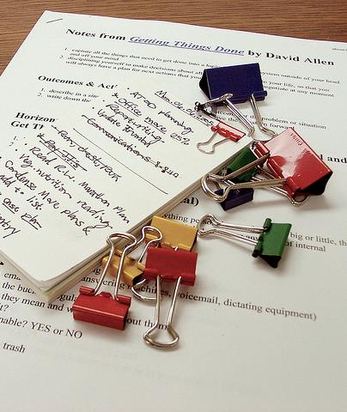
Prepare for a Meeting
Tips:
Keep a calendar
Read the agenda & additional items
Review past meeting minutes
Organize your thoughts
Keep learning
Notes:
Slide #124: Prepare for a Meeting
Procedural Directions:
Share information from the presenter notes.
Discuss and provide examples of meeting preparation strategies.
Ask suggested activity question.
Presenter Notes:
To prepare for a meeting, some tips are :
Keep a calendar. Keep meeting dates and times recorded.
Read the agenda and additional items sent for the meeting. Always try to get the agenda ahead of time so you can prepare for the meeting. Even if there is no written agenda, you can ask the leader to list the meeting topics. Review past meeting minutes. Read the minutes through for accuracy and to make sure they recorded all important information.
Organize your thoughts. Think about and write down your comments ahead of time so that you will be prepared to discuss the agenda items and additional materials. Remember, you are an equal member of the group and it is important for you to offer not only your thoughts, but the ideas and perspectives of all those you represent.
Keep learning by researching items listed in the agenda and in the additional materials sent before the meeting. Build an in-depth understanding of issues, the budgeting process, policy, etc.
A few good ways to find more information are to:
Visit your local library to ask for assistance to access online resources
Practice good listening skills and communication skills
Ask others where they find information about topics and issues you care about.
Activities
Question: What do you do to prepare for a meeting?

Slide 133

Participate in a Meeting
Attend all meetings
  If unable to attend:
    Let leader know ahead of time
    Make sure to get notes or meeting minutes
Take and keep notes
Learn the lingo
Try new roles
Be a mentor
Listen for understanding
Notes:
Slide #125: Participate in a Meeting
Procedural Directions:
Share information from the presenter notes.
Discuss and provide examples of meeting participation strategies.
Ask suggested activity questions.
Lead suggested activity.
Presenter Notes:
To participate in a group, attend all meetings. Find out if all meetings are in-person or if there are alternative methods for participation such as conference calls, online meetings, etc.
Attending meetings helps build relationships and your own understanding of what the group is about and what the group is trying to do. It also shows a commitment to the group.
If you're unable to attend, remember to let the leader know ahead of time and make sure to get the notes or meeting minutes as soon as possible for your review.
Take notes to reference key points and assignments.
Learn the lingo like specific words and abbreviations used by members. Create your own “cheat sheet” or list of commonly used words, acronyms, and phrases.
Also try a new role in the group like leading the discussion, recording the meeting minutes, or being timekeeper.
Some groups incorporate a rotating facilitator role so everyone is given the opportunity to facilitate a meeting. This helps the group dynamics so one person doesn't dominate the leadership of the group
Be a mentor to new members of the group once you have been serving on the group for a while and you feel comfortable.
Listen for understanding. When you do not understand what is being said, ask “What I think I hear you saying is…” which is also known as restating what you heard. Then ask, “Is that right?” This gives the speaker a chance to clarify and add more information, if needed.
Activities
Questions: In the meetings in which you have participated, which of these strategies have you seen being used effectively? Are there some skills that are missing? How does that affect the effectiveness of the group?
Activity: Compass Points

Slide 134

Follow-Up after a Meeting
Tips:
Refer to your notes
Stay organized
Use technology
Review written guidance
Reflect on what was learned
Connect with mentor
Review data
Keep learning
Notes:
Slide #126: Follow-Up after a Meeting
Procedural Directions:
Share information from the presenter notes.
Discuss and provide examples of meeting follow-up strategies.
Presenter Notes:
There will typically be materials to read and activities between meetings. Some groups have sub-groups that meet to carry out a specific task for the group. Organizational skills are important to have to help you meet the responsibilities of your role.
A great habit to get into is to do a follow-up after the meeting. Do this by:
Referring to your notes. During the meeting, make a list of follow-up items and questions to ask. This will help you keep track of important information to refer to after the meeting.
Staying organized. Use a binder to store all material so it is easier to locate information during the meeting. Make a separate labeled divider for: contacts, by-laws, ground rules, agendas, meeting notes, reports, projects, and reference materials.
Use technology. Electronic files that are sent to you ahead of time can be stored in a folder on your computer desktop for easy access. If you have a laptop, you can type meeting notes into a document during the meeting.
Review written guidance like the group’s bylaws, procedures, etc.
Reflect on what you learned and what was discussed during the meeting.
Connect with a mentor to become more comfortable with the group work.
Review data. Take time to study the information and understand what the group is trying to do.
Keep learning by researching the topics in other areas, states, organizations, and the like. Great ideas might come from looking at the work of others.
Activities

Slide 135

Dealing with Conflict
Tips:
Keep an open mind
Use “I” statements
Don’t take things personally
Ask questions
Stay focused on the topic
Focus on solutions
Take a break
Remember the group’s purpose
Notes:
Slide #127: Dealing with Conflict
Procedural Directions:
Share information from the presenter notes.
Discuss and provide examples of how to deal with conflict.
If time allows, have participants do the optional activity on conflict management styles.
Presenter Notes:
Conflict is a natural part of group dynamics, but it can be complex.
Try to respect individual differences while helping people avoid becoming too entrenched in a fixed position.
Keep an open mind - You might learn something or increase your understanding of another’s point of view.
Use “I” statements, not “you” statements.
Don't take things personally.
Ask questions – Find out the facts by asking Who? What? When? And Why?
Stay focused on the topic – Refer to the agenda as a reminder.
Focus on solutions. If you provide an issue or concern, offer a solution or potential options.
Take a break – If you feel overwhelmed, excuse yourself for a few minutes.
Remember the group’s purpose at the center of the conversation.
Activities
Conflict Management Styles

Slide 136

Resolving Conflict
Tips:
Pay attention to interests
Listen first; talk second
Good relationships are a priority
Keep people and problems separate
Set out the facts
Explore options together
Notes:
Slide #128: Resolving Conflict
Procedural Directions:
Share information from the presenter notes.
Discuss and provide examples of how to resolve conflict.
Lead suggested activity.
Presenter Notes:
To resolve conflict, follow these rules:
Pay attention to the interests that are being presented: By listening carefully you'll most-likely understand why the person is adopting his or her position.
Listen first; talk second: To solve a problem effectively you have to understand where the other person is coming from before defending your own position.
Make sure that good relationships are the first priority: As far as possible, make sure that you treat the other calmly and that you try to build mutual respect. Do your best to be courteous to one another and remain constructive under pressure.
Keep people and problems separate: Recognize that in many cases the other person is not just "being difficult" – real and valid differences can lie behind conflictive positions. By separating the problem from the person, real issues can be debated without damaging working relationships.
Set out the "Facts": Agree and establish the objective, observable elements that will have an impact on the decision.
Explore options together: Be open to the idea that a third position may exist, and that you can get to this idea jointly.
Managed in the wrong way, real and legitimate differences between people can quickly spiral out of control, resulting in situations where cooperation breaks down and the group's mission is threatened.
To calm these situations down, it helps to take a positive approach to conflict resolution, where discussion is courteous and non-confrontational, and the focus is on issues rather than on individuals. If this is done, then, as long as people listen carefully and explore facts, issues and possible solutions properly, conflict can often be resolved effectively.
Activities
Activity: Listening Awareness Inventory

Slide 137
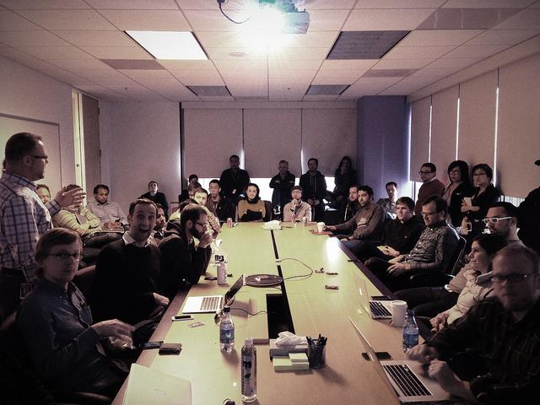


Facilitate a Meeting
Common strategies for good facilitation:
  Makes everyone feel comfortable, welcomed, and valued
  Encourages participation
  Prevents and manages conflict
  Listens and observes
  Clarifies group discussions
  Supports quality decisions
  Ensures outcome-based meetings
  Recognizes and appreciates contribution
Notes:
Slide #129: Facilitate a Meeting
Procedural Directions:
Share information from the presenter notes.
Discuss and provide examples of meeting facilitation strategies.
Presenter Notes:
An effective meeting starts with a good facilitator. To facilitate a meeting, there are some common strategies good facilitators have.
They try to make everyone feel comfortable and valued by allowing time for 'small talk', thanking people for their participation, and using open body language, like uncrossed arms.
They encourage participation by all members by using open-ended questions, dividing into small groups, and using flip charts and handouts.
Remember there are extremes of participation in groups so the facilitator needs to balance that.
They prevent or manage conflict by using team-building activities, setting ground rules, and drawing attention to things that everyone agrees on instead of focusing on the disagreements.
They actively listen and observe the others in the group by scanning reactions to comments or issues.
They clarify group discussions by summarizing and rephrasing what was said. They may use the phrase “I hear that….”
They also support quality decisions being made by reminding the group of the decision deadlines, reviewing the criteria and supporting information, and polling the group before major decisions to avoid surprises.
They make sure the meetings stay on track and the group is getting done what needs to be done by keeping the group members focused, recording decisions, and developing an action plan.
Finally, they recognize and express appreciation for member contribution to the work of the group and participation during meetings and activities.
Activities

Slide 138
Section 8 Resources
Meeting Preparation: Lead Effective Meetings (video-6:24) https://www.youtube.com/watch?v=itdYBXrJm-8
Meeting Facilitation Tips: How to Facilitate Your 1st Meeting (video-6:07) https://www.youtube.com/watch?v=oPZJQ-Mhwq0
Applying Results-Based Facilitation in Virtual Settings (Annie E. Casey Foundation) https://www.aecf.org/blog/applying-results-based-facilitation-skills-in-virtual-meetings
Virtual Meetings Etiquette-Do’s & Don’ts (video-7:56) https://www.youtube.com/watch?v=HYUVXQfaVp0
Developing Facilitation Skills Toolkit http://ctb.ku.edu/en/tablecontents/sub_section_main_1154.aspx
Planning and Structuring Effective Meetings - Skills You Need http://www.skillsyouneed.com/ips/meetings.html
Forming, Storming, Norming, and Performing: Model for Nurturing a Team to High Performance (incl. video-1:58) http://www.mindtools.com/pages/article/newLDR_86.htm
Notes:
Slide #130: Section 8 Resources
Procedural Directions:
Highlight 1 or 2 online resources listed on the slide.
Have one or two web links accessible and ready to show.
Presenter Notes:
Meeting Preparation: Lead Effective Meetings (video-6:24) https://www.youtube.com/watch?v=itdYBXrJm-8
Meeting Facilitation Tips: How to Facilitate Your 1st Meeting (video-6:07) https://www.youtube.com/watch?v=oPZJQ-Mhwq0
Applying Results-Based Facilitation in Virtual Settings (Annie E. Casey Foundation) https://www.aecf.org/blog/applying-results-based-facilitation-skills-in-virtual-meetings
Virtual Meetings Etiquette-Do’s & Don’ts (video-7:56) https://www.youtube.com/watch?v=HYUVXQfaVp0
Developing Facilitation Skills Toolkit http://ctb.ku.edu/en/tablecontents/sub_section_main_1154.aspx
Planning and Structuring Effective Meetings - Skills You Need http://www.skillsyouneed.com/ips/meetings.html
Forming, Storming, Norming, and Performing: Model for Nurturing a Team to High Performance (incl. video-1:58) http://www.mindtools.com/pages/article/newLDR_86.htm
http://www.mindtools.com/pages/article/newLDR_86.htm
Activities
Handout: Guidebook Sectional Resource List

Slide 139
Section 8 Resources
Conflict Resolution: Using the Interest-based Rational Approach (incl. video-2:57) http://www.mindtools.com/pages/article/newLDR_81.htm
When Conflict Arises: Working with Emotion (video-16:21) https://www.wsems.us/multimedia/videos/when-conflict-arises/
Handling Disagreements Productively http://parents-teachers.com/lib/Disagreements_Between_Parents_And_Teachers_-_Handling_Them_Productively/
The Big Bang Theory on Active Listening (video-1:55) https://www.youtube.com/watch?v=3_dAkDsBQyk
5 Ways to Listen Better(TED Talk video-7:51) https://www.youtube.com/watch?v=cSohjlYQI2A
Listening Skills (video-7:48) https://www.youtube.com/watch?v=B8EJVcRJSXo
Communicate - Paraphrasing (video-3:42) https://www.youtube.com/watch?v=5JL2iizK2c0
Notes:
Slide #130: Section 8 Resources
Procedural Directions:
Highlight 1 or 2 online resources listed on the slide.
Have one or two web links accessible and ready to show.
Presenter Notes:
Conflict Resolution: Using the Interest-based Rational Approach (incl. video-2:57) http://www.mindtools.com/pages/article/newLDR_81.htm
When Conflict Arises: Working with Emotion (video-16:21) https://www.wsems.us/multimedia/videos/when-conflict-arises/
Handling Disagreements Productively http://parents-teachers.com/lib/Disagreements_Between_Parents_And_Teachers_-_Handling_Them_Productively/
The Big Bang Theory on Active Listening (video-1:55) https://www.youtube.com/watch?v=3_dAkDsBQyk
5 Ways to Listen Better(TED Talk video-7:51) https://www.youtube.com/watch?v=cSohjlYQI2A
Listening Skills (video-7:48) https://www.youtube.com/watch?v=B8EJVcRJSXo
Communicate - Paraphrasing (video-3:42) https://www.youtube.com/watch?v=5JL2iizK2c0
http://www.mindtools.com/pages/article/newLDR_86.htm
Activities
Handout: Guidebook Sectional Resource List

Slide 140
Where to Go From Here?
To learn about personal skills for serving on a decision-making group, check out:
  Section 1: Opportunities to Get Involved
  Section 2: Types of Groups
  Section 6: Understanding Data as Information
  Section 7: Role of Families
  Section 8: Skills for Serving on Groups
To learn about group skills for serving on a decision-making group, check out:
  Section 2: Types of Groups
  Section 3: Processes Groups Use
  Section 4: Tools Groups Use
  Section 5: Tips & Strategies for Groups
  Section 6: Understanding Data as Information
Notes:
Slide #131: Guidebook Sections for Personal or Group Skills
Procedural Directions:
*Slide contains animation. Click for animation to appear.
Share information from the presenter notes.
Presenter Notes:
If you are someone who is interested in learning about personal skills for serving on a group, then you will want to review:
Section 1 – Opportunities to Get Involved,
Section 2 – Types of Groups
Section 6 – Understanding Data as Information
Section 7 – The Role of Families on Groups
Section 8 – Skills for Serving on Groups
These sections contain information about the personal skills, knowledge, and roles that an individual plays in a group.
If you are interested in group skills, then you will want to view:
Section 2 - Types of Groups
Section 3 - Processes Groups Use
Section 4 - Tools Groups Use
Section 5 - Tips and Strategies for Groups
Section 6 - Understanding Data as Information
You will find a great deal of information about how groups function, their use of data, and overall group strategies.
Activities

Slide 141
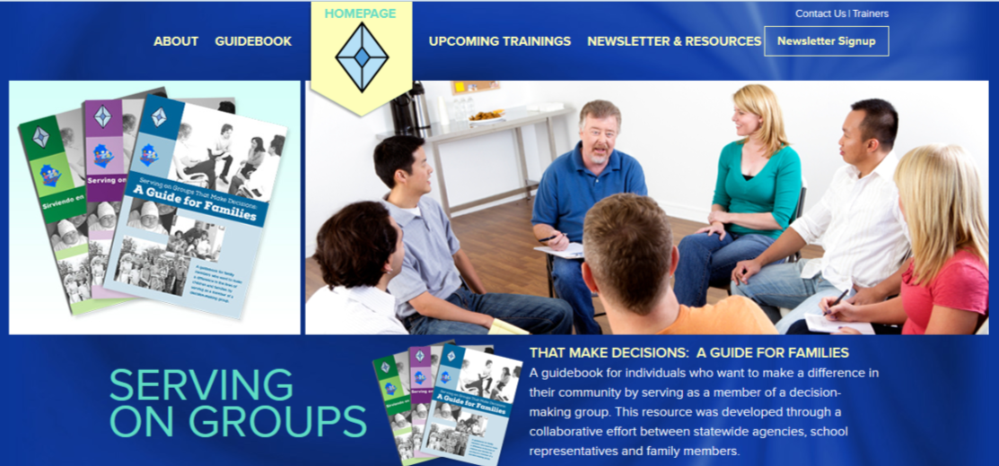
For more information, explore: www.servingongroups.org
Notes:
Slide #132: Serving on Groups Website
Procedural Directions:
Share information from the presenter notes.
Have the website link accessible and ready to show.
Presenter Notes:
There are online modules, upcoming trainings, and many additional resources found on the ServingOnGroups website.
Also, you can either order the Guidebook online or download each individual section as a pdf. Check it out!
Activities

Slide 142



Thank you!
Please remember to complete the evaluation!
Disclaimer Information
This publication was produced under a subcontract from the National Center for Systemic Improvement at WestEd, a technical assistance and dissemination center funded by the U.S. Department of Education, Office of Special Education Programs. The views expressed herein do not necessarily represent the positions or policies of the U.S. Department of Education. No official endorsement by the U.S. Department of Education of any product, commodity, service, or enterprise mentioned on this website is intended or should be inferred.
Notes:
Slide #133: Closing Remarks and Evaluations
Procedural Directions:
Thank participants for attending the workshop.
Share information from the presenter notes.
Remind participants about completing evaluation forms.
Presenter Notes:
Thank you so much for attending this workshop.
This training was originally developed as part of the Wisconsin State Personnel Development Grant (SPDG) under the Wisconsin Department of Public Instruction (DPI) and the Office of Special Education Programs (OSEP).
This training was developed by funds from the Center for Parent Information Resources (CPIR) under the National Center for Systemic Improvement (NCSI) and the Office of Special Education Programs (OSEP).
It was created by the Wisconsin Family Assistance Center for Education, Training, and Support (WI FACETS) and the Wisconsin Statewide Parent-Educator Initiative (WSPEI).
Your feedback is important so please remember to complete the evaluation.
Words to remember: “Leaders are not born ~ they rise out of a person’s passion for how they want the world to be”.
Activities
Evaluation Forms

