Slide 1
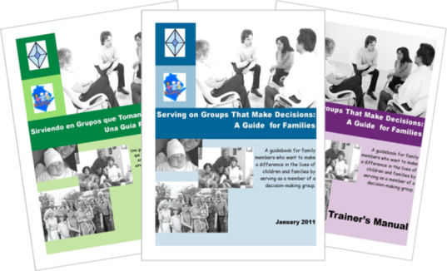

Serving on Groups That Make Decisions: A Guide for Families
Presented by:
Name
Organization/Agency
www.servingongroups.org
Notes:
Slide #1: Welcome and Introduction
Procedural Directions:
Have a copy of the Guidebook and the Training manual with you.
Make sure everyone has the materials needed for the presentation.
Ask if everyone can hear you and see the slides.
Introduce yourself and give a brief background of your experience (relevant to the group you are speaking to).
Address “housekeeping” such as restrooms, breaks, “parking lot”, group transitions, etc.
Presenter Notes:
Hello and welcome to this Serving on Groups that Make Decisions: A Guide for Families training.
My name is __insert name___ and I am the ___insert position__at _insert location__.
*Give a brief background of your experience (relevant to the group you are speaking to).
Activities

Slide 2
What brings you here today?
School
Family
Community
Leadership
Notes:
Slide #2: Reason for Attendance
Procedural Directions:
Show slide.
Have participants introduce themselves.
Ask suggested questions.
Ask follow-up questions for more information, specific details, etc.
Presenter Notes:
The purpose of this workshop is to increase confidence and participation of all members on decision-making groups.
Ask the question, “What brings you to today’s workshop?”
Please introduce yourself by sharing your name, where you live/work, and your role (family member/administrator/agency rep./community member/student/educator).
Also answer the question, “What do you hope to get out of today’s workshop?”
Activities
Participant introductions (name, location, role)
Question: What brings you to today’s workshop?
Question: What do you hope to get out of today’s workshop?
Activity: Experts Unite! (Share with a partner about one thing that you know about decision-making groups.)
Adjust participant introductions to the size of the group. (ie small group = share with whole group; large group = share with table or person(s) close by)
Activities

Slide 3

Agenda
Workshop Objectives
Guidebook Overview
Family Engagement & Leadership
Guidebook Sections
1. Opportunities to Get Involved
2. Types of Groups
3. Processes Groups Use
4. Tools Groups Use
5. Tips and Strategies for Groups
6. Understanding Data as Information
7. The Role of Families on Groups
8. Skills for Serving on Groups
Additional Information & Resources
Notes:
Slide #3: Agenda: Workshop Outline
Procedural Directions:
Always include this slide in all workshops with all Guidebook sections listed. It is important for participants to see the whole Guidebook, as well as the separate sections.
Explain the agenda and the structure of the Guidebook and the topic of each section.
If only presenting on certain sections, you can highlight those featured sections by using PowerPoint animation.
Provide opportunity for participants to develop agreed upon ground rules for this training. *Referred to in Section 4 of the Guidebook.
Determine culturally responsive practices for group management during the workshop (ie raised hands, chimes, etc.)
Presenter Notes:
Today’s agenda for the presentation will start with the workshop objectives.
Next we will briefly introduce the Guidebook highlighting its intended audience and the features within it.
There are a total of eight sections in the Guidebook. Some sections are specific to individual skills for serving on a decision-making groups. Other sections are specific on how groups function and make decisions.
Then we will focus on the information within sections of the Guidebook.
Finally we will end with additional information and resources.
Activities
Slide 3: Workshop Ground Rules

Slide 4

Objectives
Familiarize yourself with the Guidebook resource and the contents within it
Build an understanding about decision-making groups
Learn about the principles that guide group practices and the processes groups use
Gain strategies to help you confidently and actively participate in a decision-making group
Notes:
Slide #4: Workshop Objectives
Procedural Directions:
Review each objective.
Connect objectives and audience needs.
Presenter Notes:
By the conclusion of the workshop, you will have:
Familiarized yourself with the Guidebook resource and the contents within it so it can support you and your group to be effective decision makers.
Built an understanding about decision making groups, learning how they function and what your role may be within them
Learned about the principles that guide group practices and the processes groups use
Gained strategies to help you confidently and actively participate in a decision making group of your choice
Activities

Slide 5
Beliefs in Leadership
Leaders are not born ~ they rise out of a person’s passion for how they want the world to be.
Leadership isn’t a gift ~ it’s accessible to anyone who wants it.
Leadership isn’t a calling ~ it’s a matter of listening to a question and trying to come up with an answer.
A leader is anyone who has a very BIG and COMPELLING story of how it could all turn out.
Barbara Walsh, HP
Family Leadership Project
Notes:
Slide #5: Beliefs in Leadership
Procedural Directions:
Share information from the presenter notes.
*Slide contains animation. Click for each section to appear.
Discuss each highlighted section.
Presenter Notes:
The idea of who can be a leader has been changing.
The traditional model would have only a select few with transcendent vision and charismatic presence can be leaders. They are elected or appointed to positions with high visibility and prestige. Leadership would be maintained through power over others.
The service leadership model, which is becoming increasing popular, states that anyone willing to serve can be a leader. It would be by ongoing service and care for others. Leadership would be maintain through power shared with others.
Activities
Choral read the bulleted points as a whole group or ask for volunteers.

Slide 6

Family Engagement & Leadership
To support and increase participation of families on decision-making groups
Research on family involvement in the decision-making process have found:
Children have better outcomes when families are involved
There needs to be support for families
Research of Dr. Joyce Epstein & others
Notes:
Slide #6: Research that supports the development of the Guidebook
Procedural Directions:
Discuss family engagement and leadership as the purpose of Guidebook.
Share information from the presenter notes.
Provide background Dr. Joyce Epstein’s research on family involvement.
Presenter Notes:
The purpose of this workshop is to help support and increase participation of families on decision-making groups.
Dr. Epstein and others have focused on the effects of family involvement and have come up with keys for successful school, family, and community partnerships. The research have found:
children have better outcomes when families are involved in the decision-making process and
there needs to be support for families in decision-making groups
Based on her research, Dr. Epstein identified 6 types of family involvement. They are:
Parenting
Communicating
Volunteering
Learning at Home
Decision Making &
Collaborating with the Community
All of the types are important. This workshop focuses specifically on Decision Making.
We are beginning to see a shift in thinking that emphasizes partnering with families… not just asking parents to do what is needed at school. Families are now regularly being invited into groups and committees that are working towards improved outcomes for kids. What we’ve found though is that it’s not enough just to invite families to the table; the families need to be empowered to be active members of these groups.
Activities
Handout: Epstein’s Six Types of Family Involvement

Slide 7
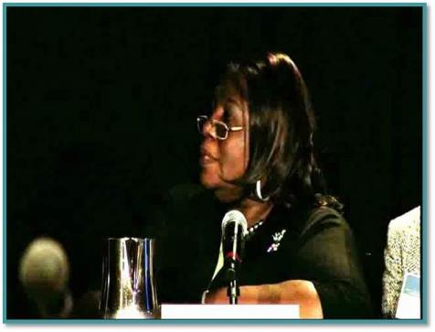
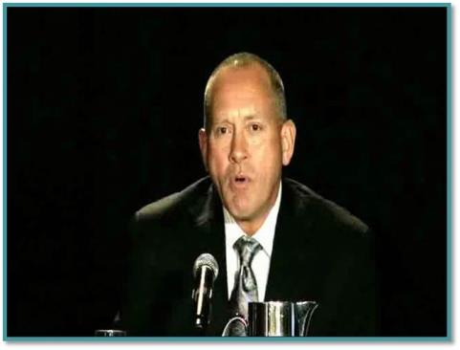
Family Engagement
Family Perspective
Professional Perspective
https://youtu.be/w2Ce7U8HeiI
https://youtu.be/ej4AbNV2fTg
Minnie Pearce-Tate
Parent Representative & Parent/Community Engagement Consultant
National Coalition of ESEA Title 1 Parents
Ron Mirr
President
RM Consulting

Slide 8
Benefits to (Shared) Decision Making
Results for Families
Awareness and input on policies
Feeling of ownership
Shared experiences and connections with professionals and other families
Results for Professionals
Awareness of family perspectives
Increased confidence and ability to partner with families
Acceptance of family representatives in leadership roles
Adapted from studies from J. Epstein & others
Notes:
Slide #8: Benefits for families and professionals to shared Decision Making
Procedural Directions:
Share information from the presenter notes.
Ask suggested questions.
Presenter Notes:
Involving families in decision making activities has benefits for families as well as professionals.
The benefits for families are an awareness and input on policies, a feeling of ownership, and shared experiences and connections with professionals and other families.
The benefits for professionals are an awareness of family perspectives, increased confidence and ability to partner with families, and an acceptance of family representatives in leadership roles.
Activities
Question: Do these benefits reflect your experience?
Question: What other benefits are there for families? Professional?

Slide 9

Overview of Serving on Groups
Developed due to an identified need
Collaborative effort by stakeholders
Audience
Family Members
Students
Educators
Groups
Community Members
Administrators
Notes:
Slide #9: Overview of Guidebook, its development and intended audience
Procedural Directions:
Review the background development of the Guidebook by sharing information from the presenter notes.
Presenter Notes:
The genesis of the guidebook came from an identified need to support families in serving on decision-making groups, but the information and structure of the book is intended to support anyone serving on those groups.
The Guidebook was developed from a grant that looks at education—the State Personnel Development Grant (or SPDG) from the WI Department of Public Instruction (or DPI). But, the Guidebook itself applies to all decision making groups, not just in education. Additionally, the information and skills included in the guidebook are NOT specific to Wisconsin.
There is something for everyone in the Guidebook. It is a great introduction for some, a welcome refresher for others, and a resource for all, including experts and mentors, so everyone can come to the table ready to serve.
Activities

Slide 10
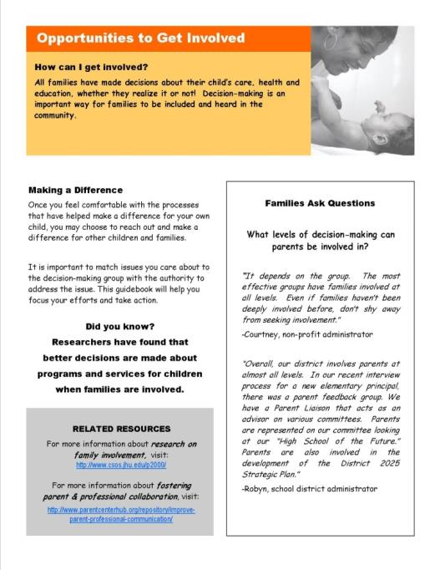
Sample Page
Real-Life Examples
Heading
with a
Focus Question
& Objective
Facts to Consider
Informative Reading
Additional Resources
Notes:
Slide #10: Sample Page of Guidebook
Procedural Directions:
*Slide contains animation. Click for each section to appear.
Discuss each highlighted section.
Presenter Notes:
Here is an example of a page from the guidebook. <Point out each highlighted section.> There are additional resources and activities embedded within some of the pages. All words bolded and italicized are found in the glossary in the appendix.
It’s important to use this book in a way that is going to be most meaningful for you and your group. If you need to use just one section, use just that section! If you want to take the book as a whole curriculum, that works too. The intention of the Guidebook is to meet the needs of the user. Use it however you’d like.
Activities
Have participants turn to a page or two in the Guidebook section(s) that the workshop is focused on.

Slide 11
Family Engagement & Leadership Resources
Family School Community Partnerships https://safesupportivelearning.ed.gov/training-technical-assistance/education-level/early-learning/family-school-community-partnerships
National Center for Family & Community Connections with Schools http://www.sedl.org/connections/
Project Appleseed National Campaign for Public School Improvement http://www.projectappleseed.org/chklst
National Association for Family, School, and Community Engagement (toolkits, other resources) https://nafsce.org/page/Resources
National PLACE Family Engagement Resources (Parent Leadership Advocacy & Community Empowerment) https://www.parentsatthetable.org/resources/main-resources/
National Standards for Family-School Partnerships https://www.pta.org/home/run-your-pta/National-Standards-for-Family-School-Partnerships
2021 Family Engagement Study: Insights for Building Effective School-Family Partnerships https://talkingpts.org/2021-family-engagement-study-insights-for-building-effective-school-family-partnerships/7173/
Notes:
Slide #11: Family Engagement & Leadership Resources
Procedural Directions:
Highlight 1 or 2 online resources listed on the slide.
Have one or two web links accessible and ready to show.
Presenter Notes:
National Center for Family and Community Connections with Schools
http://www.sedl.org/connections/
The Harvard Family Research Project
http://www.hfrp.org/
Project Appleseed: National Campaign for Public School Improvement
http://www.projectappleseed.org/chklist.html
National Coalition for Parent Involvement in Education (NCPIE)
http://www.ncpie.org
Family Leadership Project
http://familieslead.org/
SEDL Creating Collaborative Action Teams: Working Together for Student Success
http://www.sedl.org/pubs/fam18/
Activities
Handout: Guidebook Sectional Resource List

Slide 12
Family Engagement & Leadership Resources
Family Engagement Resources (U.S. DHHS/ACF/Children’s Bureau - ) https://www.childwelfare.gov/topics/famcentered/
National Family-School-Community Alliance https://fscalliance.org/category/resources/
Dual-Capacity Building Framework https://www.dualcapacity.org/
WI Interview with Dr. Karen Mapp on Family Engagement (Video 17:11) https://www.youtube.com/watch?v=eElzWQ6azMg
Building Parent-Teacher Relationships https://www.readingrockets.org/article/building-parent-teacher-relationships
Family Engagement in a Virtual World https://www.pta.org/docs/default-source/default-document-library/family-engagement-in-the-virtual-world.pdf
Family Engagement Month Ideas https://www.ecac-parentcenter.org/family-engagement-month-2024/
Leading by Convening https://servingongroups.org/leading-by-convening
Serving on Groups http://www.servingongroups.org/
Notes:
Slide #11: Family Engagement & Leadership Resources
Procedural Directions:
Highlight 1 or 2 online resources listed on the slide.
Have one or two web links accessible and ready to show.
Presenter Notes:
National Center for Family and Community Connections with Schools
http://www.sedl.org/connections/
The Harvard Family Research Project
http://www.hfrp.org/
Project Appleseed: National Campaign for Public School Improvement
http://www.projectappleseed.org/chklist.html
National Coalition for Parent Involvement in Education (NCPIE)
http://www.ncpie.org
Family Leadership Project
http://familieslead.org/
SEDL Creating Collaborative Action Teams: Working Together for Student Success
http://www.sedl.org/pubs/fam18/
Activities
Handout: Guidebook Sectional Resource List

