Slide 1
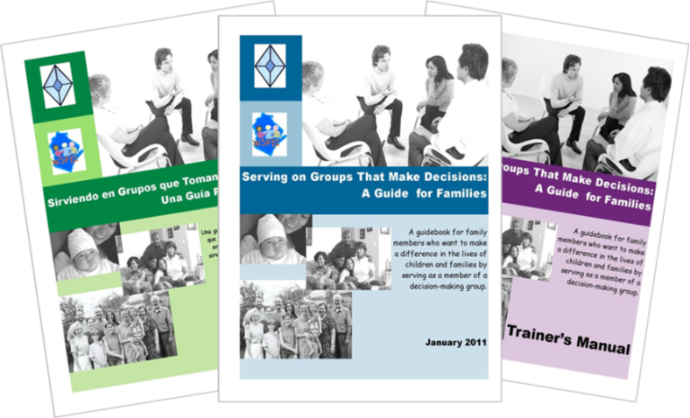
Serving on Groups That Make Decisions: A Guide for Families
Presented by:
Name
Organization/Agency
www.servingongroups.org
Notes:
Slide #38: Welcome and Introduction
Procedural Directions:
Have a copy of the Guidebook and the Training manual with you.
Make sure everyone has the materials needed for the presentation.
Ask if everyone can hear you and see the slides.
Introduce yourself and give a brief background of your experience (relevant to the group you are speaking to).
Address “housekeeping” such as restrooms, breaks, “parking lot”, group transitions, etc.
Presenter Notes:
Hello and welcome to this Serving on Groups that Make Decisions: A Guide for Families training.
My name is __insert name___ and I am the ___insert position__at _insert location__.
*Give a brief background of your experience (relevant to the group you are speaking to).
Activities

Slide 2
Section 3: Processes Groups Use
Questions
What are the principles that guide group practices?
What are important processes groups use?
Notes:
Slide #39: Section 3 Introduction
Procedural Directions:
Share information from the presenter notes.
If participants have a copy of the Guidebook, guide them to the appropriate section.
Presenter Notes:
The most effective groups use processes to guide their work. These processes may be new to you.
In this section, we will explain some common processes that groups might use.
Activities

Slide 3
Guiding Principles of Shared Decision-Making
Shared Decision Making
Shared Vision
Equal Partners
Collaboration
Representation
Shared Responsibility
Information Sharing
Producing Results
Notes:
Slide #40: Guiding Principles
Procedural Directions:
*Slide contains animation. Click for animation to appear.
Explain the Guiding Principles framework by sharing information from the presenter notes.
Highlight each of the seven principles and explain what happens when a principle is missing.
Presenter Notes:
This graphic shows all of the principles that contribute to the process of shared decision making. Those principles are:
Shared Vision— which means groups need to find common ground otherwise each member is working towards different goals
Representation—which means there must be consideration for the needs and perspectives of all people who are affected otherwise the group is making decisions for others without hearing their concerns, questions, and opinions
Equal Partners—which means each member must be treated equally otherwise some members won’t feel like true participants
Collaboration—which means there are opportunities to work together otherwise everyone is working alone in their own bubble
Shared Responsibility—which means everyone agrees to do their part, for example, improving outcomes for children otherwise 1 person or a small group does it all and there is less feeling of ownership by the other members. What happens when that 1 person or small group leaves?
Information Sharing—which means staying up-to-date on information regarding an issue otherwise a gap will arise within the group and not all members will be able to make well-informed decisions
Producing Results—groups need to check their progress and adjust as needed otherwise nothing is accomplished so what is the point of the group?
Remember if one of these principles is missing, the outcomes are impacted and shared decision-making is compromised.
Activities

Slide 4
Guiding Principles Example
IFSP/IEP meeting
Shared Vision
All want the child to be healthy, happy, and successful.
Equal Partners
All ideas, concerns, and questions are heard and are valued.
Collaboration
Everyone works together to come up with a plan.
Representation
Anyone working with the child or representing the child’s best interest is present.
Shared Responsibility
Everyone does their part to support the child’s learning at school, home, and in the community.
Information Sharing
The same information is given to all so all are able to make a well-informed decision.
Producing Results
Child makes progress.
Notes:
Slide #41: Guiding Principles Example
Procedural Directions:
*Slide contains animation. Click for animation to appear.
Discuss the relation between the guiding principles and an everyday example that relates to a decision-making body.
Lead suggested activity.
Presenter Notes:
The guiding principles can easily be applied to an individual group or a decision-making task.
An IFSP or IEP Team meeting is an everyday example of shared decision making. Let's take a look at each guiding principle through this lens.
Shared Vision—All want the child to be healthy, happy, and successful.
Representation—Anyone working with the child or representing the child’s best interest is present.
Equal Partners—All ideas, concerns, and questions are heard and are valued.
Collaboration—Everyone works together to come up with a plan.
Shared Responsibility—Everyone does their part to support the child’s learning at school, home, and in the community.
Information Sharing—The same information is given to all so all are able to make a well-informed decision.
Producing Results—Child makes progress.
Remember if one of these principles is missing, then it is not shared decision making and the vacation is not planned with everyone in mind.
IFSP = Individual Family Service Plan
IEP = Individualized Education Program
Activities
Activity/Handout: Example of Guiding Principles
Question: Have you been involved in shared decision-making? What made it successful? What was challenging?

Slide 5
Helpful Reminders:
Start with the end in mind
Focus on Outcomes
Work towards positive results
= Celebrate and publicize the success
= Go back and make adjustments
Notes:
Slide #42: Helpful Reminders
Procedural Directions:
Share information from the presenter notes.
Presenter Notes:
The most effective groups use different processes to guide their work. In this section, we will go through some common processes that groups might use.
So how do groups make decisions, and hopefully GOOD decisions?
It is by starting with the end in mind, in other words, focusing on the outcomes and then working towards positive results.
If the results are not positive or what they hoped to have accomplished, the group will need to go back to the processes and make adjustments until they have a plan that is producing positive results.
Activities

Slide 6
Processes Groups Use
1. Information Gathering
2. Goal Setting
3. Planning
4.Collaboration
5. Evaluation
6. Reaching Agreement
Notes:
Slide #43: Processes Groups Use
Procedural Directions:
*Slide contains animation. Click for animation to appear.
Introduce processes group use by sharing information from presenter notes.
Presenter Notes:
The six common processes groups use are:
Information Gathering
Goal Setting
Planning
Collaboration
Evaluation
Processes for Reaching Agreement
Now let’s take a look at each process in detail.
Activities

Slide 7
1. Information Gathering
Data
Numbers
Facts
Brain-
storming
Ideas
Focus Group Perspectives Stories
Prioritize Issues
Notes:
Slide #44: Information Gathering
Procedural Directions:
*Slide contains animation. Click for animation to appear.
Share information from presenter notes.
Ask suggested activity question.
Presenter Notes:
It is important for groups to gather and use accurate information or sometimes called data. It can come in many forms like numbers, facts, perspectives, ideas or stories. It can be collected in many ways.
Brainstorming is a strategy used when groups want to generate and collect lots of ideas.
A focus group is a group of participants who are asked questions and then give their perspectives or stories.
Example: Gathering school families and community members together
Issues may be identified during the information gathering process that will need to be addressed.
Priority may be given to issues that are the most important or that may take the most time to accomplish.
The bottom line is that it is critical to have accurate, up-to-date information before the group makes a decision.
Activities
Questions: How do you personally gather information before making decisions? How do determine what issues or tasks are most important?

Slide 8
2. Goal Setting
What does the group wants to see happen?
Helpful Tools to Set Direction
Vision Statement
Mission Statement
S.M.A.R.T. Goals
Specific
Measurable
Attainable
Realistic
Timely
Notes:
Slide #45: Goal Setting
Procedural Directions:
*Slide contains hyperlinks to YouTube videos. Click on orange, underlined words for hyperlinked videos.
Share information from the presenter notes.
Define the differences between vision and mission statements.
Provide copies of handouts for all participants.
Presenter Notes:
A goal is what a group wants to see happen and it needs to be stated up front so the group knows what they are working towards.
Goals, both short term and long term, are set after a group determines their priorities.
Reviewing the group’s vision and mission statements are helpful guides during the goal setting process.
Ineffective groups often lack clear goals or have failed to communicate the groups’ goals to all members.
A vision statement describes the changes the group wants to see happen in the future as a result of their actions.
An example is: A community where people of all ages are treated with respect and dignity, and are valued for their contributions.
A mission statement provides the direction and sets the goals, actions, and decision-making processes of the group.
An example is: Linking older adults with a caring community.
S.M.A.R.T. goals are goals written to help the group accomplish what they set out to do and are described as:
Specific – What are you going to do?
Measurable – How are you going to do it?
Attainable – Can you commit to doing it?
Realistic – Is it doable?
And Timely – What is your timeframe?
Example: Making a peanut butter sandwich or cleaning a house on the weekend
Activities
Handout: Mission/Vision Statements
Handout: SMART Goals
Videos:
How to Write a Vision Statement that Inspires: https://www.youtube.com/watch?v=7yBUBmciQBk&t=7s
How to Write a Mission Statement: https://www.youtube.com/watch?v=1xs4I349cdc
SMART Goals – Quick Overview https://www.youtube.com/watch?v=1-SvuFIQjK8

Slide 9
3. Planning
Who will do what, by when and in what order?
Helpful Tools to Reach Goals
Action Plan
Logic Models
Schedules
Strategy Charts
Notes:
Slide #46: Planning
Procedural Directions:
Share information from the presenter notes.
Ask suggested activity question.
Presenter Notes:
A plan begins to form when the team agrees on the first steps and how much to work on at a time.
Sometimes called an ‘action plan’, the plan should include who will do what, by when, and in what order.
Two tools that can be effective in helping to plan are logic models and schedules.
Logic models are diagrams that illustrate how a group’s activities connect to its goals and outcomes.
Schedules, also referred to as timelines, provide the group with assignments to accomplish within agreed upon deadlines.
Activities
Question: Think about the last time you have had to come up with a plan personally or in a group. How did you do it?

Slide 10
Logic Model Example
Notes:
Slide #47: Logic Model Example
Procedural Directions:
Explain the example of a logic model on the slide.
Presenter Notes:
Here is a simple example of a logic model. It is for a family camping vacation.
The orange items are the inputs. For a family vacation, you will need family members, a budget, a car, and camping equipment.
The green items are the outputs or what needs to be done. You will need to drive to the state park, set up camp, and cook, play, talk, laugh, and hike.
The hot pink item is the outcome of the family vacation. It will be that family members learn about each other, the family has a good time, and the family bonds.
Activities

Slide 11
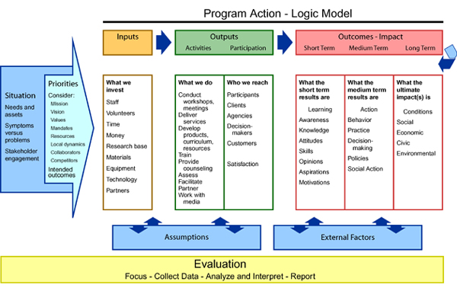
Logic Model Example
Notes:
Slide #48: Logic Model Example
Procedural Directions:
Briefly explain the example of the logic model on slide.
Presenter Notes:
Here is another example of a logic model.
It has the same categories as the last one of inputs, outputs, and outcomes.
There are other areas too. What are they? Why are they there?
Activities
Activity: Logic Model

Slide 12
4. Collaboration
Members working together toward a common goal.
Helpful Tools:
Agreed Upon Expectations
On-going Communication and Networking
Neutral Facilitator
Meaningful Activities
Focused Training and Technical Assistance
Notes:
Slide #49: Collaboration
Procedural Directions:
Share information from presenter notes.
Describe methods/tools of collaboration.
Presenter Notes:
Collaboration is when members of a group voluntarily bring their knowledge and experiences together to work toward a common goal. There are several ways to help encourage collaboration:
Agreed upon expectations which helps with cooperation and a positive working environment.
On-going communication and networking.
A neutral facilitator to help with group dynamics, especially if the members of the group have not worked together before.
Meaningful activities for all members
And focused training and technical assistance.
Activities

Slide 13
4. Collaboration
If you want to go fast,
go alone;
if you want to go far,
go together.
–African Proverb
Notes:
Slide #50: Collaboration
Procedural Directions:
Choral read proverb on slide.
Ask suggested question.
Provide personal example of experience that illustrates the message in the proverb.
Presenter Notes:
Read together: “If you want to go fast, go alone; if you want to go far, go together.” –African Proverb
Activities
Question: What is an experience you’ve had that illustrates the message in this proverb?

Slide 14
4. Collaboration
Benefits
More Involvement
Better Relationships
Greater Commitment
Better Communication
Notes:
Slide #51: Collaboration
Procedural Directions:
*Slide contains animation. Click for animation to appear.
Highlight benefits of collaboration.
Presenter Notes:
When a collaborative process is used, the benefits a group sees includes:
more involvement by its members
better communication
better relationships
greater commitment
Activities

Slide 15
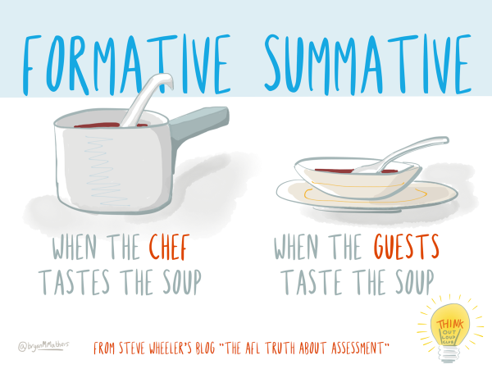
5. Evaluation
New information is compared to previously collected information
Helpful Types of Evaluation
Measure Final Results
Monitor Progress
Notes:
Slide #52: Evaluation
Procedural Directions:
Explain the difference between formative and summative evaluations.
Provide examples of each type of evaluation.
Presenter Notes:
After a group has begun collaborating and working together for a while, the members will need to revisit their plan to see if it is resulting in what they had hoped for. It may be necessary for the group to collect more information.
Evaluation is when the new information is compared to the information you already know.
There are two types of evaluation to discuss in the decision making process - formative and summative evaluations. What is the difference?
A formative evaluation is when the information is reviewed, usually in-house or with a small test group, during the plan so then the plan can be tweaked if needed. It is also known as to “monitor progress”.
A summative evaluation is done at the end of the plan to look at what has been accomplished. It is also known as “measure final results”.
Another way of looking at it is: "When the cook tastes the soup, that’s formative; when the guests taste the soup, that’s summative.” -quote by Robert Stakes.
Activities

Slide 16
6. Process for Reaching Agreement
Voting
Robert’s Rules of Order
A structured process
Making and Passing Motions
Consensus
Discussion continues until all mutually agree
Every member shares
Key is compromise
Notes:
Slide #53: Process for Reaching Agreement
Procedural Directions:
Share information from the presenter notes.
Define Robert’s Rules of Order and the processes used in reaching consensus.
Lead a review of terms and activity in activity/handout on Robert’s Rules of Order.
Presenter Notes:
Sometimes one of the most difficult tasks for groups is reaching agreement on an issue.
Parliamentary procedures may be used by groups to establish a process for managing discussions and reaching agreement.
Voting is one way and the most formal way to reach agreement.
Using Robert’s Rules of Order is a tool that provides structure to the voting process.
A majority of members must vote in favor for the motion to pass.
Meeting minutes typically document the decision-making process.
Another way groups create agreement is through consensus.
Consensus is when the whole group comes to a mutual agreement.
It is true compromise and can be a complicated, lengthy, yet rewarding process.
Consensus does not necessarily mean that everyone has gotten exactly the outcome they were desiring, but instead that an outcome was reached which is acceptable to everyone.
Consensus does have one advantage.
It has the potential to strengthen group relationships. In true consensus, the key is compromise. It involves combining proposals to achieve a better overall position that has more support.
Activities
Activity/Handout: Robert’s Rules of Order

Slide 17
Tips to Help YOU Personally be Effective
Organize your information
Keep in mind the group’s goals
List priorities
Keep track of where others stand on decisions
Ask the leader to explain member roles
Take notes
Write down the results of your activities
Notes:
Slide #54: Tips to Help be Effective
Procedural Directions:
Share information from the presenter notes and slide.
Presenter Notes:
Even if the group has not found a process, you can!
All good processes are really just a plan for staying organized, taking action, and planning for the next steps.
Here are tips that may help you personally be effective. <read slide>
Activities

Slide 18
Section 3 Resources
Conducting a Focus Group (video 5:36) https://www.youtube.com/watch?v=Auf9pkuCc8k
3 Brainstorming Techniques that Work (video 3:12) https://www.youtube.com/watch?v=jNFBoBAAYuw
How to Write a Vision Statement (video 5:35) https://www.youtube.com/watch?v=ioY-YSOKBtY
Visioning: Free Guide to Create a Clear Vision https://onstrategyhq.com/resources/video-how-to-write-a-vision-statement/
How to Write a Mission Statement (video 4:04) https://www.youtube.com/watch?v=XtyCt83JLNY
Mission Statements http://www.missionstatements.com/
Difference Between Mission & Vision Statement (video 5:14) https://www.youtube.com/watch?v=DzhJNiQ3vMM
Logic Models: Tool for Effective Program Planning, Evaluation, & Monitoring https://www2.ed.gov/about/offices/list/oese/oss/technicalassistance/easnlogicmodelstoolmonitoring.pdf
Notes:
Slide #55: Section 3 Resources
Procedural Directions:
Highlight 1 or 2 online resources listed on the slide.
Have one or two web links accessible and ready to show.
Presenter Notes:
Conducting a Focus Group (video 5:36) https://www.youtube.com/watch?v=Auf9pkuCc8k
3 Brainstorming Techniques that Work (video 3:12) https://www.youtube.com/watch?v=jNFBoBAAYuw
How to Write a Vision Statement (video 5:35) https://www.youtube.com/watch?v=ioY-YSOKBtY
Visioning: Free Guide to Create a Clear Vision https://onstrategyhq.com/resources/video-how-to-write-a-vision-statement/
How to Write a Mission Statement (video 4:04) https://www.youtube.com/watch?v=XtyCt83JLNY
Mission Statements http://www.missionstatements.com/
Difference Between Mission & Vision Statement (video 5:14) https://www.youtube.com/watch?v=DzhJNiQ3vMM
Logic Models: Tool for Effective Program Planning, Evaluation, & Monitoring https://www2.ed.gov/about/offices/list/oese/oss/technicalassistance/easnlogicmodelstoolmonitoring.pdf
Activities
Handout: Guidebook Sectional Resource List

Slide 19
Section 3 Resources
S.M.A.R.T. Goals (video 3:57) https://www.youtube.com/watch?v=1-SvuFIQjK8
WI Personnel Development Model https://dpi.wi.gov/sites/default/files/imce/sped/pdf/wpdmtools.pdf
How to Make an Action Plan (video 3:12) https://www.youtube.com/watch?v=lwoVRVgKg-o
The Easy Guide to Developing an Action Plan https://creately.com/blog/diagrams/how-to-write-an-action-plan/
Leading by Convening http://servingongroups.org/leading-by-convening
Creating Agreement: Educators & Parents Working Together https://dpi.wi.gov/sped/topics/agreement
Proposal-based Decision Making (Video 3:43) https://www.youtube.com/watch?v=-SYTkMv1J-E&feature=youtu.be
Robert’s Rules of Order http://www.robertsrules.com/
Program Evaluation (video 17:03) https://www.youtube.com/watch?v=6ZEYgEv7EL4
Notes:
Slide #55: Section 3 Resources
Procedural Directions:
Highlight 1 or 2 online resources listed on the slide.
Have one or two web links accessible and ready to show.
Presenter Notes:
S.M.A.R.T. Goals (video 3:57) https://www.youtube.com/watch?v=1-SvuFIQjK8
WI Personnel Development Model https://dpi.wi.gov/sites/default/files/imce/sped/pdf/wpdmtools.pdf
How to Make an Action Plan (video 3:12) https://www.youtube.com/watch?v=lwoVRVgKg-o
The Easy Guide to Developing an Action Plan https://creately.com/blog/diagrams/how-to-write-an-action-plan/
Leading by Convening http://servingongroups.org/leading-by-convening
Creating Agreement: Educators & Parents Working Together https://dpi.wi.gov/sped/topics/agreement
Proposal-based Decision Making (Video 3:43) https://www.youtube.com/watch?v=-SYTkMv1J-E&feature=youtu.be
Robert’s Rules of Order http://www.robertsrules.com/
Program Evaluation (video 17:03) https://www.youtube.com/watch?v=6ZEYgEv7EL4
Activities
Handout: Guidebook Sectional Resource List

