Slide 1
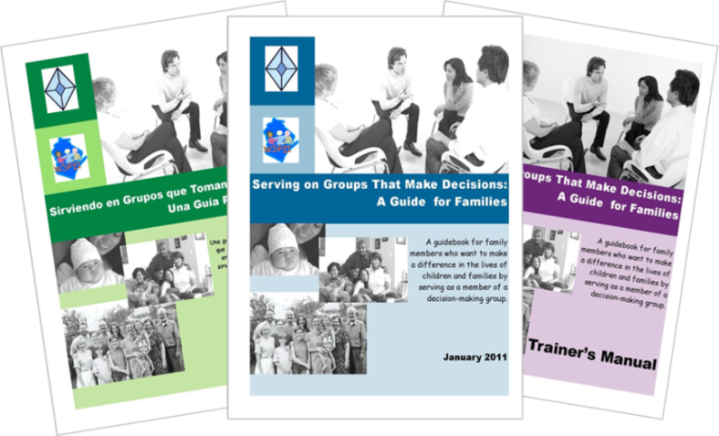
Serving on Groups That Make Decisions: A Guide for Families
Presented by:
Name
Organization/Agency
www.servingongroups.org
Notes:
Slide #113: Welcome and Introduction
Procedural Directions:
Have a copy of the Guidebook and the Training manual with you.
Make sure everyone has the materials needed for the presentation.
Ask if everyone can hear you and see the slides.
Introduce yourself and give a brief background of your experience (relevant to the group you are speaking to).
Address “housekeeping” such as restrooms, breaks, “parking lot”, group transitions, etc.
Presenter Notes:
Hello and welcome to this Serving on Groups that Make Decisions: A Guide for Families training.
My name is __insert name___ and I am the ___insert position__at _insert location__.
*Give a brief background of your experience (relevant to the group you are speaking to).
Activities

Slide 2
Section 7: The Role of Families on Groups
Where do I start?
What do I need to know about my role?
What do I need to know about the group?
What ways might I represent the perspective of other families?
What ways might I share my family story?
Notes:
Slide #114: Section 7 Introduction
Procedural Directions:
Share information from the presenter notes.
If participants have a copy of the Guidebook, guide them to the appropriate section.
Presenter Notes:
In this section, we will review the role of families on decision-making groups.
A particular emphasis will be on the family representative role and ways to make sure all voices are heard and represented.
Activities

Slide 3
The Group
Learn about:
Mission, Purpose, & History
Style of leadership
Priorities and goals
Structure
Decision-making process
Reminder…
Review past meeting minutes
Attend a meeting before joining
Notes:
Slide #115: The Group
Procedural Directions:
Share information from the presenter notes.
Discuss the different aspects of groups.
Share a personal example of a decision-making group.
Presenter Notes:
Each group is unique in their mission, style, priorities, structure, and decision-making process.
Your time is valuable so choose your opportunity wisely. You will want to find an opportunity that is meaningful to you. To make sure your time is productive, consider a few points before agreeing to serve.
Review the group’s mission statement, purpose and history to see if the group is working on issues that are important to you. Find out the reason the group was created in the first place.
Is the group formal or informal? Is there a president, vice-president, secretary, and treasurer? If there is no designated leader, find out who organizes the meetings.
Find out the group’s expectation and description of member roles. Are there attendance requirements? Do you have the time and necessary commitment level? Are you required to serve on additional committees?
Ask if meeting notes from the past few meetings are available. This will help you understand what the group has been doing most recently. These meeting minutes record what the group has talked about and also identifies any decisions that were made.
Visit one of the group’s meetings before you officially commit to joining. This will help you see the group dynamics.
Activities

Slide 4
The Group
Important to understand….
How the group’s work fits
into the work of the larger organization
The process and timeline for getting things done
Remember: Be patient and don’t give up!
Notes:
Slide #116: Big Picture
Procedural Directions:
*Slide contains animation. Click to make animation appear.
Share information from the presenter notes.
Consider a personal example to share to illustrate the information.
Presenter Notes:
It is important to understand the big picture of how the group’s work fits into the larger organization.
Understand the process and timeline for considering and implementing the recommendations given by the group.
Things often don’t happen right away! Be patient and don’t give up.
Activities

Slide 5
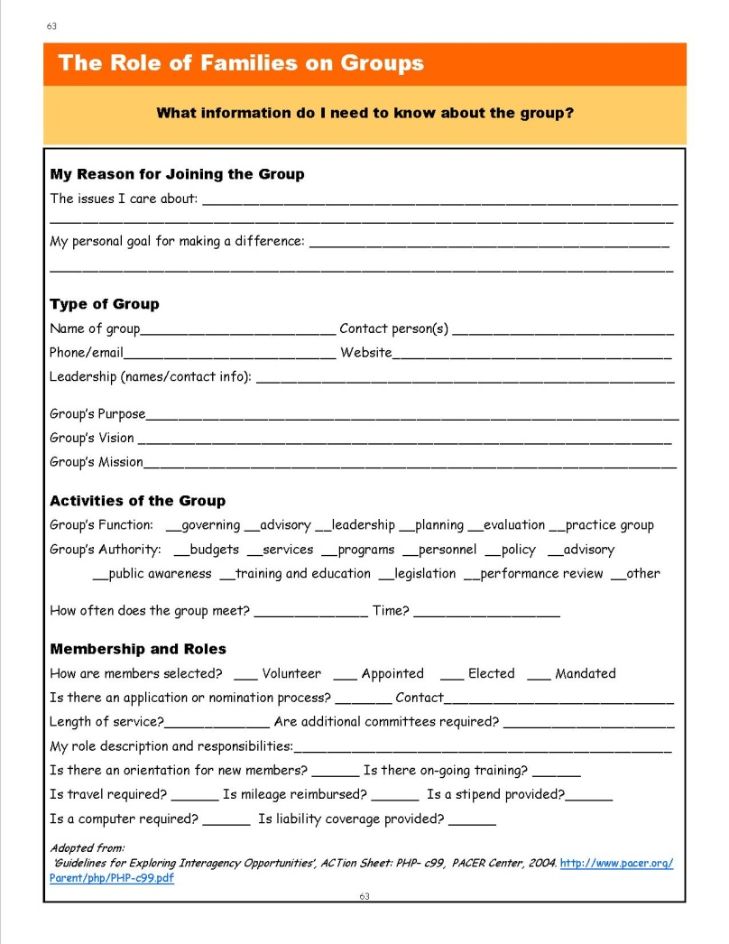
Resource
*Page 63:
What Information Do I Need to Know About the Group?
Uses:
Learning Tool
Reflection
Assessment
Mentorship
Notes:
Slide #117: Resource: What Information do I need to know about the Group?
Procedural Directions:
Provide copies of the handout (in-person or online) or refer to the Guidebook page 63 and highlight its important features.
Have participants complete the first section and then as much as possible.
Presenter Notes:
This resource helps organize information about the group.
As someone new to a group, it can be used to build an understanding about your purpose on the group, the structure of the group, and the processes the group uses.
As someone experienced on a group, it can be used to assess your own understanding of the group, as a resource for mentors and new members, or as an instrument to determine missing information about the group.
Question: Where could you go to find information to complete the resource?
Possible answers: Ask the group leader or your mentor, visit the group’s website, review the group’s bylaws and other written guidance
Activities
Guidebook pg. 63: What Information Do I Need to Know About the Group?

Slide 6
Your Role on the Group
Connect with past representative
Ask for a mentor
Come prepared
Ask for group’s written guidance
Inquire about attendance support
Plan introduction carefully
Notes:
Slide #118: Your Role on the Group
Procedural Directions:
Share information from the presenter notes.
Discuss the different aspects of the family representative on decision-making groups.
Share a personal example of being a representative on a decision-making group.
Presenter Notes:
As a family representative, you will be required to bring the family perspective to the decision-making process.
When the families can’t physically be in the meeting, they rely on family representatives to bring their interests and concerns to the discussion.
The energy you will spend learning new skills, preparing for and attending meetings will be worth it, especially when you begin to see the results of your efforts.
There are a few things to do as you begin your new role.
Connect with the parent who served before you to get an honest picture of your role.
Ask for a mentor in the group who can serve as your guide as you begin.
Always try to come to the meeting prepared. If the group will be reviewing a draft document at the meeting, it may be helpful to you to read a copy ahead of time.
Find out if the group has by-laws or procedures that guide the way they operate. If so, ask for a copy of the most recent version and review them.
Ask what the process is for requesting reimbursement or a stipend. Especially if childcare is needed in order for you to participate, you have out-of-pocket expenses, or if travel is required.
Finally, make sure you plan your introduction carefully. You may only have a few minutes or less to introduce yourself so you want to make sure you state a little about yourself, why you are here, and what YOU will bring to the group.
Activities

Slide 7
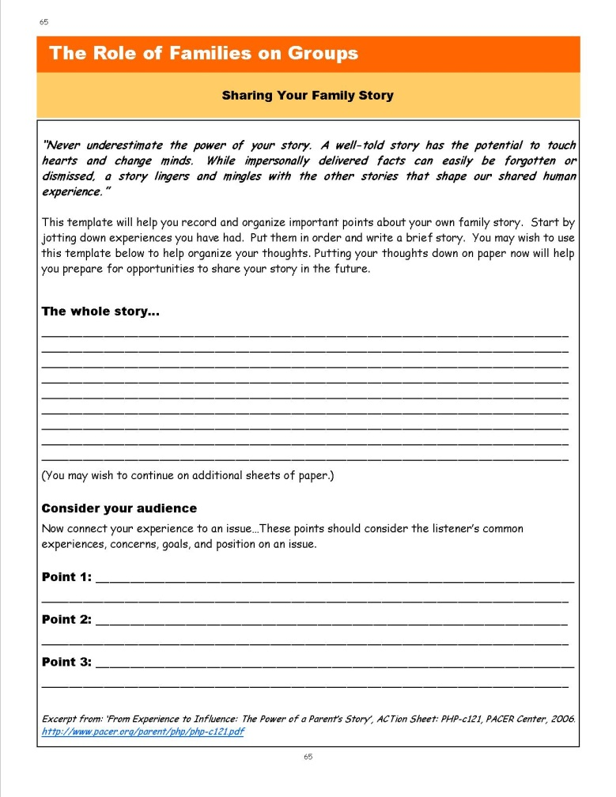
Resource
*Page 65:
Sharing Your Family Story
Answer the questions:
Who are you?
What brings you to the group?
What will YOU bring to the group?
Notes:
Slide #119: Resource: Sharing Your Family Story
Procedural Directions:
Provide copies of the handout (in-person or online) or refer to the Guidebook page 65 and highlight its important features.
Have participants complete it.
Presenter Notes:
As mentioned in the previous slide, it is important to plan your introduction carefully.
Keep it concise and relevant to the group.
Answer the 3 questions:
Who are you (relevant to the group)?
What brings you to the group?
What will YOU bring to the group?
Activities
Guidebook pg. 65: Sharing My Family Story

Slide 8
Best Ways to Represent Others
Welcome Input
Create a brief survey
Go where the families are
Be Accessible
Attend meetings in the community
Provide contact information
Seek out and support involvement
Communicate
Write and post summary reports
Be the link between families and the group
Notes:
Slide #120: Representing Others
Procedural Directions:
Share information from the presenter notes.
Offer examples of groups working with diverse communities.
Complete suggested activity.
Presenter Notes:
A family representative’s role is to represent the voice of families in their community.
Family representatives on groups serve as liaisons to families by providing them with information they need to know. This information will help families participate an contribute in meaningful ways.
Family representatives also help connect input and questions from families to the people who need this information.
As a family representative, remember it is your job to represent the voice of MANY families, not just your own.
It is your role to seek out and support the involvement of families who are interested in and potentially affected by the group’s decisions.
Be accessible to families and reach more people by attending parent group meetings and other community or school meetings and events. Have your contact information available so families can call or email you.
Also always welcome ongoing input from families.
Provide feedback to families so they can see the impact they made by providing summary reports about the group’s decisions and posting them in places like libraries, grocery stores, and community centers.
If you’re feeling like there are families that you haven’t been receiving any input from and want to represent better, you might need to reach out to them. Some ideas are to:
Create a brief survey. Be mindful of confidentiality.
Plan a focus group meeting for anyone interested in a specific topic, but remember to provide information in advance so people can prepare their thoughts.
Offer to visit with families in their home or neighborhood location.
Activities
Activity: Representing Families

Slide 9
Section 7 Resources
Leading by Convening www.servingongroups.org/leading-by-convening
EPIC– Every Person Influences Children (video-20:26) http://www.youtube.com/watch?v=BI4rqX_F69c
Board of Management in Your Primary School: A Guide for Parents https://www.educatetogether.ie/wordpress/wp-content/uploads/2010/02/the_board_of_management_in_your_primary_school__a_guide_for_parents.pdf
Advocacy in Action: A Guide to State Education Parent Advisory Councils https://www.parentcenterhub.org/wp-content/uploads/repo_items/National_SEPAC_Guide_120218.pdf
Home and Community Positive Behavior Support Network (HCPBS) https://hcpbs.org/
Tips for Recruiting Patients & Families to Serve in Advisory Roles http://www.ipfcc.org/resources/Tips_For_Recruiting.pdf
Diverse Voices Matter: Improving Diversity in Patient & Family Advisory Councils https://www.ipfcc.org/resources/Diverse-Voices-Matter.pdf
Notes:
Slide #121: Section 7 Resources
Procedural Directions:
Highlight 1 or 2 online resources listed on the slide.
Have one or two web links accessible and ready to show.
Presenter Notes:
Leading by Convening www.servingongroups.org/leading-by-convening
EPIC– Every Person Influences Children (video-20:26) http://www.youtube.com/watch?v=BI4rqX_F69c
Board of Management in Your Primary School: A Guide for Parents https://www.educatetogether.ie/wordpress/wp-content/uploads/2010/02/the_board_of_management_in_your_primary_school__a_guide_for_parents.pdf
Advocacy in Action: A Guide to State Education Parent Advisory Councils https://www.parentcenterhub.org/wp-content/uploads/repo_items/National_SEPAC_Guide_120218.pdf
Home and Community Positive Behavior Support Network (HCPBS) https://hcpbs.org/
Tips for Recruiting Patients & Families to Serve in Advisory Roles http://www.ipfcc.org/resources/Tips_For_Recruiting.pdf
Diverse Voices Matter: Improving Diversity in Patient & Family Advisory Councils https://www.ipfcc.org/resources/Diverse-Voices-Matter.pdf
Activities
Handout: Guidebook Sectional Resource List

Slide 10
Section 7 Resources
Wisconsin Board for People with Developmentally Disabilities https://wi-bpdd.org/
Guidelines for Exploring Interagency Opportunities ACTion Sheet http://www.pacer.org/Parent/php/PHP-c99.pdf
From Experience to Influence: The Power of a Parent’s Story ACTion Sheet http://www.pacer.org/parent/php/php-c121.pdf
Five Top Tips for Engaging Families in Advisory Roles: Advice from a Family Leader https://www.lpfch.org/publication/five-top-tips-engaging-families-advisory-roles-advice-family-leader
National Association for Family, School, and Community Engagement https://nafsce.org/page/About
WI DPI Community of Practice Group on Assistive Technology https://dpi.wi.gov/sped/educators/consultation/assistive-technology/at-forward
Notes:
Slide #121: Section 7 Resources
Procedural Directions:
Highlight 1 or 2 online resources listed on the slide.
Have one or two web links accessible and ready to show.
Presenter Notes:
Wisconsin Board for People with Developmentally Disabilities https://wi-bpdd.org/
Guidelines for Exploring Interagency Opportunities ACTion Sheet http://www.pacer.org/Parent/php/PHP-c99.pdf
From Experience to Influence: The Power of a Parent’s Story ACTion Sheet http://www.pacer.org/parent/php/php-c121.pdf
Five Top Tips for Engaging Families in Advisory Roles: Advice from a Family Leader https://www.lpfch.org/publication/five-top-tips-engaging-families-advisory-roles-advice-family-leader
National Association for Family, School, and Community Engagement https://nafsce.org/page/About
WI DPI Community of Practice Group on Assistive Technology https://dpi.wi.gov/sped/educators/consultation/assistive-technology/at-forward
Activities
Handout: Guidebook Sectional Resource List

