Slide 1
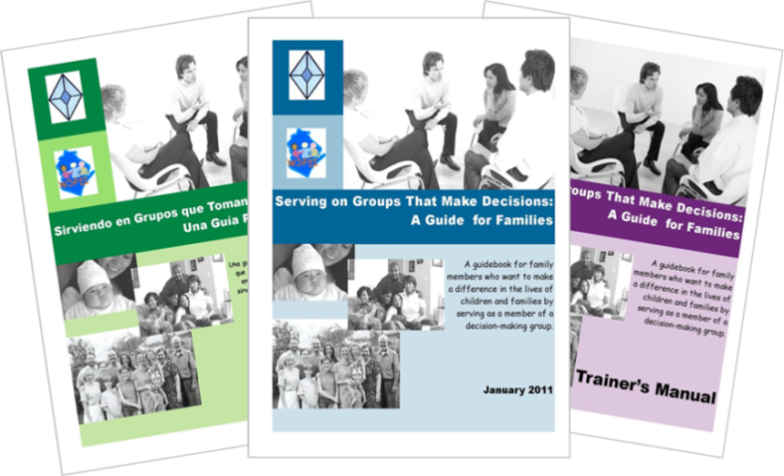
Serving on Groups That Make Decisions: A Guide for Families
Presented by:
Name
Organization/Agency
www.servingongroups.org
Notes:
Slide #122: Welcome and Introduction
Procedural Directions:
Have a copy of the Guidebook and the Training manual with you.
Make sure everyone has the materials needed for the presentation.
Ask if everyone can hear you and see the slides.
Introduce yourself and give a brief background of your experience (relevant to the group you are speaking to).
Address “housekeeping” such as restrooms, breaks, “parking lot”, group transitions, etc.
Presenter Notes:
Hello and welcome to this Serving on Groups that Make Decisions: A Guide for Families training.
My name is __insert name___ and I am the ___insert position__at _insert location__.
*Give a brief background of your experience (relevant to the group you are speaking to).
Activities

Slide 2
Section 8: Skills for Serving on Groups
What skills will help me…
prepare for a meeting?
participate in a meeting?
follow-up after the meeting?
deal with conflict?
facilitate a meeting?
Notes:
Slide #123: Skills for Serving on Groups
Procedural Directions:
Share information from the presenter notes.
If participants have a copy of the Guidebook, guide them to the appropriate section.
Presenter Notes:
Remember that the most effective team work starts with well-prepared members!
Necessary skills for serving on groups are preparing, participating, follow-up, and facilitating a meeting.
We’ll take a look at each one of these areas in more detail and provide tips and strategies to help you be the best group member that you can be.
Activities

Slide 3
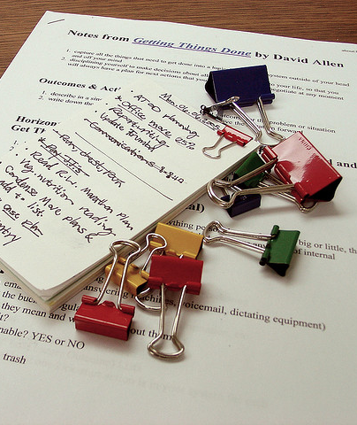
Prepare for a Meeting
Tips:
Keep a calendar
Read the agenda & additional items
Review past meeting minutes
Organize your thoughts
Keep learning
Notes:
Slide #124: Prepare for a Meeting
Procedural Directions:
Share information from the presenter notes.
Discuss and provide examples of meeting preparation strategies.
Ask suggested activity question.
Presenter Notes:
To prepare for a meeting, some tips are :
Keep a calendar. Keep meeting dates and times recorded.
Read the agenda and additional items sent for the meeting. Always try to get the agenda ahead of time so you can prepare for the meeting. Even if there is no written agenda, you can ask the leader to list the meeting topics. Review past meeting minutes. Read the minutes through for accuracy and to make sure they recorded all important information.
Organize your thoughts. Think about and write down your comments ahead of time so that you will be prepared to discuss the agenda items and additional materials. Remember, you are an equal member of the group and it is important for you to offer not only your thoughts, but the ideas and perspectives of all those you represent.
Keep learning by researching items listed in the agenda and in the additional materials sent before the meeting. Build an in-depth understanding of issues, the budgeting process, policy, etc.
A few good ways to find more information are to:
Visit your local library to ask for assistance to access online resources
Practice good listening skills and communication skills
Ask others where they find information about topics and issues you care about.
Activities
Question: What do you do to prepare for a meeting?

Slide 4
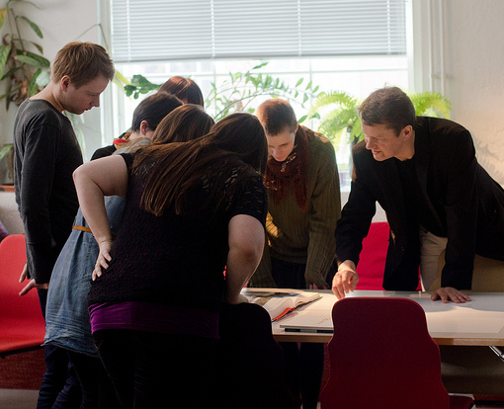
Participate in a Meeting
Attend all meetings
If unable to attend:
Let leader know ahead of time
Make sure to get notes or meeting minutes
Take and keep notes
Learn the lingo
Try new roles
Be a mentor
Listen for understanding
Notes:
Slide #125: Participate in a Meeting
Procedural Directions:
Share information from the presenter notes.
Discuss and provide examples of meeting participation strategies.
Ask suggested activity questions.
Lead suggested activity.
Presenter Notes:
To participate in a group, attend all meetings. Find out if all meetings are in-person or if there are alternative methods for participation such as conference calls, online meetings, etc.
Attending meetings helps build relationships and your own understanding of what the group is about and what the group is trying to do. It also shows a commitment to the group.
If you're unable to attend, remember to let the leader know ahead of time and make sure to get the notes or meeting minutes as soon as possible for your review.
Take notes to reference key points and assignments.
Learn the lingo like specific words and abbreviations used by members. Create your own “cheat sheet” or list of commonly used words, acronyms, and phrases.
Also try a new role in the group like leading the discussion, recording the meeting minutes, or being timekeeper.
Some groups incorporate a rotating facilitator role so everyone is given the opportunity to facilitate a meeting. This helps the group dynamics so one person doesn't dominate the leadership of the group
Be a mentor to new members of the group once you have been serving on the group for a while and you feel comfortable.
Listen for understanding. When you do not understand what is being said, ask “What I think I hear you saying is…” which is also known as restating what you heard. Then ask, “Is that right?” This gives the speaker a chance to clarify and add more information, if needed.
Activities
Questions: In the meetings in which you have participated, which of these strategies have you seen being used effectively? Are there some skills that are missing? How does that affect the effectiveness of the group?
Activity: Compass Points

Slide 5
Follow-Up after a Meeting
Tips:
Refer to your notes
Stay organized
Use technology
Review written guidance
Reflect on what was learned
Connect with mentor
Review data
Keep learning
Notes:
Slide #126: Follow-Up after a Meeting
Procedural Directions:
Share information from the presenter notes.
Discuss and provide examples of meeting follow-up strategies.
Presenter Notes:
There will typically be materials to read and activities between meetings. Some groups have sub-groups that meet to carry out a specific task for the group. Organizational skills are important to have to help you meet the responsibilities of your role.
A great habit to get into is to do a follow-up after the meeting. Do this by:
Referring to your notes. During the meeting, make a list of follow-up items and questions to ask. This will help you keep track of important information to refer to after the meeting.
Staying organized. Use a binder to store all material so it is easier to locate information during the meeting. Make a separate labeled divider for: contacts, by-laws, ground rules, agendas, meeting notes, reports, projects, and reference materials.
Use technology. Electronic files that are sent to you ahead of time can be stored in a folder on your computer desktop for easy access. If you have a laptop, you can type meeting notes into a document during the meeting.
Review written guidance like the group’s bylaws, procedures, etc.
Reflect on what you learned and what was discussed during the meeting.
Connect with a mentor to become more comfortable with the group work.
Review data. Take time to study the information and understand what the group is trying to do.
Keep learning by researching the topics in other areas, states, organizations, and the like. Great ideas might come from looking at the work of others.
Activities

Slide 6
Dealing with Conflict
Tips:
Keep an open mind
Use “I” statements
Don’t take things personally
Ask questions
Stay focused on the topic
Focus on solutions
Take a break
Remember the group’s purpose
Notes:
Slide #127: Dealing with Conflict
Procedural Directions:
Share information from the presenter notes.
Discuss and provide examples of how to deal with conflict.
If time allows, have participants do the optional activity on conflict management styles.
Presenter Notes:
Conflict is a natural part of group dynamics, but it can be complex.
Try to respect individual differences while helping people avoid becoming too entrenched in a fixed position.
Keep an open mind - You might learn something or increase your understanding of another’s point of view.
Use “I” statements, not “you” statements.
Don't take things personally.
Ask questions – Find out the facts by asking Who? What? When? And Why?
Stay focused on the topic – Refer to the agenda as a reminder.
Focus on solutions. If you provide an issue or concern, offer a solution or potential options.
Take a break – If you feel overwhelmed, excuse yourself for a few minutes.
Remember the group’s purpose at the center of the conversation.
Activities
Conflict Management Styles

Slide 7
Resolving Conflict
Tips:
Pay attention to interests
Listen first; talk second
Good relationships are a priority
Keep people and problems separate
Set out the facts
Explore options together
Notes:
Slide #128: Resolving Conflict
Procedural Directions:
Share information from the presenter notes.
Discuss and provide examples of how to resolve conflict.
Lead suggested activity.
Presenter Notes:
To resolve conflict, follow these rules:
Pay attention to the interests that are being presented: By listening carefully you'll most-likely understand why the person is adopting his or her position.
Listen first; talk second: To solve a problem effectively you have to understand where the other person is coming from before defending your own position.
Make sure that good relationships are the first priority: As far as possible, make sure that you treat the other calmly and that you try to build mutual respect. Do your best to be courteous to one another and remain constructive under pressure.
Keep people and problems separate: Recognize that in many cases the other person is not just "being difficult" – real and valid differences can lie behind conflictive positions. By separating the problem from the person, real issues can be debated without damaging working relationships.
Set out the "Facts": Agree and establish the objective, observable elements that will have an impact on the decision.
Explore options together: Be open to the idea that a third position may exist, and that you can get to this idea jointly.
Managed in the wrong way, real and legitimate differences between people can quickly spiral out of control, resulting in situations where cooperation breaks down and the group's mission is threatened.
To calm these situations down, it helps to take a positive approach to conflict resolution, where discussion is courteous and non-confrontational, and the focus is on issues rather than on individuals. If this is done, then, as long as people listen carefully and explore facts, issues and possible solutions properly, conflict can often be resolved effectively.
Activities
Activity: Listening Awareness Inventory

Slide 8
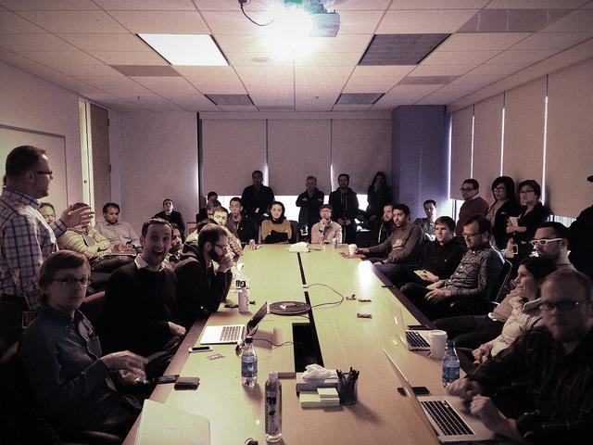
Facilitate a Meeting
Common strategies for good facilitation:
Makes everyone feel comfortable, welcomed, and valued
Encourages participation
Prevents and manages conflict
Listens and observes
Clarifies group discussions
Supports quality decisions
Ensures outcome-based meetings
Recognizes and appreciates contribution
Notes:
Slide #129: Facilitate a Meeting
Procedural Directions:
Share information from the presenter notes.
Discuss and provide examples of meeting facilitation strategies.
Presenter Notes:
An effective meeting starts with a good facilitator. To facilitate a meeting, there are some common strategies good facilitators have.
They try to make everyone feel comfortable and valued by allowing time for 'small talk', thanking people for their participation, and using open body language, like uncrossed arms.
They encourage participation by all members by using open-ended questions, dividing into small groups, and using flip charts and handouts.
Remember there are extremes of participation in groups so the facilitator needs to balance that.
They prevent or manage conflict by using team-building activities, setting ground rules, and drawing attention to things that everyone agrees on instead of focusing on the disagreements.
They actively listen and observe the others in the group by scanning reactions to comments or issues.
They clarify group discussions by summarizing and rephrasing what was said. They may use the phrase “I hear that….”
They also support quality decisions being made by reminding the group of the decision deadlines, reviewing the criteria and supporting information, and polling the group before major decisions to avoid surprises.
They make sure the meetings stay on track and the group is getting done what needs to be done by keeping the group members focused, recording decisions, and developing an action plan.
Finally, they recognize and express appreciation for member contribution to the work of the group and participation during meetings and activities.
Activities

Slide 9
Section 8 Resources
Meeting Preparation: Lead Effective Meetings (video-6:24) https://www.youtube.com/watch?v=itdYBXrJm-8
Meeting Facilitation Tips: How to Facilitate Your 1st Meeting (video-6:07) https://www.youtube.com/watch?v=oPZJQ-Mhwq0
Applying Results-Based Facilitation in Virtual Settings (Annie E. Casey Foundation) https://www.aecf.org/blog/applying-results-based-facilitation-skills-in-virtual-meetings
Virtual Meetings Etiquette-Do’s & Don’ts (video-7:56) https://www.youtube.com/watch?v=HYUVXQfaVp0
Developing Facilitation Skills Toolkit http://ctb.ku.edu/en/tablecontents/sub_section_main_1154.aspx
Planning and Structuring Effective Meetings - Skills You Need http://www.skillsyouneed.com/ips/meetings.html
Forming, Storming, Norming, and Performing: Model for Nurturing a Team to High Performance (incl. video-1:58) http://www.mindtools.com/pages/article/newLDR_86.htm
Notes:
Slide #130: Section 8 Resources
Procedural Directions:
Highlight 1 or 2 online resources listed on the slide.
Have one or two web links accessible and ready to show.
Presenter Notes:
Meeting Preparation: Lead Effective Meetings (video-6:24) https://www.youtube.com/watch?v=itdYBXrJm-8
Meeting Facilitation Tips: How to Facilitate Your 1st Meeting (video-6:07) https://www.youtube.com/watch?v=oPZJQ-Mhwq0
Applying Results-Based Facilitation in Virtual Settings (Annie E. Casey Foundation) https://www.aecf.org/blog/applying-results-based-facilitation-skills-in-virtual-meetings
Virtual Meetings Etiquette-Do’s & Don’ts (video-7:56) https://www.youtube.com/watch?v=HYUVXQfaVp0
Developing Facilitation Skills Toolkit http://ctb.ku.edu/en/tablecontents/sub_section_main_1154.aspx
Planning and Structuring Effective Meetings - Skills You Need http://www.skillsyouneed.com/ips/meetings.html
Forming, Storming, Norming, and Performing: Model for Nurturing a Team to High Performance (incl. video-1:58) http://www.mindtools.com/pages/article/newLDR_86.htm
http://www.mindtools.com/pages/article/newLDR_86.htm
Activities
Handout: Guidebook Sectional Resource List

Slide 10
Section 8 Resources
Conflict Resolution: Using the Interest-based Rational Approach (incl. video-2:57) http://www.mindtools.com/pages/article/newLDR_81.htm
When Conflict Arises: Working with Emotion (video-16:21) https://www.wsems.us/multimedia/videos/when-conflict-arises/
Handling Disagreements Productively http://parents-teachers.com/lib/Disagreements_Between_Parents_And_Teachers_-_Handling_Them_Productively/
The Big Bang Theory on Active Listening (video-1:55) https://www.youtube.com/watch?v=3_dAkDsBQyk
5 Ways to Listen Better(TED Talk video-7:51) https://www.youtube.com/watch?v=cSohjlYQI2A
Listening Skills (video-7:48) https://www.youtube.com/watch?v=B8EJVcRJSXo
Communicate - Paraphrasing (video-3:42) https://www.youtube.com/watch?v=5JL2iizK2c0
Notes:
Slide #130: Section 8 Resources
Procedural Directions:
Highlight 1 or 2 online resources listed on the slide.
Have one or two web links accessible and ready to show.
Presenter Notes:
Conflict Resolution: Using the Interest-based Rational Approach (incl. video-2:57) http://www.mindtools.com/pages/article/newLDR_81.htm
When Conflict Arises: Working with Emotion (video-16:21) https://www.wsems.us/multimedia/videos/when-conflict-arises/
Handling Disagreements Productively http://parents-teachers.com/lib/Disagreements_Between_Parents_And_Teachers_-_Handling_Them_Productively/
The Big Bang Theory on Active Listening (video-1:55) https://www.youtube.com/watch?v=3_dAkDsBQyk
5 Ways to Listen Better(TED Talk video-7:51) https://www.youtube.com/watch?v=cSohjlYQI2A
Listening Skills (video-7:48) https://www.youtube.com/watch?v=B8EJVcRJSXo
Communicate - Paraphrasing (video-3:42) https://www.youtube.com/watch?v=5JL2iizK2c0
http://www.mindtools.com/pages/article/newLDR_86.htm
Activities
Handout: Guidebook Sectional Resource List

