Slide 1



Serving on Groups
That Make Decisions
Section 6: Using Data as Information
October 23, 2025
Presented by:
Jan Serak
WI FACETS 877-374-0511
Notes:
WEBINAR LOGISTICS
Procedural Directions BEFORE WEBINAR:
At least 1 week in advance, review and update the PPt, Speaker Notes, and HOs to make sure they have current information and live links. (For sure, PPt Stage 3: Organizing Data slide needs to be redone for most current data; and HO1 needs to be redone.)
Send PPt, Notes & HOs to webinar moderator (if there is one).
On the day of, upload & minimize PowerPoint (don’t use a .pdf version), to your desktop. You will click “Slide Show” when ready to start presentation.
Upload, open & minimize the Handouts to your desktop to have during the presentation in case you want to refer to them.
Join the Zoom webinar at least 15 minutes in advance.
For Jan: attach clip mic. Zoom settings: Mic:”Same as Speakers”/Mic USB; Speakers: “Real Audio.”
Presenter Notes:
Hello & welcome to today’s webinar. This is the 4th webinar in our 5-part Serving on Groups that Make Decisions Fall webinar series.
My name is Jan Serak. I am the founder & former ED of WF. I am also the Director of Serak Consulting Services, where I provide training for nonprofit agencies and others, consult with Boards of Directors, and provide interim agency management.
I am the parent of two adult sons, one of whom has autism, the other is CFO for a large WI school district.

Slide 2

Agenda
Serving on Groups Overview
Section 6 – Using Data as Information
  What is data?
  How can I learn more about data groups use?
  What are the 8 stages of data use?
Resources
Notes:
Slide #2: Agenda
Show slide.
Presenter Notes:
Here’s the agenda for today’s webinar:
We’ll do a quick overview of the Serving on Groups Guidebook resource.
There are 8 sections in the Guidebook. Today we will cover Section 6: Using Data as Information
We will look at: what is data, how to learn more about data that groups use in decision-making.
Data can be really comfortable for some and really intimidating for others.
Then, we will cover the 8 stages of data use.
Finally, we will end today with some additional resources.

Slide 3

Your Group Experience
A. If you have never served on a decision-making
group
B. If you have served on a decision-making group
before
C. If you are thinking about joining a decision-
making group
D. If you are currently serving on a
decision-making group now.
Notes:
Slide #2a: Poll #1
Procedural Directions:
Show the slide.
Presenter Notes:
Can everyone take a moment to please think about what brings you here today.
I would like to do a quick POLL to see what the experiences are of you all with serving on decision-making groups.
In the Q&A Box at the bottom of your screen (on Zoom), write the letter for your experience:
□ Write “A”. If you have never served on a decision-making group
□ B. If you have served on a decision-making group before
□ C. If you are thinking about joining a decision-making group
D. If you are currently serving on a decision-making group (or groups) now.
…And, if you are willing to share, can you also write the
name of the group in the Chat Box.
Share results of Poll….

Slide 4

Overview of Serving on Groups
Developed due to an identified need
Collaborative effort by stakeholders
Audience – parents, educators, students, others
www.servingongroups.org
Notes:
Slide #3: SOG Overview
Procedural Directions:
Slow Slide.
Link is “live.”
Presenter Notes:
First, for those of you who weren’t with us for previous Serving on Groups webinars, I want to briefly tell you about the Serving on Groups resource.
SOG was developed in response to an identified NEED.
WI FACETS found that it is not enough to just invite parents to join decision-making groups, but that they may need empowerment, information, & support in order to be more effective participants.
This resource provides that for parents. AND, the info is intended to really support anyone on those groups, not just parents.
And, it applies to all types of groups, not just related to education, and not just in WI – but can be applied nationally.
WI FACETS developed the SOG Guidebook with funding from the WI DPI & US Dept of Ed/Office of SpEd Programs.
You’ll hear me refer to the resource as “the Guidebook” for short.
The research and review of the Guidebook publication was the result of WI FACETS working with a large group of stakeholders from across WI that included parents, educators, state agencies, and others.
There is something for everyone in the Guidebook. It is a great introduction for some, a welcome refresher for others, and a resource for all, including experts and mentors, so everyone can come to the table ready to serve.
The Guidebook and many resources can be downloaded free from the SOG website. The link is on your screen. (Show if time)
Also on the site is an Online Learning platform, that people can access 24/7 to go through the 8 SOG modules on their own.
You can also order the hardcopy of the SOG Guidebook from the site.
QUICK QUESTION for you all - Are you comfortable working with and understanding data? Put a “Y” for yes, “N” for no, or “K” for kind of - in the Q&A box. Read results…

Slide 5

What is Data?
Data…
Is factual information
Helps groups make decisions
Must be:
  Reliable
  Valid
  Accessible
Notes:
Slide 4. What’s Data?
Show the slide.
Presenter Notes:
What is Data? Data is, most simply, factual information.
You can think about times when you’ve come across sources of data that are confusing & hard to understand? How did you deal with it? These are points to consider when we discuss understanding data in decision-making groups.
When dec-makg grps use data to make decisions, they are basing their decisions on facts, not guesswork or feelings. This is called “Data Based Dec-mkg.
Data doesn’t just apply to more formal decision-making groups. It is used by all kinds of groups and can come in many different forms.
You can see on your screen some important terms that we need to be familiar with related to data – reliable, valid, and accessible.
Reliable means the data is accurate and true every time. Would it be the same if someone else collected the data?
Valid means the data reflects a truth and produces the desired result. In other words, does the data measure what it claims to measure?
Data needs to be accessible. This means, what does someone do when the data is not clear or is hard for them to understand. All concerns, needs, & abilities of the audience need to be considered when using data.
Reliability problems in education often arise when researchers overstate the importance of data that is drawn from too small or too restricted a sample.
Such as, the data from 5 people is probably not going to be as reliable as the data from 25 or 100 people.
For example, imagine if when I was a high school principal I claimed to the school board that I had evidence that the parents love our school's programs.
When the school board chair asked me how I could make such a claim, I responded by defensively asserting it was a conclusion based on “hard data”—specifically, a survey taken at the last winter band banquet.
The board chair might respond that because that event was attended by only 5 percent of the school's parents and all the parents who attended had one thing in common—they had children in band—my conclusions were “unreliable.” He would be right.
Claiming that such a small and select sample accurately represented the views of a total population (all the school's parents) stretches the credibility of my assertion well beyond reasonableness.

Slide 6

Confidentiality
A set of rules or a promise
Limit access or put restrictions on certain types of information
When working with data as a group, it is important to state if certain information should not be shared with others outside of the group.
Notes:
Slide 5. Confidentiality
Show slide.
Presenter Notes:
Confidentiality is an important term when it relates to data.
Confidentiality is a set of rules or a promise that a person makes to limit access or put restrictions on certain types of information.
When working with data as a group, it is important to always state if certain information should stay in the group and not be shared with others.
If you are new to a group, you have to make sure to ask questions about what data can be shared
Ask if there is a written protocol or policy that the group has about what can be shared – and then be sure to follow it.
If there is not a written protocol for the group, and if you see that the group is handling data that probably should be kept confidential, you might suggest that the group develop a a written protocol (or guidelines) for confidentiality.

Slide 7
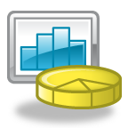
Forms of Data
Quantitative Data
Typically numbers
Answers the questions:
  How much? How often? When? Where?
Qualitative Data
Typically descriptions
Answers the questions:
  What is it like? What do you observe about it?
Notes:
Slide 6. Forms of Data
Show the slide.
Presenter Notes:
There are basically 2 different forms of data – the first is qualitative data & the other is quantitative data.
Let’s look at differences between the two types:
Quantitative Data deals with numbers.
This is data that can be measured, like: Length, height, area, volume, weight, speed, time, temperature, humidity, sound levels, cost, number of members, ages of students, etc.
So, when you think of Quantitative, think Quantity
The other kind of data is Qualitative Data.
This type deals with descriptions – this is data that can be observed but is not able to be measured, or easily measured.
This might include things like colors, textures, smells, tastes, appearance, beauty, etc.
When you think of Qualitative, think Quality
For example, when we think of weather,
The quantitative data would be the exact temperature, the barometric pressure, and the wind speed.
The qualitative data can be a bit more subjective. Is it partly cloudy? Is it windy or calm? Is it cool or warm? Qualitative data describes what is observed or felt.
Key questions to ask about data that your group uses is on p.40 of Section 6 in the Guidebook.
These questions include things like – what kind of data does your group use? Where does the data come from? How does the group use data to make informed decisions?
You can ask for examples of how data was collected by the group in the past and conclusions that were made.
You can ask if there are areas of the data that might be missing or that your group is unable to view and why.
And ask for an explanation of data if you don’t understand it.

Slide 8
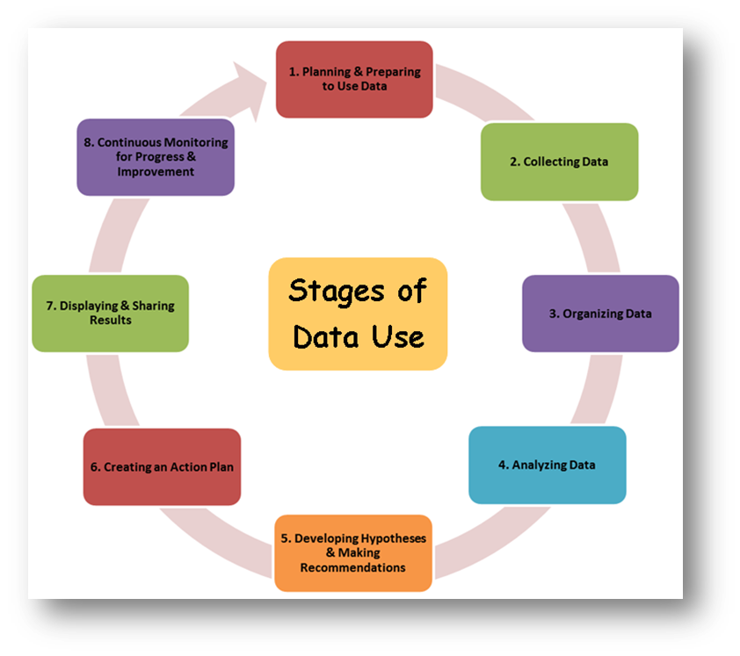
Stages of Data Use
Planning & Preparing to Use Data
Collecting Data
Organizing Data
Analyzing Data
Developing Hypotheses & Making Recommendations
Creating an Action Plan
Displaying & Sharing Results
Continuous Monitoring for Progress & Improvement
Notes:
Slide 7. Stages of Data Use
Show the slide.
Presenter Notes:
Using data in a decision-making group is a process with multiple steps or stages.
These eight stages help make sure a decision-making group is effectively using data to inform its decisions.
Planning & Preparing to Use Data
Collecting Data
Organizing Data
Analyzing Data
Developing Hypotheses & Making Recommendations
Creating an Action Plan
Displaying & Sharing Result
Continuous Monitoring for Progress & Improvement
The following slides describe each of the eight stages decision-making groups are in when they use data to help make decisions and take action.

Slide 9
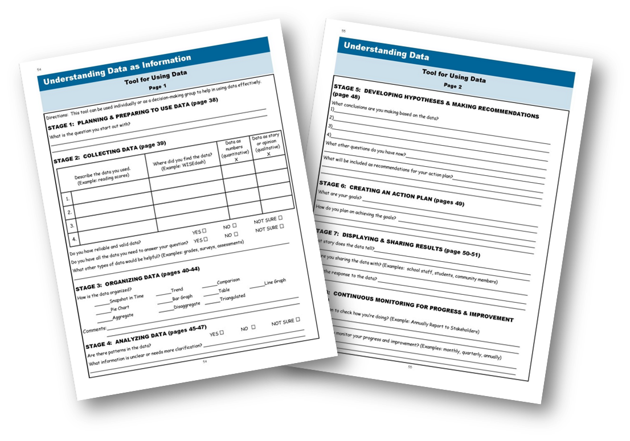
Tool for Using Data
Notes:
Slide 8. Tool for Using Data
Show the slide.
Presenter Notes:
One of your HANDOUTs for today is the Guidebook Section 6, p. 58 & 59, Tool for Using Data.
This is a 2-page tool, or a template, that groups can use to help work through the stages of data use.
This tool can be used individually, just by yourself, or you can share it with your whole decision-making group as an idea to help them in using data effectively to make informed decisions.
This tool has all the 8 Stages of Data on it and questions related to each stage.
You can follow along today, using the Handout if you want, as I go through the 8 stages.
If you are in a group that is using data, you could share this Tool with them and work through it with your whole group.

Slide 10
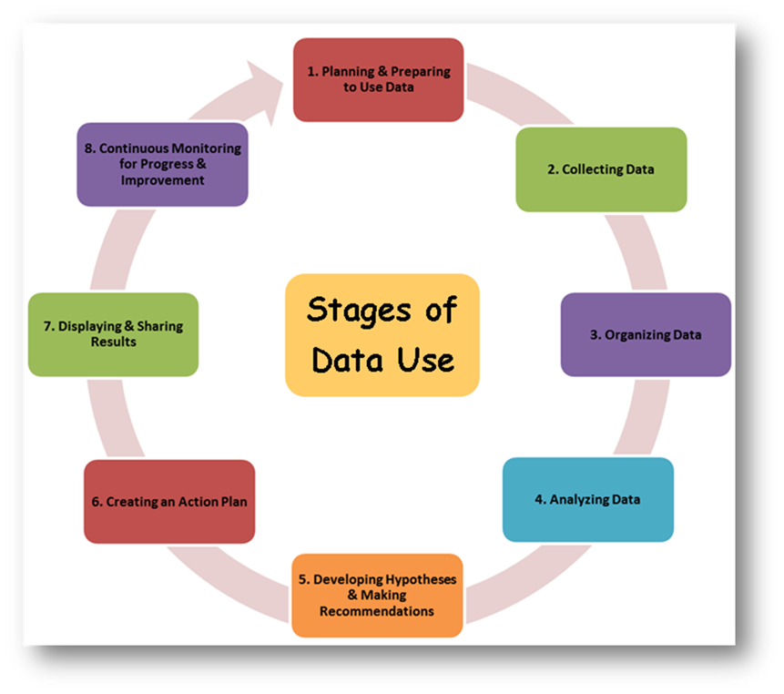

Stages of Data Use
Planning & Preparing to Use Data
Collecting Data
Organizing Data
Analyzing Data
Developing Hypotheses & Making Recommendations
Creating an Action Plan
Displaying & Sharing Results
Continuous Monitoring for Progress & Improvement
Notes:
Slide 9. Stages of Data Use-Stage 1
Show the slide.
[CLICK] for animation.
Presenter Notes:
[CLICK] The first step in working with data is to plan and prepare to use data.
The group needs to ask questions, reflect, and plan before the data are collected.

Slide 11

Stage 1:
Planning & Preparing to Use Data
What do we want to know?
Tips
  Ask focusing questions
  Use a variety of methods & sources
  Find data already out there - baseline
  Try to find gaps
  Pinpoint possible roadblocks
  Ask others knowledgeable of the data
Notes:
Slide 10. Stage 1 – Planning & Preparing to Use Data
Show the slide.
Presenter Notes:
All data planning should start with the question, "What do we want to know?" This helps to focus the data search and keeps the group on track.
Selecting or collecting data is not always about finding new data.
Sometimes, the group needs to look at what data they already have and what data they need. More often groups spend time trying to find the right data.
You should make sure to ask focusing questions that help pinpoint the information that you need to be able to make an informed decision and to take action.
Use a variety of methods & sources to select data. You will want to have multiple sources of data to inform your decisions.
Find out what data is already out there to use. What is the baseline? (or starting point)
Try to find gaps in information found in the current data.
Pinpoint possible roadblocks in finding information and figure out how to overcome them.
You can ask people familiar with data to explain what the school, agency, or organization (whatever entity you are working with) knows. Have them also share areas where there is not enough data to make a hypothesis.

Slide 12
Stages of Data Use
Planning & Preparing to Use Data
Collecting Data
Organizing Data
Analyzing Data
Developing Hypotheses & Making Recommendations
Creating an Action Plan
Displaying & Sharing Results
Continuous Monitoring for Progress & Improvement
Notes:
Slide 11. Stages of Data Use – Stage 2
Show the slide.
[CLICK] for animation.
Presenter Notes:
[CLICK] The next step in working with data is to collect it.
Data should be collected for a specific reason or purpose relevant to the work of the group.
Groups can collect data themselves or they can use data that someone else has collected.
The question a group needs to answer when collecting data is “How do I find the data –both new and existing -that I need?”
Groups should only collect data they will use.
Too much information can be overwhelming.
Too little information won't help the group find the answers they're looking for.

Slide 13
Stage 2: Collecting Data
Answer questions to make an informed decision and act.
Data from Schools
  Student Learning Data
  Student Demographic Data
  School Perception Data
  School Process Data
Families as a Data Source
  Surveys
  Focus Groups
  Participants or Attendees
  School Perception Data
Notes:
Slide 12. Stage 2-Collecting Data
Show the slide
[CLICK] for animation.
Presenter Note:
So, for example, let’s look at data that might be available for a decision-making group that is related to a school or schools. Schools are full of data. [CLICK] For example there is:
Student learning data is about the schoolwork and assessments of individual students. This could be IEP data, state assessment data, graduation rate data
Student demographic data are the personal factors about each student. Such as - Attendance records, age, race/ethnicity, application and enrollment data
School perception data is information about the school based on views of school staff, parents, and the community.
As, surveys, personal testimonies, parent meeting notes, etc.
School process data provide information about school management, administration, structure, and general workings of the school.
For example, income and expense reports, teacher to student ratios, class sizes, available space in the building, etc.
[CLICK] Ways schools can use Families as a Source of Data include:
Doing Surveys, holding Focus groups. They can gather data from families participating or attending various school activities and events, Or collecting School Perception data
It is important for schools to let families know why they are collecting data provided by families & what they are going to do with the data.
EX of collecting data – Schools often make a big deal about encouraging students to come to school on the 3rd Friday of Sept. They let parents know that attendance that day is used for the “3rd Friday Report” to the WI Dept of Public Instruction, which helps determine the school’s future funding.

Slide 14
Stages of Data Use
Planning & Preparing to Use Data
Collecting Data
Organizing Data
Analyzing Data
Developing Hypotheses & Making Recommendations
Creating an Action Plan
Displaying & Sharing Results
Continuous Monitoring for Progress & Improvement
Notes:
Slide 13. Stages of Data Use-Stage 3
Show the slide.
[CLICK] for animation.
Presenter Notes:
[CLICK] The third step in working with data is to find a way to organize it so that it helps others to understand it.
Data is organized for different purposes.
Finding the right way to organize data should depend on both your audience and the data you’re trying to present.

Slide 15
Stage 3: Organizing Data
Aggregated Data:
a whole set of data formed by combining several parts
Disaggregated Data:
a whole set of data separated into its categories or subgroups
Notes:
Slide 14. Stage 3 – Organizing Data
Show the slide.
Presenter Notes:
2ways to organize data are – aggregated and/or disaggregated.
Let’s look at what the 1st way of organizing data - Aggregated Data - means.
Combining all the data from the whole group which gives you the BIG picture.
Most data is first shown as aggregated dataFor example, teachers aggregate data to get an overall picture of their classes. This “big picture” view of data is especially useful in sharing information with audiences such as your governing body.
Aggregated data is also appropriate for annual reports to the public.
The second way to organize data is Disaggregated Data
A group may want to disaggregate data. Which basically means, “picking it apart.”
Disaggregating data means looking at results or scores from the whole or larger group and breaking it down by smaller groups to get more and more details.
When you disaggregate data, you can dig deeper and deeper.
An example is: You can disaggregate district-wide data by school, by school data by grade, by grade-level data by classroom, and classroom data by child. And, even deeper by child with or without a disability, or child with a certain type of disability.
You can disaggregate five-year data by year, yearly data by month, and monthly data by week.
Each time that you disaggregate or further break down your data, you get a better look of one part of data.
Sometimes disaggregated data can surprise you.
Disaggregated data can help your group decide on and prioritize your action plans.
On your screen, you can see an example of the 2 ways to organize data:
You can see Aggregated data on the left side. The display, which is a “pie chart” picture of data – shows the percentage of youth, ages 20-24, that are not enrolled in school and also not working.
48% have less that a high school diploma; 32% have a high school diploma; 10% have some college; and 10% have earned their bachelor’s degree or higher.
Disaggregated data, on the right side here, shows a “bar chart” with the data broken down into much smaller pieces of data.
Here you can see that we are still looking at youth, ages 20-24, who are not enrolled in school and also not working…
but the data is broken down even further to dig in to see who those 32% of students with a high school diploma are – by race and ethnicity…
and on this chart, it looks like the highest number are Native American, and next highest are black.

Slide 16
Stage 3: Organizing Data
Triangulated Data:
Use of multiple independent sources of data to establish the truth & accuracy of a claim.
College Admissions
Essay
Extracurricular Activities
High School Grades
Interview
ACT/SAT Scores
Application
References
Notes:
Slide 15. Stage 3 – Organizing Data.
Show the slide.
Presenter Notes:
Groups may look data that is triangulated.
The term Triangulated data means that the group looks at, or compares, 3 or more different sources of data that applies to the same person, place, object, or subject.
They do this to see if the information from one source is supported by other sources. Comparing data from multiple, independent sources also can provide some good insights into the data.
For example, a college admission process wants to see the whole picture of the student.
It answers the questions: Is this student ready to be successful in college? At our college? How do we know?
The data includes not just the grade point average from high school, but also listing the volunteer and extracurricular activities, an essay, application form, references from teachers and coaches or other people who know the student, an in-person interview, etc.
Put altogether, all of this information, from multiple sources, gives a much more accurate picture of the student.
Another example, IEP Teams often triangulate data to decide if a child has a disability.
Results from 2 tests at school and an outside therapist test
Or, parent information about the child at home & in the community; 1 test result from a teacher; and another test result from a different teacher
Or, 2 evaluations from 2 different school personnel; and information from the child’s doctor

Slide 17
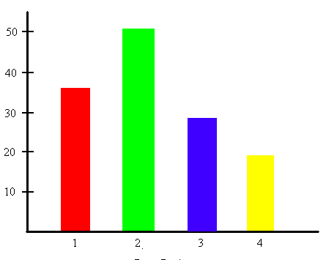
Stage 3: Organizing Data
Tips for Interpreting Graphs
Read all labels.
What is…
  in each COLUMN?
  in each ROW?
  the RANGE OF VALUES?
Where was…
  the MOST change or growth?
  the LEAST change or growth?
Notes:
Slide 16. Step 3-Organizing Data
Show the slide.
Presenter Notes:
One way to organize data is to use a Graph to make the data easier to understand.
Formats like lists, tables, charts, spreadsheets, and written and verbal descriptions help you see a visual representation of data.
When looking at a graph, you must make sure to read all the labels that are included on the graph or table.
Reading a graph may be something many of you already feel comfortable doing, or something that some of you have not done very often in the past.
Remember to read all the labels on the graph.
Ask yourself:
What is in each column? (on this graph, the columns are the colored bars and are numbered 1 through 4)
What is in each row? (on this graph, rows go sideways, and are labeled 10, 20, 30, 40, 50)
What is the range of values? (The lowest value, or #4/yellow column, is 20 points. The highest, or the #2/green column, is 50 points. So the Range of values is 30 points (50 minus 20=30.
Does the data have a direct or indirect relationship?
Do the lines have positive or negative slopes? (here-up&down)
Where was the most change or growth? (column #1 to #2)
Where was the least change or growth? (from column #3 to #4)
Ask for help interpreting the graph if you don’t totally understand it.

Slide 18
Stage 3: Organizing Data
A Snapshot in Time
https://www.indicator14wi.org/
Notes:
Slide 17. Stage 3 – Organizing Data
Show the slide.
Presenter Notes:
All data is just a snapshot in time.
One way to show a Snapshot in Time – is by using a pie chart to display the data.
A pie chart shows the information by dividing a circle into several parts (like cutting a pie) and shows how each part – or each piece of the pie - relates to the whole.
There always needs to be a total of 100% when using pie charts.
We saw an example of a pie chart a few slides ago, which showed data about youth, ages 20-24, that were not enrolled in school and also were not working.
This slide shows another example of a pie chart. For this one, a community member wanted to find out what students with IEPs were doing after they graduated from high school.
One great source for graduation data in Wisconsin is WI Post School Outcomes website – the link to this data is at bottom of your screen. (https://www.indicator14wi.org/ ). This is also known as Indicator 14 data, which all states are required to collect by the US Dept of Ed/Office of SpecEd Programs annually. The Wisconsin website has Outcome data for multiple years.
This pie chart is a great way to show community members what WI students with IEPs in high school were doing 1 year after graduation from high school.
Look at the labels carefully, the numbers & percentages. The color coding on the right gives you clues to read this pie chart.
Reading this chart, you can see that, in 2023, the data shows that 20% of the students were in enrolled in higher education, 51% were working competitive employment, 3% were in some type of training, 7% were in other employment (like supported employment, a sheltered workshop, or something like that), and 18% were doing something else.

Slide 19
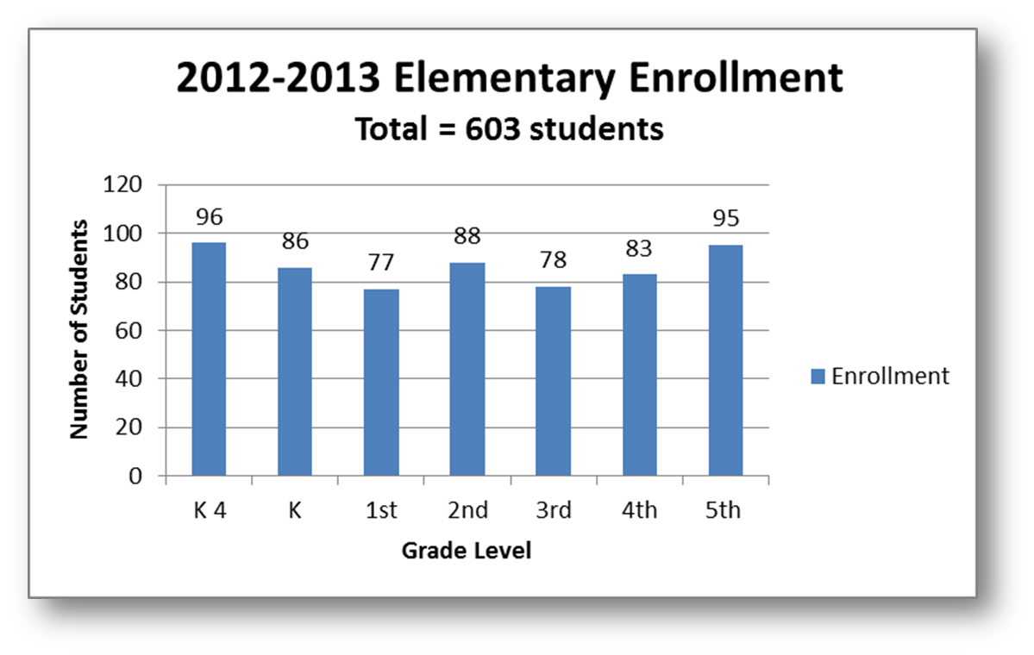
Stage 3: Organizing Data
Comparisons
Notes:
Slide 18. Stage 3 – Organizing Data
Show the slide.
Presenter Notes:
Another way that you will sometimes see data organized is by using Comparisons.
Using a bar graph or a line graph can help us compare the relationship between several variables.
Variables may be things like: the grade level, gender, English Language Learner or other categories. Studying this data can help draw conclusions about student achievement.
Look at the bar graph on this slide. (This bar graph is on p. 46 of your HO from Section 6 of the Guidebook.)
This graph shows a school district’s total elementary enrollment of students during the 2012-2013 school year.
This bar graph tells us how the 603 students are distributed across the 7 grade levels, from K4 through 5th grade.
This information helps to guide decisions on things like the number of teachers and other staff needed in a particular grade level.
For example: Class size policies are present in most school districts. So, if the class size policy states that 4K and K classes will have a range of 18 to 22 students per class,
On the graph, the K4 column says there are 96 kids. We would have four 4K classrooms of 19 students each (or 76 kids) & one classroom of 20.
The Kindergarten column says there are 86 kids. We would have 2 Kindergarten classes with 22 students (44 total) and 2 with 21 (42). 42 + 44 = 86.
You can think about ways to use information on the bar graph to answer other important questions that a school decision-making group, or school board, might need to make, like:
How will the number of students in each grade affect the staffing needs of the school district? Or,
How do enrollment numbers affect instructional needs (as, textbooks, computers, supplies) & budget for the district?
________________________________________________________PPOLL #2 – (Multiple choice/one answer)
Here’s a quick poll for you. Look at the graph on your screen again…
Say we have a district policy of 25 students per class,
How many 5th grade classes will the school need to plan for?
2 classes
3
4
5
Please write your answer in the Q&A box.
4 is the answer – 95 students is shown on the 5th grade column on the chart - divided by 25 is 3.8 classes, round up to 4 classes

Slide 20
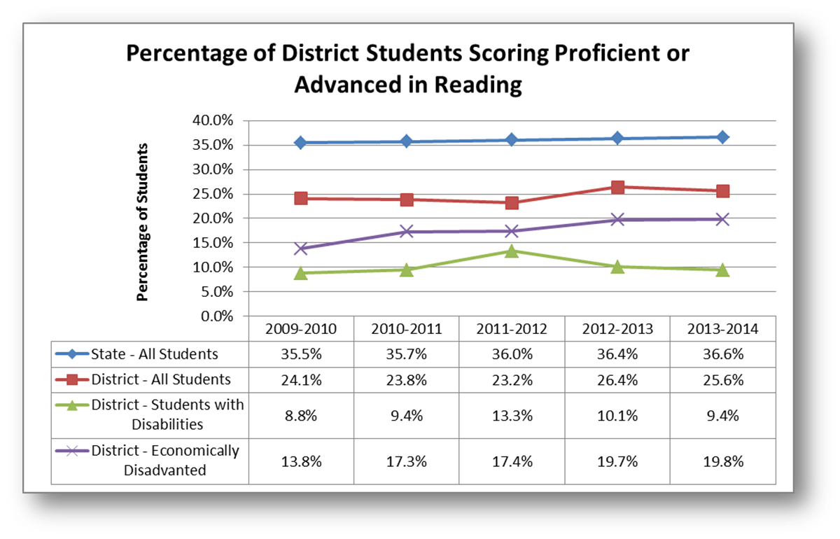
Stage 3: Organizing Data
Trends
Notes:
Slide 19. Stage 3 – Organizing Data
Show the slide.
Presenter Notes:
Data can also be looked at by identifying Trends.
This means looking at and comparing data over time.
Looking at data this way can help a group make predictions about the future.
Using baseline data, you can track progress towards goals over time.
For example, to see achievement trends in different groups of students over time, it is helpful to use a bar graph, a line graph or a spreadsheet.
When data from multiple periods of time (weeks, months, years, etc.) is also displayed, we begin to see trends form.
The graph at the top of this slide is a LINE GRAPH. Just underneath it is a SPREADSHEET of data.
These both show the trends in the Wisconsin Student Assessment System (WSAS) results in reading from the 2009-2010 school year to the 2013-2014 school year.
(For those who may not know, this includes both students who took the Wisconsin Knowledge and Concepts Exam (the WKCE) with and without accommodations and also students who took the Wisconsin Alternative Assessment for Students with Disabilities (WAA-SwD). And, these tests were done with students in Grades 3, 4, 5, 6, 7, 8, and 10.)
These statewide assessments have new names now in WI.
The blue line represents all the students in the state that took the test.
red line all the students in the school district being looked at.
The green line, the students with disabilities,
and the purple line, students who were considered economically disadvantaged.
You can look at either the line graph or the spreadsheet and see which group or groups of students are improving….
The purple line looks the most advanced over the 5-year period.
The blue line shows a slight improvement of all students over the 5 yrs.
You can see which group(s) are staying the same or just improved slightly.
It is, as you can see, useful to display data in a way that you can see the data long term in order to gain a broad perspective about the information

Slide 21

Stage 3: Organizing Data
Tips to Validate the Findings
To make sure the data are sound & accurate:
Use trusted sources
Follow-up with questions
Use different ways of gathering data
Ensure everyone agrees and accepts the findings
Notes:
Slide 20. Stage 3 – Organizing Data
Show the slide.
Presenter Notes:
In stage 3, organizing data, we have to think about what do we have to do to make sure that the data we are looking at are VALID.
Valid means sound or accurate.
To be confident that we can validate that the data we have found is sound or accurate, your group can use the processes shown on the slide to make sure the data you want to use for making decisions are sound:
One way to validate your data is to make sure to look for trusted sources for the data
Two is to follow-up with questions to make sure data are accurate and understood by the group
Also, we should be sure to use many different ways of gathering data
And finally, make sure that everyone in the group agrees with and accepts the findings of the data

Slide 22
Stages of Data Use
Planning & Preparing to Use Data
Collecting Data
Organizing Data
Analyzing Data
Developing Hypotheses & Making Recommendations
Creating an Action Plan
Displaying & Sharing Results
Continuous Monitoring for Progress & Improvement
Notes:
Slide 21. Stages of Data Use – Stage 4
Show the slide.
[CLICK] for animation.
[CLICK] After collecting and organizing the data, the next step, Step 4, is to analyze the data.
Analyzing the data means thinking about what the data mean and finding patterns in it.
Analyzing data is not a simple process.
The group may have to look at the data in several different ways in order to make a decision.

Slide 23
Stage 4: Analyzing Data
Look for Relationships in the Data
  Each view provides unique insight
  Look from many viewpoints
  Understand the parts as well as the whole
  Strengths and challenges
  Don’t draw conclusions too soon
  Record information as it appears in the source
Notes:
Slide 22. Stage 4 – Analyzing Data
Show the slide
Presenter Notes:
One of the ways to analyze the data is to look for relationships in the data.
When analyzing data, similarities, differences, trends, and other relationships in the data may show information that the group otherwise could not see.
Each view of the data provides a unique insight, making it important to look at the data from many viewpoints.
Only after studying the data more closely do patterns become apparent, whether surprising, expected, or repeated.
Sometimes data is collected automatically or because it is required by law or local policy.
People then have it available and are able to ask questions about it later – to be aware of the data as a whole, but also to better understand the parts of information that is available from the data….
For example, a school’s registration form is filled out by every family in August (or whenever the school does it).
This information about total school enrollment is stored in the school district’s database.
Official school enrollment is also counted on the third Friday of September in Wisconsinde & a report is shared publicly in Oct.
So, a school board could sort and display the August’s registration compared to the official school enrollment data from the September count and also determine from either or both data sources if they want to know how many students are male, female, minorities, in a grade level, students with IEPs, resident status, etc.
Patterns may begin to be seen by looking at the data – as a whole or in these various parts.
During this Analyzing Data stage, it may be possible to begin describing findings from the data as strengths and challenges.
Strengths are results in the data that show a success.
Challenges are results in the data showing areas where focus is needed.
Remember...Do not draw conclusions too soon.
When finding and recording data, you must always remind yourself to record information exactly as it appears in the data source, and to avoid analyzing the information too early.

Slide 24
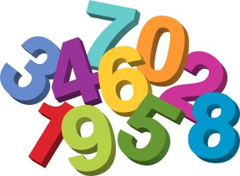
Stage 4: Analyzing Data
Terms when Working with Numbers
  MEAN – average of a group of numbers
  1+2+3+4+5=15 divided by 5 3 is Mean
  MEDIAN – middle value
  2, 1, 8, 3, 6, 10, 2, 6, 7, 3, 3, 2, 2
  1, 2, 2, 2, 2, 3, 3, 3, 6, 6, 7, 8, 10 3 is Median
  MODE – most frequent value
  2, 1, 8, 3, 6, 10, 2, 6, 7, 3, 3, 2, 2 2 is Mode
  RANGE – difference between lowest & highest
  1, 2, 2, 2, 2, 3, 3, 3, 6, 6, 7, 8, 10
  10 minus 1 9 is the Range
  OUTLIER – very high or very low number
  2, 1, 8, 3, 6, 10, 2, 27, 6, 7, 3, 3, 2, 2 27 is outlier
  STATISTICALLY SIGNIFICANT – results true & not because of chance
Notes:
Slide 23. Stage 4 – Analyzing Data
Show the slide.
Presenter Notes:
When you are working with numbers in a decision-making group, there will probably be unfamiliar terms that may come up when you are analyzing data as a group.
It is important to have a way of understanding some of the terms you see on the slide – mean, median, mode, range, outlier, statistically significant.
You may need to dig up some of these definitions from middle or high school math class if you have not used them for awhile.
Not all of us work with numbers and data on a daily basis.
And, if we don’t exactly understand what these terms mean, it can be kind of intimidating. So, some people in your group may need to have these terms explained in an understandable way. It is really important to understand these terms when working with numbers.
Analyzing numbers can be done a few different ways. Depending on how it is done, results can be very different.
Calculating the mean, median, mode, and range for a series of numbers can help in analyzing data, but first you have to know what they all mean.
It is not always a good way to just show the average of a data sample, because sometimes the middle value, or high & low difference is important.
Mean is the average of a group of numbers. So, if you have 5 numbers, you just add them all up and divide by 5 – that gives you the average, or the mean. For example, 1+2+3+4+5 = 15 divided by 5 = 3 So, 3 is the Mean
Median is the middle value of numbers when they are ordered from smallest to largest. It is better at showing the actual middle of a data sample. For example, if you have 13 data numbers – as, one 1, four 2s, three 3s, two 6s, one 7, one 8, one 10, and– you would just arrange them from 1 to 10 – and then arrange them in order 1, 2, 2, 2, 2, 3, 3, 3, 6, 6, 7, 8,10 – then, find the middle number –which ends up being 3 – so the median, or middle is 3.
Mode is the most frequent value or the number that shows up the most in a data sample. In the example we just gave, there 4 2’s, so the more frequent number, or mode, is 2. Depending on what you are looking for in your data, that might be really helpful to know.
Range would be taking the lowest value and the highest value and then find the difference between the two. SO, if we still use the same numbers from our example, the lowest value is 1 and the highest value is 10 – so the range would be 10 minus 1, or a range of 9 points.
The term Outlier is important. An outlier is either a very high or very low number that shows up in your data sample. An outlier can really distort your mean (average), for example.
If most of your data points were from 1 to 10, but then you had one number that was 27… then 27 would be the outlier.
Having an outlier, might throw off your data, but it also might lead to more discussion & questions – to have the group try to figure out why there is an outlier, what may have caused it, what to do with it, etc.
Another term that may come up when analyzing data is the term statistically significant. Statistically significant means the data results are probably true and not because of chance.
----------(Multiple choice/one answer) for these 3 polls------------------
POLL #3 – What is the MEAN of 4, 6, 10, 12? Add #s to get 32 divided by 4 is 8 So, mean is 8.
POLL #4 – What is the MEDIAN of 1, 10, 15, 18, 21? The middle # - so, median is 15.
POLL #5 – What is the RANGE of 10, 11, 15, 18, 21? 21 highest minus 10 lowest– range is 11.

Slide 25
Stage 4: Analyzing Data
EXERCISE
  MEAN of 4, 6,10,12
  MEDIAN of 18, 10, 1, 21, 15
  MODE of 10, 11, 11,15, 15, 18, 18, 18, 21
  RANGE of 15, 21, 10, 18, 11
Notes:
Slide 23a. Stage 4 – Analyzing Data
Show the slide.
Presenter Notes:
Here is a quick activity…
Put your answers to A, B, C, and D in the Q&A box at the bottom of your screen.
A. What is the MEAN of 4, 6, 10, 12?
Mean is the “average”
Add the 4 #s = get 32; then divide by 4
Answer for A. Mean is 8.
B. What is the MEDIAN of 18, 10, 1, 21, 15 ?
Median is the “middle #”
Put the #s in order, lowest to highest
So, the middle # or Median is 15
C. What is the MODE of 10, 11, 11,15, 15, 18, 18, 18, 21
Mode is the “most frequent #.”
Put the #s in order and see which # show up most
Mode is 18
D. What is the RANGE of 15, 21, 10, 18, 11 ?
Range is the highest # minus the lowest #
21 is the highest minus 10 which is the lowest
Range is 11.

Slide 26
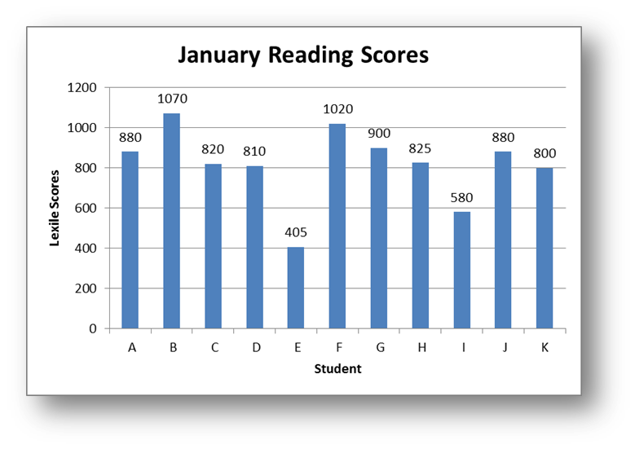
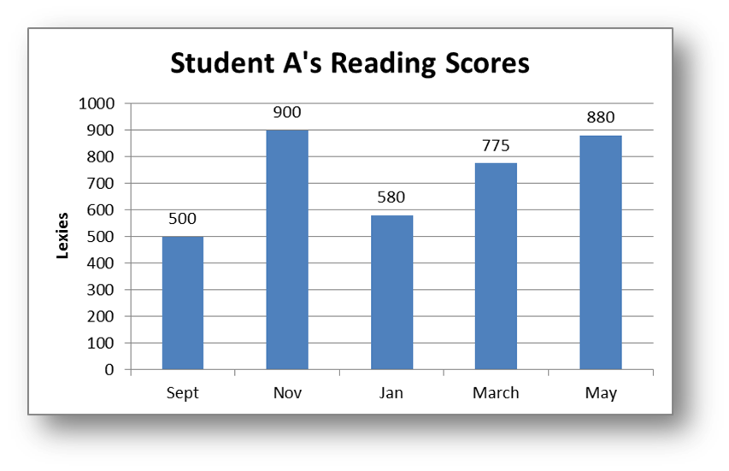

Stage 4: Analyzing Data
Examples of Working with Numbers
Mean = 817.3
Median = 825
Mode = 880
Range = 665
Outlier
Notes:
Slide 24. Stage 4 – Analyzing Data
Show the slide.
Presenter Notes:
Here is an example of working with numbers and using these various data analysis terms.
You can see the example on p. 50 of your Guidebook handout.
In this example, Mrs. Smith checks her students’ reading scores five times a year. The graph on the left shows the January Reading Scores of her students. You can see on the vertical line of the graph -the up & down line at the far left - shows that the Reading scores are based on a scale of zero to 1800. So, looking at the data on the columns labeled A through K:
the Mean is the average, or 817.3 on the chart.
It is figured out by adding up each of the student’s scores, which is 8,990 & dividing by 11, which is the # of student scores (880+ 1070+820+810+405+1020+900+825+580+880+800 = 8,990;
Total of 8,990 is divided by 11 to get 817.3)
The Median is the middle number, or 825 on this chart.
In this case, we place the numbers in order: 405, 580, 800, 810, 820, 825, 880, 880, 900, 1020, 1070.
The middle # is the 6th number out of 11 numbers, or 825.
The Mode, again, is the # which shows up the most in the data set.
In this case, 880 is present twice and is therefore the Mode.
The Range, as we also learned in the last slide, is the difference between the highest number and the lowest number in the data set.
Here, the highest number is 1070 and the lowest is 405. The difference is 665.
The graph on the right shows Reading Scores of Student A. (Chart is on p. 50 of your Guidebook HO) The individual Student A’s reading scores during the whole school year are shown on the chart.
You can see that the student’s second checkpoint, in Nov., is a score that could be considered an outlier. Student A did unusually well, scoring 400 points higher in just two months.
By the time January rolled around, Student A scored lower again and then showed steady progress through the rest of the year.
In analyzing the data, you could think about if the Nov. reading material used to test Student A included an area of high interest or something familiar contributed to the reason that he did so well?
Or you could maybe think that the dip in January might be due to the student not feeling well, being tested with uninteresting reading materials, or was it exactly where the student should be?
Remember each score is just a snapshot of that student’s reading at that time.
One just doesn’t know, however what we do know is that the student made great progress during the year in reading.
One of today’s handouts is Working With and Understanding Data.
This is an activity that you can do yourself or use with your whole group as an opportunity to practice what you have learned so far in this webinar - related to working with the terms mean, median, mode, and range terms.
It will help you & your group think about ways of looking at a source of data in a variety of formats, and to practice analyzing data and answering questions about the data.

Slide 27
Stages of Data Use
Planning & Preparing to Use Data
Collecting Data
Organizing Data
Analyzing Data
Developing Hypotheses & Making Recommendations
Creating an Action Plan
Displaying & Sharing Results
Continuous Monitoring for Progress & Improvement
Notes:
Slide 25. Stages of Data Use – Stage 5.
Show the slide.
[CLICK] for animation.
Presenter Notes:
[CLICK] The next Stage that we are going to talk about is Stage 5 - Developing Hypotheses and Making Recommendations.
When developing a hypothesis, you'll explain what the data represents and why it looks the way it does.
Then you will decide what recommendations to make based on those hypotheses.

Slide 28
Stage 5: Developing Hypotheses & Making Recommendations
Hypotheses (if, then, because)
  Understand why we think it is happening
  Look at other data
  Ask additional questions
  Agree upon the conclusions
  Figure out possible solutions
Recommendations
Notes:
Slide 26. Stage 5 – Developing Hypotheses & Making Recommendations.
Show the slide.
Presenter Notes.
Now that you've analyzed the data, it's time to develop a hypothesis and use what you've learned.
Data may tell you what is happening but not why. The more you analyze and understand the data, the better your conclusions & solutions are likely to be.
In this stage, you will try to figure out the "why."
1st, the group tries to understand WHY something is happening.
The hypothesis is developing a theory or prediction about WHY we think something is happening.
Brainstorm possible ideas based on the data.
Look at other data. See if these other data help support your ideas or not.
If your group still is not sure why something is happening, you can ask additional questions about the data. Your questions may help clear up why something might be happening.
The grp must agree upon the conclusions drawn from analyzing the data before recommendations are made by the group.
Once you know why something is happening, you can figure out possible solutions and recommendations that you could make.
The common format of a hypothesis is usually 3 parts: If [cause], then [effect], because [rationale]
POLL #6 – Is this a hypothesis statement? (Multiple choice/1 answer)
If the school year is extended, then teachers may need to adjust learning activities, because students may difficulty paying attention for more instructional hours.
Yes
No Answer –Yes

Slide 29
Stage 5: Developing Hypotheses & Making Recommendations
EXERCISE
Hypothesis statement?
If the school year is extended, then teachers may need to adjust learning activities, because students may have difficulty paying attention for more instructional hours.
Notes:
Slide 26a. Stage 5 – Hypothesis Exercise
Show the slide.
Presenter Notes:
Here is a quick activity…
Read this statement. Is it a Hypothesis statement?
Write Yes or No in your Q&A box.
Answer is YES
It has the “cause” – “IF the school year is extended…”
It has the “effect” – “THEN teachers may need to adjust learning activities”
It has the “rationale” – “BECAUSE students may have difficulty paying attention for more instructional hours.”

Slide 30
Stages of Data Use
Planning & Preparing to Use Data
Collecting Data
Organizing Data
Analyzing Data
Developing Hypotheses & Making Recommendations
Creating an Action Plan
Displaying & Sharing Results
Continuous Monitoring for Progress & Improvement
Notes:
Slide 27 – Stages of Data Use – Stage 6
Show the slide.
[CLICK] for animation.
Presenters Notes:
[CLICK] So, your next step in Using Data is to Create an Action Plan.
In order to make something happen, after looking at a variety of data, your group needs to create an action plan.
Action plans can help you improve and encounter less challenges.
An action plan usually includes goals, steps, assignments, and deadlines.
Some action plans will occur over a short period of time and have quick evaluations.
Other action plans will take longer and may require more time to put in place.

Slide 31

Stage 6: Creating an Action Plan
1. Bring key people together
2. Figure out:
· What
· Who
· When
Where
· Resources
· Communication
3. Review completed action plan
4. Follow through
5. Communicate
6. Keep track of progress
7. Celebrate!
Notes:
Slide 28. Stage 6 – Creating an Action Plan
Show the slide.
[CLICK] for animation.
Presenter Notes:
Let’s look at the Steps for creating an action plan.
[CLICK] First, bring key people together to design the action plan.
[CLICK] Next, create an action plan made up of action steps that address all possible changes. Goals must be clearly stated. You will need to figure out:
What action or change will occur
Who will carry it out
When it will take place, and for how long
Where will it happen
What resources (i.e., money, staff) are needed to carry out the change
And, logistics about Communication (who should know what and how are they going to find out)
3. [CLICK] Then, review your completed action plan carefully to check if it is complete.
4. [CLICK] Follow through on the work by using a timeline.
5. [CLICK] Let everyone in the group know what's going on.
6. [CLICK] Keep track of what is happening.
7. [CLICK] Celebrate when action plan goals are met!
---------------------------------------------------------------------------------------------
POLL #7 – Which of these are part of an Action Plan? (Multiple choice/multiple answers)
When
Where
Assignments
Hypotheses Answer – 1,2,3 Not 4,5
Triangulation

Slide 32
Stage 6: Creating an Action Plan
EXERCISE
Which are part of an action plan?
When
Where
Assignments
Hypotheses
Triangulation
Notes:
Slide 28a. Stage – Creating an Action Plan
Exercise
Show the slide.
Presenter Notes:
Here is a quick quiz…
Which of these steps are part of an action plan?
Write your answer in the Q&A box at the bottom of your screen.
Answer is 1,2,3 – not 4 & 5

Slide 33
Stages of Data Use
Planning & Preparing to Use Data
Collecting Data
Organizing Data
Analyzing Data
Developing Hypotheses & Making Recommendations
Creating an Action Plan
Displaying & Sharing Results
Continuous Monitoring for Progress & Improvement
Notes:
Slide 29. Stages of Data Use – Stage 7
Show slide.
[CLICK] for animation.
Presenter Notes:
[CLICK] The next stage, stage 7, is Displaying and Sharing the Results.
When people of different perspectives look at the same data, they may make new conclusions and see ways to make changes.
This is how sharing data with your group internally, or much more widely outside of your group, can be useful.

Slide 34

Stage 7: Displaying & Sharing Results
Displaying Results
Make Sure the Report is:
  Appealing
  Accessible
  Accurate
  Audience-specific
Be Fair and Objective
Notes:
Slide 30. Stage 7 – Displaying & Sharing Results
Show slide
Presenter Notes:
The group needs to present information found in the data in a way that is easy for an audience to understand.
You have to make sure that whatever report that comes from your group related to the data is:
Appealing: Keep it simple, clear, and visually attractive (use colorful graphics).
It should be Accessible:
Use a reading level accessible to your audience.
Avoid jargon or acronyms that the audience doesn't understand.
Use bulleted lists and the language(s) spoken by the audience members.
The report has to be Accurate:
Data must be free of errors.
The report must be about what the data actually say, not what you wish the data said.
You could include data source references – where the data came from.
Audience-specific:
Focus on the issues that the audience cares about.
Think about the level of detail needed by the audience and what the audience already knows.
Be Fair and Objective
Use data to drive decision making. It may be tempting to make a decision and then search only for those data that support it.
Such selective choosing of data is unethical and not useful.

Slide 35
Stage 7: Displaying & Sharing Results
Sharing Results
Know the Purpose of your Report
  Does it need to provide information?
  Is it to raise awareness?
  Will it be used to make decisions?
Know your Audience
  What do they already know about the topic?
  Do they need the big picture or lots of details?
Notes:
Slide 31. Stage 7 – Displaying & Sharing Results
Show slide.
Presenter Notes:
When you planning how to share the results of your data, a lot depends on the audience - who will see the data - when figuring out what, how, and even when to share data.
Different audiences need different views of the data.
As you are preparing a report of the results, think about the following questions:
What is the purpose of your report?
Does it need to provide information?
Or, is the purpose to raise awareness?
Will the report be used to make decisions?
What information is new and surprising?
What does the audience already know about the topic?
What level of information do they need: do they need just the big picture or lots of details?
Be sure to share the results with your group.
Then, your group should decide where this data can all be shared.
For example, data related to schools could be shared:
with families at parent group meetings
In school board meetings and publicly through the board minutes
On the district website
In the district’s monthly newsletter
In the community newspaper
Or even in social media, as the school’s Facebook page.

Slide 36
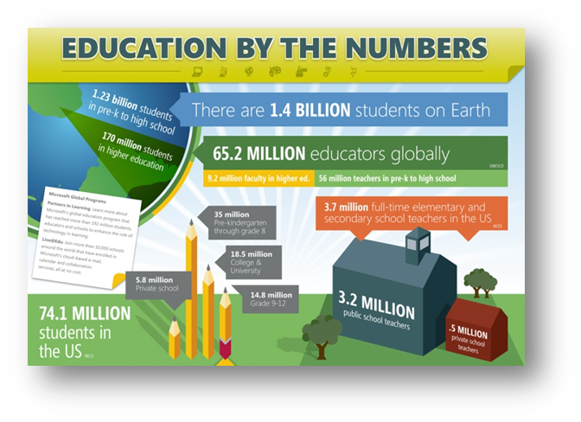
Stage 7: Displaying & Sharing Results
Make the Data Come Alive
Social Math
  Relating data numbers to what is familiar and concrete to your audience.
Data Stories
  Compelling narrative
  Audience-Specific
  Be objective
  Don’t censor
  Explain the data
Notes:
Slide 32. Stage 7 – Displaying & Sharing Results
Show slide.
Presenter Notes:
It is important to make the data come alive so that it is not totally boring or doesn’t really generate much interest.
Social math is a term that describes painting a picture with data. Sometimes numbers are just numbers when the context is missing or unfamiliar.
Social math is all about relating data and numbers to what is familiar and concrete to your audience.
It brings numbers down to earth by blending them with compelling stories and by providing comparisons with familiar things. It works by analogy.
For example, if every person in the U.S. were to change their page margins from 1.25 to .75 inches, we would save a forest around the size of Rhode Island each year. We all know paper comes from trees, so the visual of saving a forest, but not just a small forest, but a forest the size of a whole state makes a big impression and can be pretty compelling.
Social math can backfire if the story and the visual comparisons are not linked to the message you want to convey. Numbers can be presented in a memorable way but may sometimes cause the opposite reaction in your audience. So you have to be careful with what comparisons you use.
Data stories are being used more and more to explain and visualize information that is collected and analyzed. Behind every data example is a story just waiting to be told.
Here are strategies on telling a good story that apply to data visualizations.
Find the compelling narrative.
Think about your audience & what they know about the topic.
Be objective and offer balance.
Don’t censor the data in the visualization.
Edit and try to really explain the data.
On the left side of your screen, you can see a colorful infographic. Think of all the infographics you are seeing on Social media (Pinterest, Buzzfeed, etc.) These infographics are visually appealing, but yet include a lot of data information that people can relate to. Infographics are easy and interesting to look at.

Slide 37
Stages of Data Use
Planning & Preparing to Use Data
Collecting Data
Organizing Data
Analyzing Data
Developing Hypotheses & Making Recommendations
Creating an Action Plan
Displaying & Sharing Results
Continuous Monitoring for Progress & Improvement
Notes:
Slide 33. Stages of Data Use – Stage 8.
Show slide.
[CLICK] for animation.
Presenter Notes:
[CLICK] The 8th stage is Continuous Monitoring for Progress & Improvement.
Dealing with data doesn’t end with creating an action plan. That is only the beginning!
Good data practice involves continuously collecting and evaluating data to make sure progress is made.

Slide 38
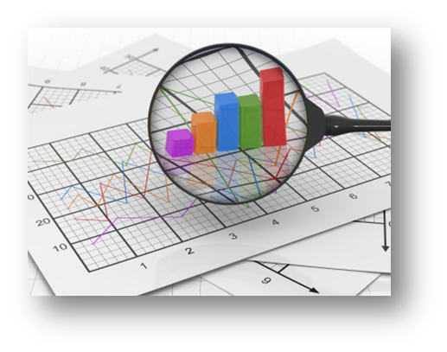
Stage 8: Continuous Monitoring for Progress & Improvement
Check Your Work
  Regularly revisit the plan
  Identify challenges
  Make changes as needed
Evaluate the Action Plan
  Collect the same TYPE of data
  from the same data SOURCE
Notes:
Slide 34. Stage 8-Continuous Monitoring for Progress & Improvement
Show slide.
Presenter Notes:
Groups should regularly check their work, that is regularly revisit their action plan which was developed as a result of data that they received.
Group members should regularly check in with one another, identifying challenges that may have come up along the way, making any changes that might be needed, and celebrating successes as things in their plan are accomplished.
When checking to see if their action plan is working, the group should collect the same type of data from the same data sources that they originally used to start the data cycle.
When data are used from different sources, differences in how the data were collected could lead to different results.
For example, if a group received and used survey data from community members to make their action plan, they should again survey community members to discover if their plan is working.
They should not survey students or school staff to see if their decisions are making a difference.
The group can more easily compare results if the same group is surveyed twice
Example – Seclusion/Restraint report – in WI, from all WI school districts annually
Sent to the same list of Special Ed Directors, collect information on the # of seclusions & restraints that was presented to each of their school districts each September.

Slide 39
Stage 8: Continuous Monitoring for Progress & Improvement
Process Begins Again
Ask yourself:
  To what extent has the initial question been answered?
  What new concerns or questions have come up?
  Which factors are clearly understood and which ones need more data?
  Has the situation improved?
Notes:
Slide 35. Stage 8 – Continuous Monitoring for Progress & Improvement
Show slide.
Presenter Notes:
Sometimes looking at how well the action plan is working leads to new questions or the needs for new data.
Effective, continuous progress monitoring often addresses questions such as:
To what extent has the initial question been answered?
What new concerns or questions have come up?
Which factors are clearly understood and which ones need more data?
Has the situation improved?
Monitoring for progress and improvement gives group members a chance to see the results of their hard work.
When groups see good things happening in education or other venues based on their decisions, their drive to keep working at it is renewed.
If things are not working as planned, the group can revisit their questions and data to adjust their plan.

Slide 40



Review
Notes:
Slide. 36. Review
Show the slide
[CLICK] for animation.
Presenter Notes:
Using data in a decision-making group is a process with multiple steps or stages.
Just to review, these eight stages help make sure a decision-making group is effectively using data to inform its decisions.
[CLICK] So, step one is Planning and Preparing to Use Data
Pinpoint the information you need.
[CLICK] Stage 2: Collecting Data
Gather new and/or already collected data.
[CLICK] Stage 3: Organizing Data
Help in ways to make the data understandable.
[CLICK] Stage 4: Analyzing Data
Find out what the data means.
[CLICK] Stage 5: Developing Hypotheses and Making Recommendations
Look at the data to try to figure out the WHY and possible next steps.
[CLICK] Stage 6: Creating an Action Plan
Make a plan to get something done related to what the data is telling you.
[CLICK] Stage 7: Displaying and Sharing Results
Show others the data shows and tying that to future plans.
[CLICK] Stage 8: Continuous Monitoring for Progress and Improvement
Check the work to make sure things are getting better.

Slide 41
Section 6 Resources
Data-driven Decision Making (video 3:28) https://www.youtube.com/watch?v=9Lew4yWlv5Q
National Center for Education Statistics Kids’ Zone https://nces.ed.gov/nceskids/
Profile of Your State/County https://data.census.gov/cedsci/profile?g=0100000US
Data about Children in Your State http://datacenter.kidscount.org/
State Education Data Profiles https://www.nationsreportcard.gov/profiles/stateprofile?chort=1&sub=MAT&sj=&sfj=NP&st=MN&year=2019R3
U.S. Dept. of Education Open Data Platform https://data.ed.gov
Data.gov (U.S. Open Data) https://www.data.gov/
WISEdash (WI Info. System for Education Data Dashboard) http://wisedash.dpi.wi.gov/
Intro to WISEdash (video 3:27) https://www.youtube.com/watch?v=lMzTy3hJvzw
WI School Performance Report https://dpi.wi.gov/spr
WI Post High School Survey Data (Indicator 14) https://www.indicator14wi.org/reports.statewide.php
Census Bureau Quick Facts Data https://www.census.gov/quickfacts/fact/table/US/PST045217
WISEdash (WI Info. System for Education Data Dashboard) http://wisedash.dpi.wi.gov/
Intro to WISEdash (video 3:27) https://www.youtube.com/watch?v=lMzTy3hJvzw
WI School Performance Report https://dpi.wi.gov/spr
WI Post High School Survey Data (Indicator 14) https://www.indicator14wi.org/reports.statewide.php
Census Bureau Quick Facts Data https://www.census.gov/quickfacts/fact/table/US/PST045217
Notes:
Slide 37. Resources
Show the slide.
Presenter Notes.
NOTE TO PRESENTER – these resources (& links on slide notes) were checked 10/21/24 to make sure they were all “live.” Always check links before giving this training to make sure they are still OK – or replace with a current link for the resource.
---------------------------------
Here are some great examples for finding data & seeing how it is gathered and displayed.
WISEdash, the resource at the top of the right column, is the WI Information System for Education Data Dashboard. It is a great example of where schools and families can go for lots of useful information related to WI Schools. Other states have similar data resources for school data.

Slide 42
Section 6 Resources
Data Driven: Making Student and School Data Accessible and Meaningful To Families, U.S. Dept. of Ed.(video 1:20:00) https://www.youtube.com/watch?v=BF-UPuEMyS8
A Nonprofit Dashboard and Signal Light for Boards https://blueavocado.org/board-of-directors/a-nonprofit-dashboard-and-signal-light-for-boards/
Data Visualization: User-Centered Design https://blueavocado.org/leadership-and-management/data-visualization-user-centered-design/
What is Data? (video 2:45) https://www.youtube.com/watch?v=EhcWQmg9EeE
Communicating About Data https://dataqualitycampaign.org/our-work/communicating-about-data
Sample Confidentiality Policy https://tinyurl.com/y7wr3p3t
Constructing a Hypothesis https://www.youtube.com/watch?v=iMVuPJc1waY
Continuous Improvement - A Tool Kit https://ies.ed.gov/ncee/edlabs/regions/northeast/pdf/REL_2021014.pdf
National Special Education Parent Advisory Councils Guide https://www.parentcenterhub.org/wp-content/uploads/repo_items/National_SEPAC_Guide_120218.pdf
Notes:
Slide 38. Resources
Show the slide.
(NOTE TO PRESENTER – these resources were checked and updated 10/21/2024 to make sure they were all “live.”
Be sure to always check links before giving this training to make sure they are still OK to use – and replace with the most current link for the same or similar resource)
Presenter Notes.
Here are more resources related to data.
I love the 2nd resource on the list, A Nonprofit Dashboard and Signal Light for Boards https://blueavocado.org/board-of-directors/a-nonprofit-dashboard-and-signal-light-for-boards/

Slide 43

Where to Go From Here?
  Sections 1 – 6. Contact Lori Karcher for recordings and handouts: lkarcher@wifacets.org
  -------------------------------------------------------------------------
  11/3/25: Section 7. The Role of Families on Groups
  Section 8. Skills for Serving on Groups
  Register: http://wifacets.org/events
Disclaimer. This publication was produced by WI FACETS with funding from the WI Dept. of Public Instruction & U.S. Dept.of Education, Office of Special Education Programs. The views expressed herein do not necessarily represent the positions or policies of these 3 agencies. No official endorsement by these agencies of any product, commodity, service, or enterprise mentioned in this resource is intended or should be inferred.
Notes:
Presenter Notes:
Slide 39. Where to go from here?
Show slide.
Presenter Notes:
So, where do you go from here?
We urge you to register for the final webinar in this SOG series -11/14/2024), we will be doing Sections 7 & 8. This webinar will cover the Role of Families and Skills for Serving on Groups.
Just go to the WI FACETS’ website (link is on the slide) to register.
If you can’t participate “live”, be sure to register anyway. WI FACETS always emails the recording to everyone who registered after the presentation. You are welcome to share it with others.

Slide 44
Thank you!
Please complete the evaluation!
Link:
Notes:
Slide #40: Evaluation
Procedural Directions:
Show slide.
Note: Be sure to change the QR code & the survey link to the new one.
Presenter Notes:
Your feedback is very important to us so please complete the evaluation that will be emailed to you today after the webinar.
Or, if you can do the evaluation right now, just use the QR code on the screen, or the link in the Chat Box; or, it will be emailed to you later today.
Words to remember: “Leaders are not born ~ they rise out of a person’s passion for how they want the world to be”.
Thanks so much for joining us today. Hope to see you for the next one on Nov. 14th
Thank you so much for attending this webinar.
Have a great rest of the day!
----------------------------------------------------------
We are going to finish up with 3 quick polls.
Poll(#8): Do you think you will join a decision-making group in next 6 months? □ Yes □ No
Poll (#9): Do you think you might share SOG information with your group or others in next 6 months? □ Yes □ No
Poll (#10): Do you think this workshop was of high quality? □ 4 Excellent □ 3 Very Good □ 2 Good □ 1 OK

