Slide 1
Serving on Groups That Make Decisions: A Guide for Families
Presented by:
Name
Organization/Agency
www.servingongroups.org
Notes:
Slide #25: Welcome and Introduction
Procedural Directions:
Have a copy of the Guidebook and the Training manual with you.
Make sure everyone has the materials needed for the presentation.
Ask if everyone can hear you and see the slides.
Introduce yourself and give a brief background of your experience (relevant to the group you are speaking to).
Address “housekeeping” such as restrooms, breaks, “parking lot”, group transitions, etc.
Presenter Notes:
Hello and welcome to this Serving on Groups that Make Decisions: A Guide for Families training.
My name is __insert name___ and I am the ___insert position__at _insert location__.
*Give a brief background of your experience (relevant to the group you are speaking to).
Activities

Slide 2
Section 2: Types of Groups
Questions
What are the different functions of groups and member roles?
What is a…
Governing group?
Advisory group?
Leadership group?
Planning group?
Evaluation group?
Practice group?
Notes:
Slide #26: Section 2 Introduction
Procedural Directions:
Share information from the presenter notes.
If participants have a copy of the Guidebook, guide them to the appropriate section.
Presenter Notes:
There are many different types of groups that have different functions and who have members that perform a variety of roles. Some of these groups may be new to you.
In this section, we will explain each group in detail and describe common functions and roles of each.
Activities

Slide 3
What Makes Decision-Making Groups Unique?
Decision-making authority
Issues
Meeting structure
Data used
Input and feedback
Processes
Membership
History
Time since formation
Diversity of perspectives
Notes:
Slide #27: What Makes Groups Unique?
Procedural Directions:
*Slide contains animation. Click for each section to appear.
Share information from presenter notes.
Presenter Notes:
Decision making groups can take on a lot of different forms
from a formal group, like a State Advisory committee providing input and feedback related to statewide issues;
to an informal group, an event committee for a local church.
Decision-making groups do important work, no matter their structure, issue, or size, and insuring that people are prepared to fulfill their role is important.
“Ad hoc” groups form for a specific purpose and are usually temporary
“Standing committees” are permanent and usually study issues and report or advise groups based on findings
Some groups meet for years and their membership changes over time. Others meet for an agreed-upon amount of time or until their work together is complete.
Each decision-making group is unique. Here are some variables that differentiate groups from one another.
Their decision-making authority
The issues they are working on
The meeting structure they choose
The data they use
The input and feedback they collect
The processes they use
Their membership
Their history
The length of time since formation
The diversity of perspectives represented
Activities

Slide 4
Member Roles
https://youtu.be/LmWiBnGkWww
Notes:
Slide #28: Member Roles
Procedural Directions:
Watch video clip. Make your computer is connected to speakers or an audio system.
Present information.
Ask suggested activity questions.
Presenter Notes:
Member roles vary from group to group depending upon the type and function of the group.
Insuring that people are prepared to fulfill their role is important.
Find out what types of roles there are for members of the group. Is there a leader? A facilitator? A chairperson?
Make sure you understand the role you are considering BEFORE you agree to commit to a role.
Activities
Question: Are there other member roles you might see in a group?

Slide 5
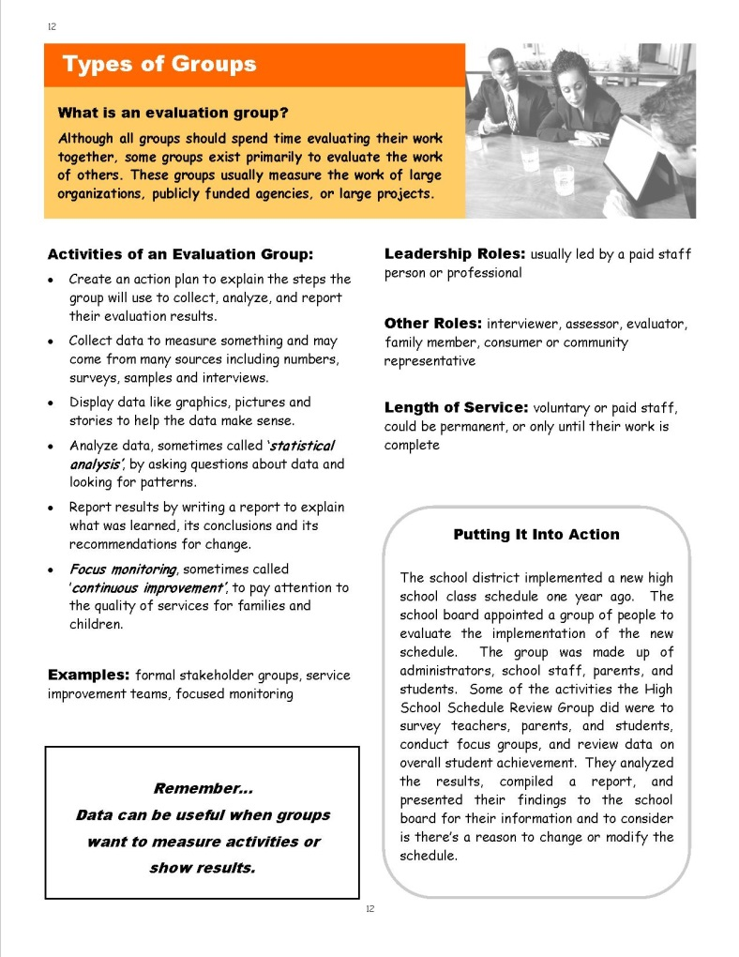
Sample Page
Leadership Roles
Definition
Other Roles
Activities
Length of Service
Examples
Putting It Into Action
Notes:
Slide #29: Section 2 Sample Page
Procedural Directions:
*Slide contains animation. Click for each section to appear.
Comment on each highlighted section.
Presenter Notes:
The Guidebook highlights 6 different types of decision making groups.
Here is a sample page from the Guidebook.
There is a Definition of the group at the top of each page.
Activities and Examples of the group are listed on the left side of the page.
On the right side of the page, it gives leadership roles in the group, other member roles in the group, the typical length of service, and a scenario called “Putting It Into Action”.
Activities

Slide 6
Functions of Groups
Governing
Advisory
Leadership
Planning
Evaluation
Practice
Notes:
Slide #30: Functions of Groups
Procedural Directions:
*Slide contains animation. Click once for sections to appear.
Share information from presenter notes.
Presenter Notes:
There are six unique functions of groups and some groups may serve more than one of these functions.
Governing
Advisory
Leadership
Planning
Evaluation
Practice
Remember groups can look very similar while having very different purposes. Let’s look a little more closely at each group.
Activities

Slide 7
Governing
Activities
Establish by-laws
Govern an organization
Develop policies
Establish goals
Communicate with the public & funding sources
Employ & evaluate executives
Negotiate with employee groups
Allow for community participation
Examples
School Board
City Council
Notes:
Slide #31: Governing
Procedural Directions:
Share information from the presenter notes.
If participants have a copy of the Guidebook, guide them to the appropriate page.
Read the written scenario or share a personal example.
Presenter Notes:
The first type of group mentioned in the Guidebook is the Governing Group.
This is one of the more formal groups where members are usually appointed or elected to a position.
Their purpose is to govern an organization and set policy.
Scenario - Governing Groups: In school districts across the state, the best known example of a governing group is the school board. The school board is an elected body which develops and adopts policies that align to state and federal laws, employs and evaluates administrators, negotiates staff contracts, and provides oversight on the budget. Board members are elected by the taxpayers and are accountable to everyone.
Activities

Slide 8
Advisory
Activities
Represent a broader group of people
Seek out the views of those affected
Advise on needs
Bring awareness to issues
Help develop action plans
Make recommendations
Serve as a resource
Examples
Committee
Panel
Focus group
Notes:
Slide #32: Advisory
Procedural Directions:
Share information from the presenter notes.
If participants have a copy of the Guidebook, guide them to the appropriate page.
Read the written scenario or share a personal example.
Presenter Notes:
The 2nd group is the Advisory Group.
This is a group usually concerned with a single issue and membership is composed of individuals who are representative of a broader group of people affected by an issue and who have expertise in the issue.
Unlike the governing board, the advisory group does not have fiscal or legal responsibility.
Advisory councils typically have their authority limited to giving advice or counsel to the board of the organization, the CEO or executive director, or members of the staff who are responsible for specific programs.
Examples of advisory group actions are:
making recommendations
providing background for board decisions
furnishing pros and cons
listing questions that are appropriate for a situation
The board will review and approve all recommendations from advisory groups, though it is not obligated to follow the advice.
Unlike committees, advisory groups are usually composed of individuals outside of the board (although they might include one or two board members as well).
Scenario - Advisory Groups: The district’s Special Education Advisory Group is comprised of parent and teacher representatives from each school in the district. The Special Education Director and a parent co-facilitate the group’s meetings. The focus of the group’s work is to discuss current initiatives and provide feedback on how those initiatives affect students with disabilities. The group provides input on the needs of families and may help assist with coordination of activities and events for families in the school or district.
Activities

Slide 9
Leadership
Activities
Initiate awareness of an emerging or systemic issue
Collectively work on targeted issues
Conduct listening sessions and public forums
Actively plan and implement strategies
Attract a collective voice
Monitoring entities (watchdog)
Examples
Associations/Organizations/Coalitions
School improvement teams
Initiatives/Grants
Notes:
Slide #33: Leadership
Procedural Directions:
Share information from the presenter notes.
If participants have a copy of the Guidebook, guide them to the appropriate page.
Read the written scenario or share a personal example.
Presenter Notes:
The 3rd group is the Leadership Group.
This group can provide important direction for state lawmakers at a national level and for district administrators at a local level.
Membership can include any combination of family members, youth, community members, policymakers, and professionals.
Specific roles and responsibilities of a leadership team may vary widely from school to school or district to district.
A leadership team is typically a group of administrators, teachers, and other staff members who make important governance decisions in a school and/or who lead and coordinate school-improvement initiatives.
Participants may volunteer for a leadership team, or they may be recruited by administrators.
In recent decades, leadership teams have evolved into a form of shared leadership—the practice of expanding the number of people involved in making important decisions related to the organization, operation, and academics of a school.
Scenario - Leadership Groups: A school’s RtI & PBIS Leadership Team is an example of a leadership group. This group is comprised of various staff members and parents and / or community members. The leadership team looks at systemic issues such as student learning and outcomes. In this case, the school’s RtI and PBIS Leadership team would look at academic data as well as behavior data in the form of in-school suspensions and office referrals. The team looks at data and creates plans to implement strategies for addressing an identified need. They meet on a regular basis to monitor progress and suggest necessary changes if needed.
Activities

Slide 10
Planning
Activities
Research and study a specific issue
Assess needs and develop priorities
Make recommendations
Design information and conduct training
Develop or select a curriculum
A channel for communication and feedback
Plan and carry out an activity
Examples
Committee
Workgroup
Action team
IFSP/IEP team
Notes:
Slide #34: Planning
Procedural Directions:
Share information from the presenter notes.
If participants have a copy of the Guidebook, guide them to the appropriate page.
Read the written scenario or share a personal example.
Presenter Notes:
The 4th group is the Planning Group.
Planning groups deal with a specific issue and their job is to plan and carry out an activity, usually designated by a more formal group.
Tasks include:
Dealing with a specific issue
Plan and carry out an activity
Design information and conduct trainings about relevant topics
Develop or select a curriculum
Assess needs and develop priorities
IFSP = Individual Family Service Plan
IEP – Individualized Education Program
Scenario - Planning Groups: An IEP team is an example of a planning group. John’s daughter’s IEP team is comprised of John and his wife, the English teacher, her special education teacher, the speech therapist, occupational therapist, school guidance counselor, psychologist, and the principal. John’s daughter was invited to the IEP meeting too. The IEP team will review how well John’s daughter did this last year in working toward her IEP goals. The team will take into account her strengths, interests, and challenges, parent concerns, and baseline data on academic achievement and functional performance. Based on the data and information in the present level, annual goals are created, and services and supports will be determined. The team meets on an annual basis to review the plan and revise it for the next year as long as the student still qualifies.
Activities

Slide 11
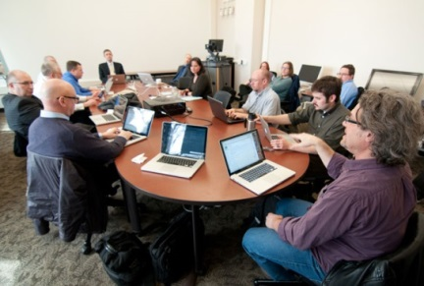
Evaluation
Activities
Create an action plan
Collect, display, and analyze data
Report results
Continuous monitoring for progress and improvement
Examples
Formal stakeholder groups
Service improvement teams
Focused monitoring
Notes:
Slide #35: Evaluation
Procedural Directions:
Share information from the presenter notes.
If participants have a copy of the Guidebook, guide them to the appropriate page.
Read the written scenario or share a personal example.
Presenter Notes:
The 5th group is the Evaluation Group.
This group evaluates the work of others by measuring the work of large organizations, publicly funded agencies, or large projects.
Tasks include:
Evaluate the work of others
Measure the work of large organizations, publicly funded agencies, or large projects
Work with the stages of data use (plan, collect, organize, analyze, make recommendations, create a plan, share results, monitor for progress)
Scenario - Evaluation Group: The school district implemented a new high school class schedule one year ago. The school board appointed a group of people to evaluate the implementation of the new schedule. The group was made up of administrators, school staff, parents, and students. Some of the activities the High School Schedule Review Group did were to survey teachers, parents, and students, conduct focus groups, and review data on overall student achievement. They analyzed the results, compiled a report, and presented their findings to the school board for their information and to consider is there’s a reason to change or modify the schedule.
Activities

Slide 12
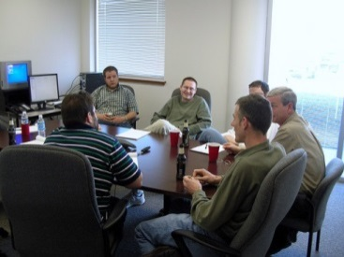
Practice
Activities
Provide a structure to communicate, learn, & act
Continually reach out to others
Create opportunities for networking & sharing
Enhance participation and connections
Discuss emerging or systemic issues
Promote interagency connections
Share information and solutions
Promote the spread of best practices
Examples
A learning circle
A community of practice
Notes:
Slide #36: Practice
Procedural Directions:
Share information from the presenter notes.
If participants have a copy of the Guidebook, guide them to the appropriate page.
Read the written scenario or share a personal example.
Lead suggested activity.
Presenter Notes:
The last group is the Practice Group.
A practice group provides a structure for communication, learning and action.
Members agree to meet regularly to promote interagency and stakeholder connections.
Tasks include:
Provide a structure to communicate, learn, and take action.
Promote interagency/stakeholder connections and ‘shared work’.
Seek and exchange information and solutions
Promote the spread of best practices
Continually reach out
Sense emerging or systemic issues
Scenario - Practice Group: John and Laura live in Wilson County. The Wilson County Community on Transition (C-CoT) meets each month during the school year. The C-CoT membership includes school district staff, adult service agency staff, parents, and students. The team learns together, shares information, and discusses issues and concerns around transitioning students with disabilities from high school to the adult world. They share experiences on best practices, work together on creating solutions, and schedule learning opportunities for students and their families.
Each year the C-CoT plans a student conference for high school students from all the high schools in the county. The focus of the conference is on preparing for college and living on your own. This is just one of the ways the C-CoT expands their learning community by engaging more people in a transition activity.
Activities
Activity: Types of Groups

Slide 13
Section 2 Resources
National Nonprofit Association Tools & Resources https://www.councilofnonprofits.org/resources/governance-and-leadership
Advocacy in Action: Parent Advisory Councils https://sepacguide.parentcenterhub.org/
Guidelines for Establishing Family Advisory Boards https://www.aucd.org/docs/Guidelines%20for%20Family%20Advisory%20Boards.pdf
Guidelines for Leadership Teams https://eleducation.org/resources/guidelines-for-leadership-teams
Unleash the Power of the Team with Shared Leadership https://leaders.com/articles/leadership/shared-leadership
Notes:
Slide #37: Section 2 Resources
Procedural Directions:
Highlight 1 or 2 online resources listed on the slide.
Have one or two web links accessible and ready to show.
Presenter Notes:
National Nonprofit Association Tools & Resources https://www.councilofnonprofits.org/resources/governance-and-leadership
Advocacy in Action: Parent Advisory Councils https://sepacguide.parentcenterhub.org/
Guidelines for Establishing Family Advisory Boards https://www.aucd.org/docs/Guidelines%20for%20Family%20Advisory%20Boards.pdf
Guidelines for Leadership Teams https://eleducation.org/resources/guidelines-for-leadership-teams
Unleash the Power of the Team with Shared Leadership https://leaders.com/articles/leadership/shared-leadership
Activities
Handout: Guidebook Sectional Resource List

Slide 14
Section 2 Resources
Strategic Planning Committee (video 4:11) https://www.youtube.com/watch?v=7F2-4zy_hj0
Board Effect - Strategic Planning Committee https://www.boardeffect.com/blog/what-is-a-strategic-planning-committee/
Planning https://www.minnesotanonprofits.org/resources-tools/principles-practices-for-nonprofit-excellence/planning
10 Keys to Successful Strategic Planning https://www.tccgrp.com/resource/ten-keys-to-successful-strategic-planning-for-nonprofit-and-foundation-leader/
Definition of Evaluation Committee https://www.lawinsider.com/dictionary/evaluation-committee
School Board Program Evaluation Committee (video 8:18) https://www.youtube.com/watch?v=Rdp3bL7fwCE
Evaluation and Planning Resources https://www.minnesotanonprofits.org/resources-tools/resources-by-topic/evaluation-planning
Notes:
Slide #37: Section 2 Resources
Procedural Directions:
Highlight 1 or 2 online resources listed on the slide.
Have one or two web links accessible and ready to show.
Presenter Notes:
Strategic Planning Committee (video 4:11) https://www.youtube.com/watch?v=7F2-4zy_hj0
Board Effect - Strategic Planning Committee https://www.boardeffect.com/blog/what-is-a-strategic-planning-committee/
Planning https://www.minnesotanonprofits.org/resources-tools/principles-practices-for-nonprofit-excellence/planning
10 Keys to Successful Strategic Planning https://www.tccgrp.com/resource/ten-keys-to-successful-strategic-planning-for-nonprofit-and-foundation-leader/
Definition of Evaluation Committee https://www.lawinsider.com/dictionary/evaluation-committee
School Board Program Evaluation Committee (video 8:18) https://www.youtube.com/watch?v=Rdp3bL7fwCE
Evaluation and Planning Resources https://www.minnesotanonprofits.org/resources-tools/resources-by-topic/evaluation-planning
Activities
Handout: Guidebook Sectional Resource List

